Slide 1
Greening Your Business Program
Tips and Resources for
Sustainable Environmental Management
October 12, 2022

Slide 2
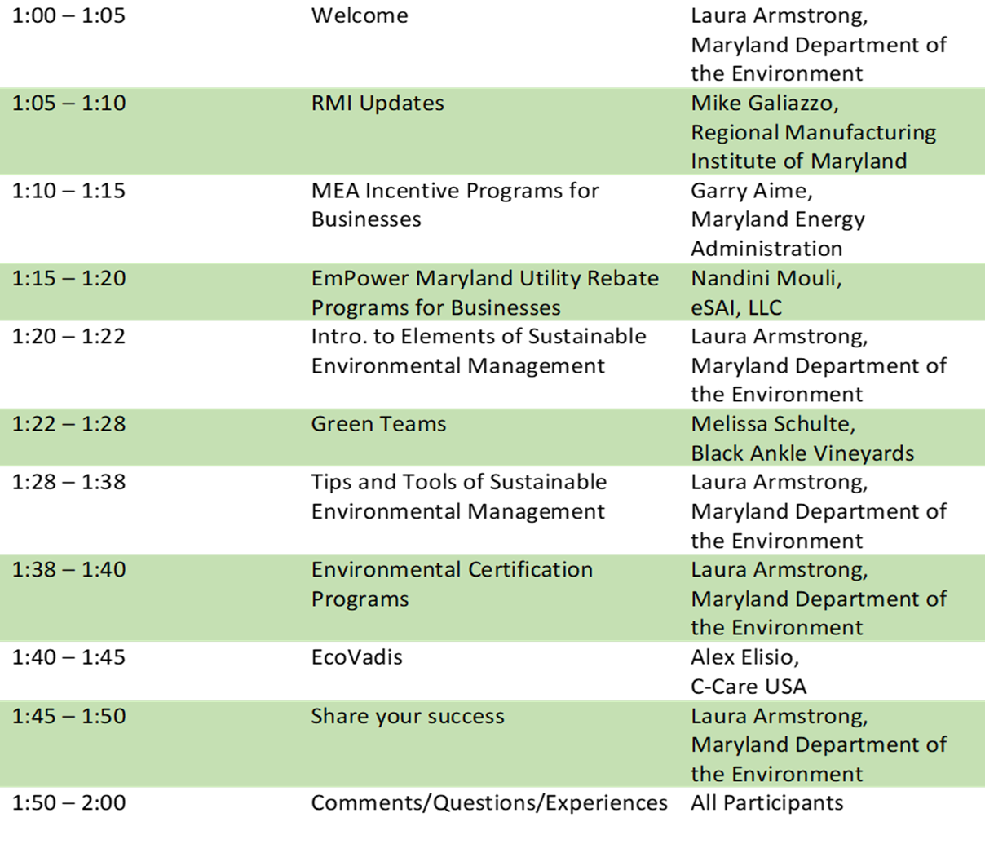
Agenda

Slide 3
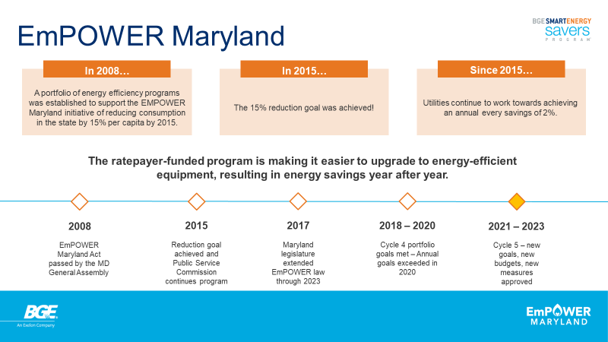

Slide 4
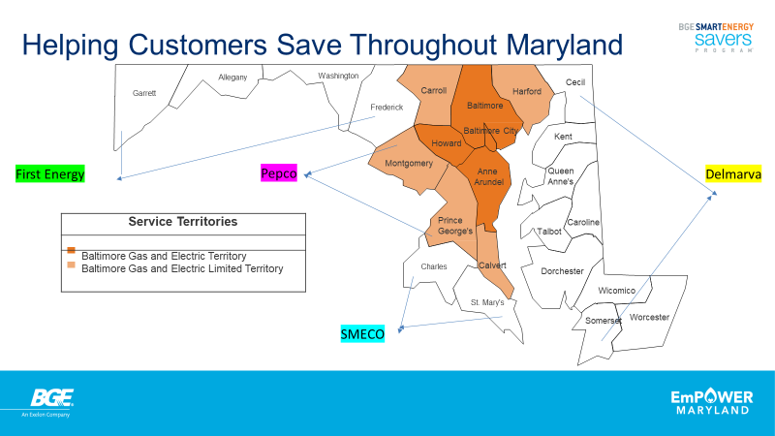

Slide 5
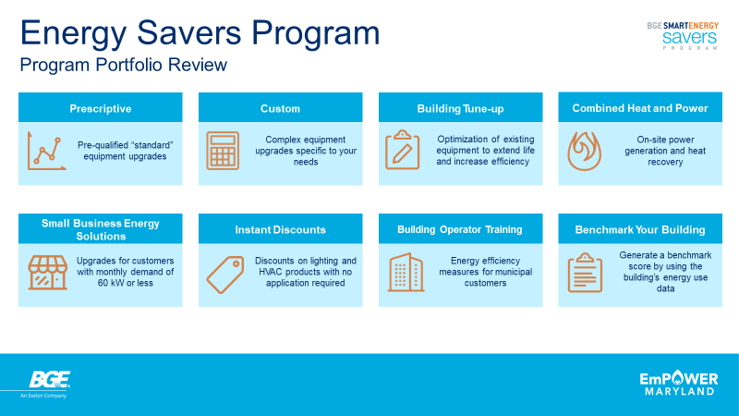

Slide 6
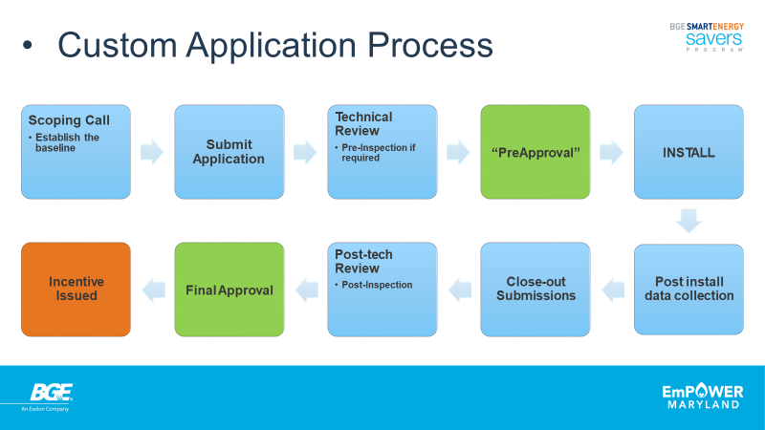

Slide 7
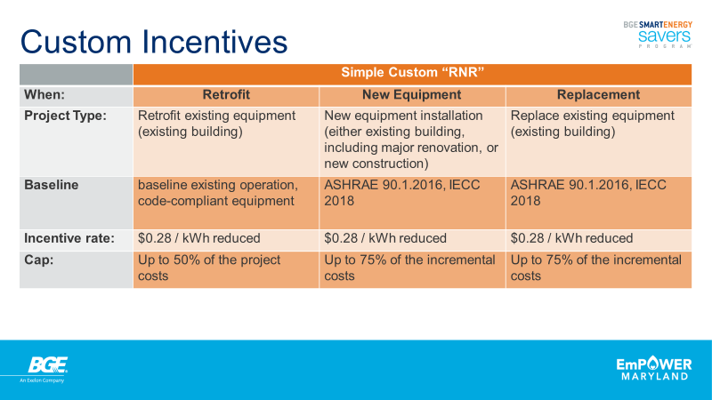

Slide 8
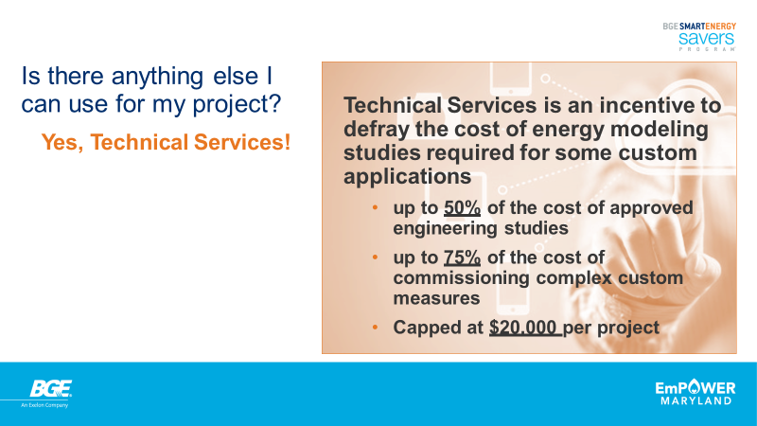

Slide 9
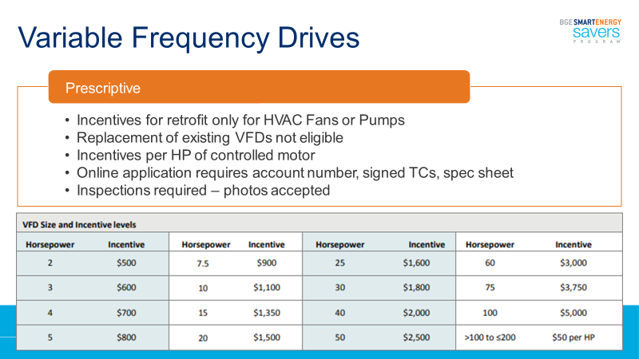

Slide 10
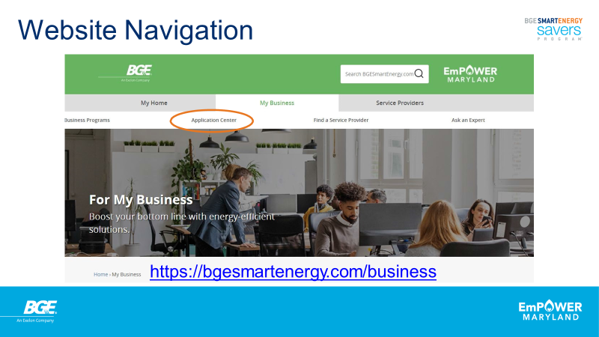

Slide 11
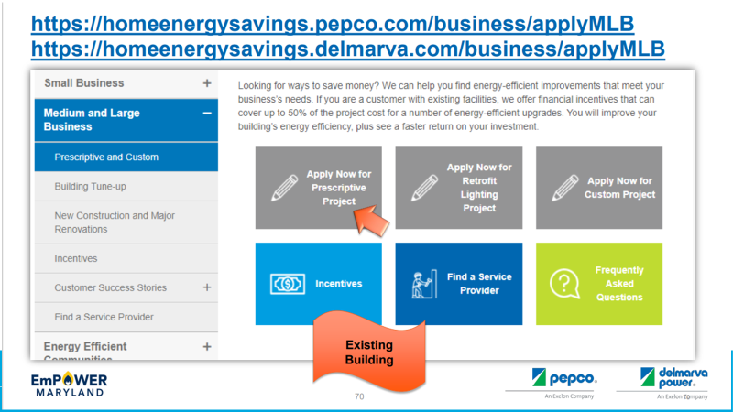

Slide 12


Slide 13
DOE Industrial Assessment Centers
Maryland businesses are served by the
West Virginia University
Industrial Assessment Center
The WVU IAC offers no cost energy, water, waste, cyber security, resiliency planning, and decarbonization assessments to Maryland manufacturers.
Contact:
Bhaskaran Gopalakrishnan, Ph.D (Gopala)
Bhaskaran.Gopalakrishnan@mail.wvu.edu
(304) 293 9434

Slide 14
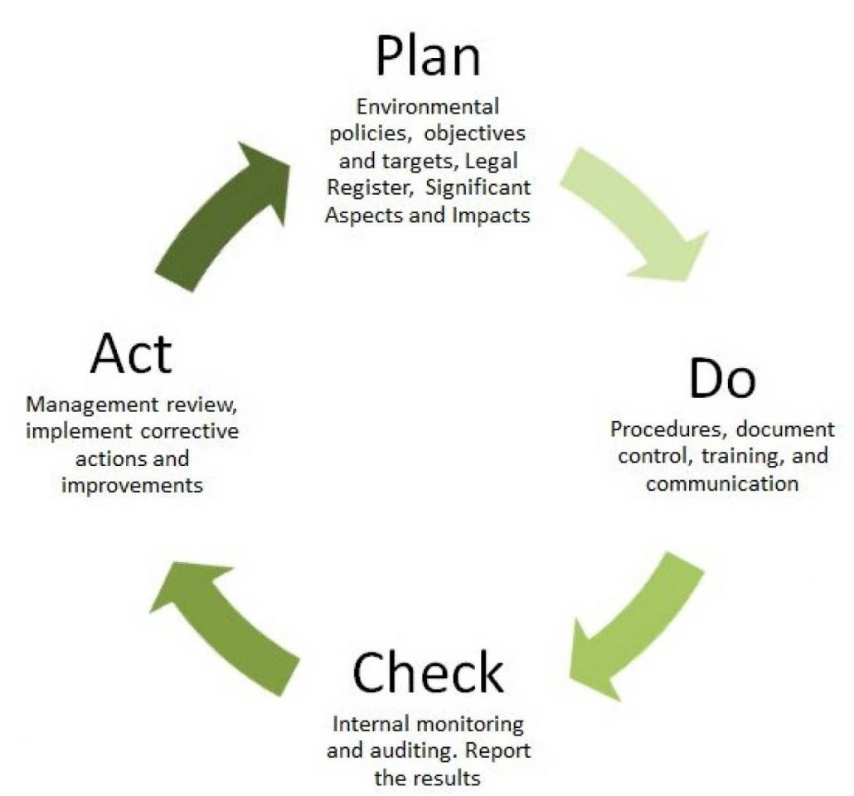
Environmental Management Systems

Slide 15
Five Tips for Green Teams
Be Inclusive
Ensure a diverse membership by including representatives from different departments, functions, levels and years of tenure at your organization.
Balance the Needs of the Front Line with Leadership Priorities
Link your green team to the corporate mission and goals, while maintaining grassroots energy.
Be Accountable
Establish annual goals, targets and objectives. Define projects clearly, assign responsibilities, track progress, and evaluate results.
Meet Regularly and Creatively
Develop a meeting calendar for the year so that members can plan in advance. Meeting content should be engaging. Consider guest speakers.
Publicize and Celebrate Results
Publicize and celebrate accomplishments. Select an employee or department for recognition.

Slide 16
Where to start…
​​Create a Green Team that includes employees from different departments and levels within your organization.​
​Create an environmental policy statement with high-level management support in order to communicate priorities to both your employees and customers.
Ensure compliance with all environmental laws and regulations - an important starting point before embarking on further-reaching environmental goals.
Brainstorm a list of all the environmental aspects of your facility, activities, products, and services. Consider the actual and potential impacts of both your regulated and unregulated activities. Don't forget to take a good look at your utility bills and waste streams.

Slide 17
Where to start (continued)
Prioritize these impacts based on their significance (e.g. severity and frequency of impact to air, water, land, natural resources, humans, flora and fauna).​
Choose one or more of these environmental impacts to address. Define the project, goals, timelines, and responsibilities.
Implement the changes.
Measure and share results.
Repeat! Maintain your momentum by setting new annual goals.

Slide 18
Elements of an ISO 14001:2015 Environmental Policy
Allows top management to formally expresses its commitment to improving environment performance. Should be shared with employees, contractors, and the public and reviewed periodically.
An ISO 14001 Environmentally Policy should :
Be appropriate to the nature, scale and environmental impacts of an organization’s activities, products and services;
Provide a framework for setting environmental objectives;
Include a commitment to the protection of the environment, including prevention of pollution;
Include a commitment to fulfill compliance obligations;
Include a commitment to continual improvement of the environmental management system to enhance environmental performance.

Slide 19
Sample Environmental Policy Statement
____Name of Organization_____ is committed to reducing its impact on the environment. We will strive to improve our environmental performance over time and to initiate additional projects and activities that will further reduce our impacts on the environment.
Our commitment to the environment extends to our customers, our staff, and the community in which we operate. We are committed to:
Comply with all applicable environmental regulations;
Prevent pollution whenever possible;
Train all of our staff on our environmental program and empower them to contribute and participate;
Communicate our environmental commitment and efforts to our customers, staff, and our community; and
Continually improve our environmental performance by setting annual goals to reduce our environmental impacts and measuring our results.
Signed:____________________________________________________ Date:___________________
Printed/Title:_______________________________________________

Slide 20
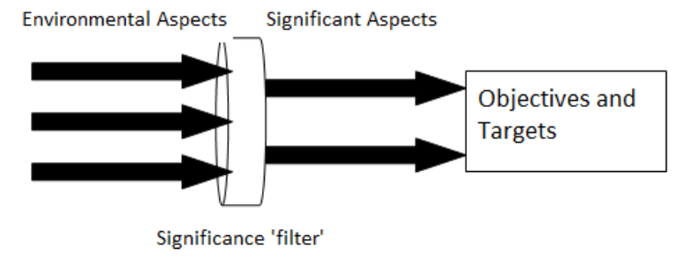
Setting Objectives and Targets

Slide 21
Identifying Aspects and Determining Significance
Activity, Product, Services | Environmental Aspect | Control | Influence | Energy Usage | Water Usage | Materials Usage | Frequency | Severity | Regulated | Total Score
Manufacturing
 | VOC emissions
 | Electricity
 | Natural Gas
 | Water consumption
 | Raw materials
 | Non Hazardous waste
 | Hazardous waste
 | Wastewater
 | Scrap materials
 | Packaging materials
 | Electronics
Sales & Marketing
Shipping/Receiving
Facilities
Administration

Slide 22
Identifying Aspects and Determining Significance
Environmental Aspects | Air | Water | Land | NR | Flora | Fauna | Humans | N/S
Employee Commute | X |  |  | X |  |  | X | N
Electricity Use | X | X |  | X | X | X | X | S
Natural Gas Use | X |  |  | X |  |  |  | N
Natural Resources/Materials |  |  |  |  |  |  |  | --
Chemicals |  | X | X |  | X | X | X | S
Solvents | X |  |  |  |  |  | X | N
Acids |  | X |  |  |  |  | X | N
Paper |  |  |  | X | X |  |  | N
Metals |  |  |  | X |  |  |  | N
Water |  |  |  | X |  |  |  | N
Packaging |  |  |  | X | X |  |  | N
Sudden Events Potential | X | X | X | X | X | X | X | N
Fugitive VOCs | X |  |  |  |  |  | X | N
Stormwater Runoff |  | X |  |  |  |  |  | N
Solid Waste |  |  | X |  |  |  |  | S
Hazardous Waste |  | X | X |  |  | X | X | N
Product Impacts |  |  |  |  |  |  |  | --
Distribution | X |  |  |  |  |  |  | N
Use |  |  |  |  |  |  |  | N
Disposal |  |  | X |  |  |  |  | N

Slide 23
Objectives and Targets
Objectives are clear environmental goals. Targets are the detailed incremental steps necessary to achieve your objectives. Both objectives and targets should be measurable where practicable.
Tips:
Pick a manageable number of objectives and try to include one likely to produce quick positive results and costs savings.
Set interim targets and measurements to assess whether projects are on track or require adjustments.
Include actual staff names on the form so that there is no confusion about responsibility.
Objective: | Example: Reduce volume/weight of solid waste by X% |  |  | Set: Month/year
Targets | Means | Functional Area | Responsibility/ Organizational Level | Target Completion Date
X% reduction in wood waste | Repair/reuse pallets | Shipping & Receiving | J. Smith | Month/year
X% reduction in cardboard waste | Reuse boxes where feasible Obtain compactor for cardboard waste recycling | Shipping & Receiving | C. Allen | Month/year
X% reduction in food waste | Institute a food composting program Provide employee training | Facilities Human Resources | B. Jones A. Baxter | Month/year

Slide 24

Evaluating Certification Programs
https://mde.maryland.gov/MarylandGreen/Pages/certification-central.aspx
Lists Maryland companies with environmental certifications

Slide 25
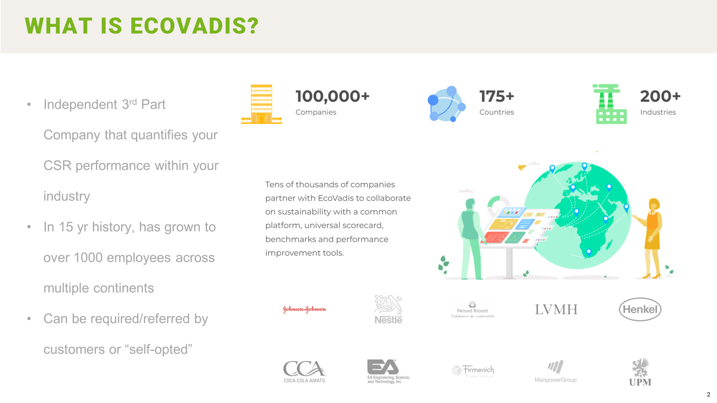

Slide 26
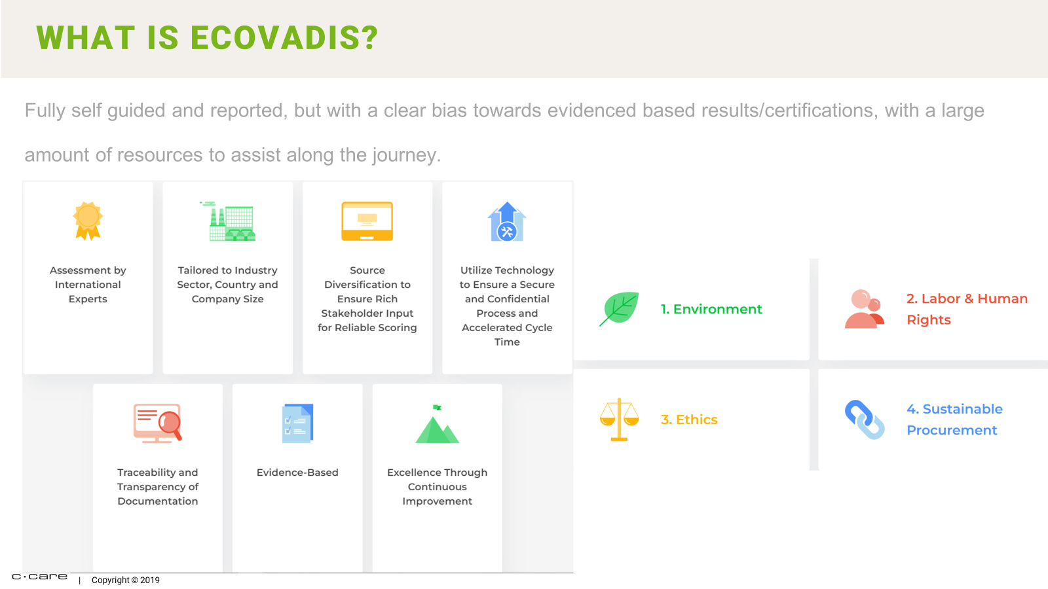

Slide 27
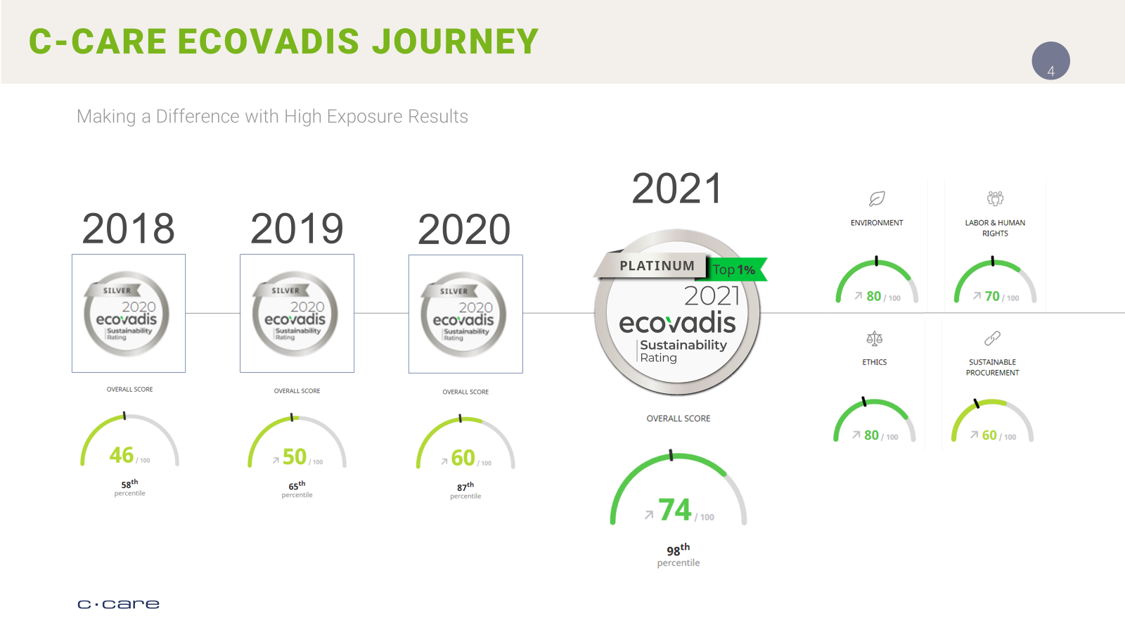

Slide 28


Slide 29
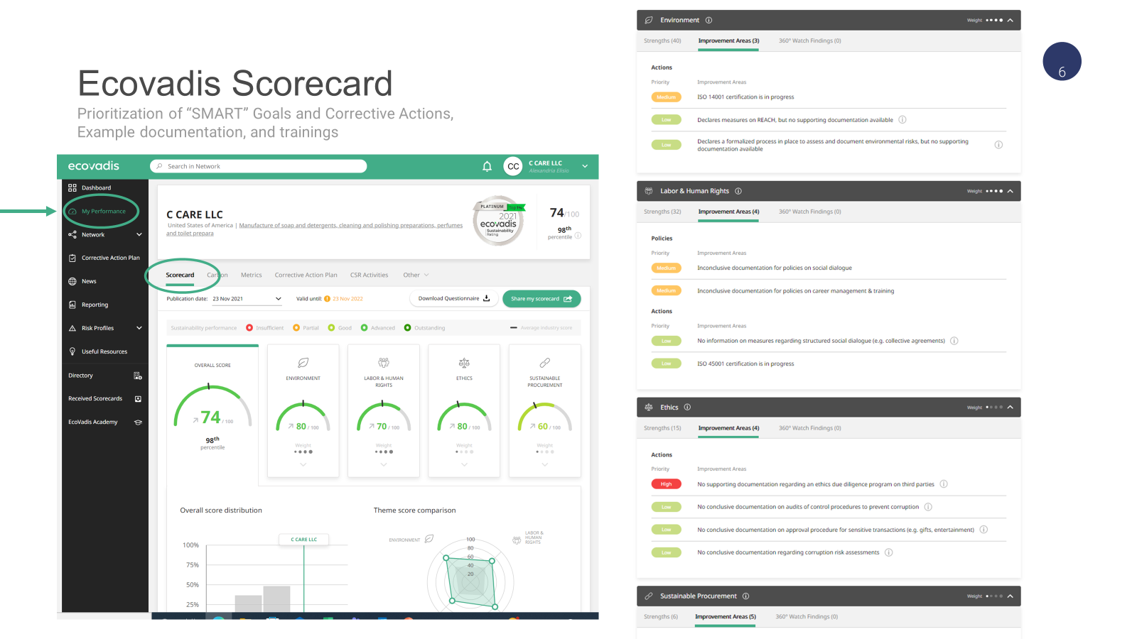

Slide 30
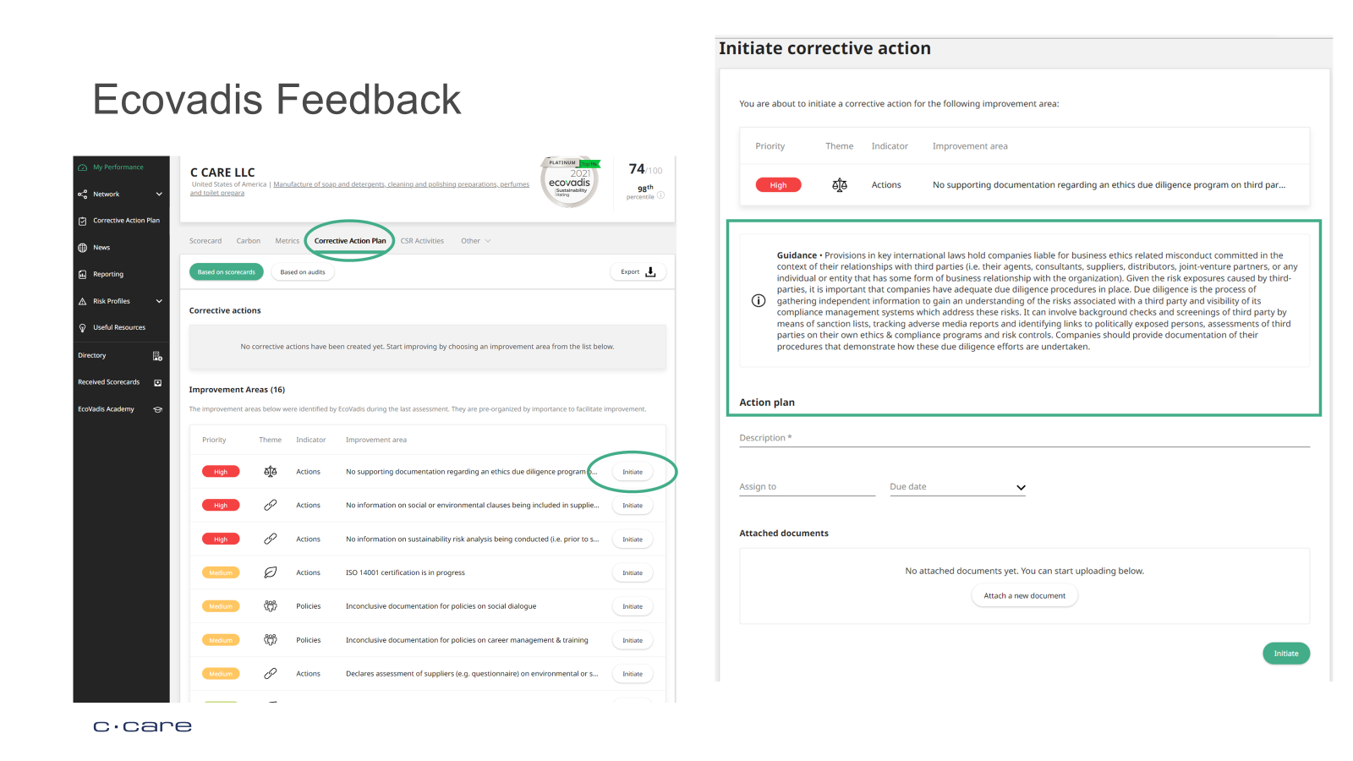

Slide 31
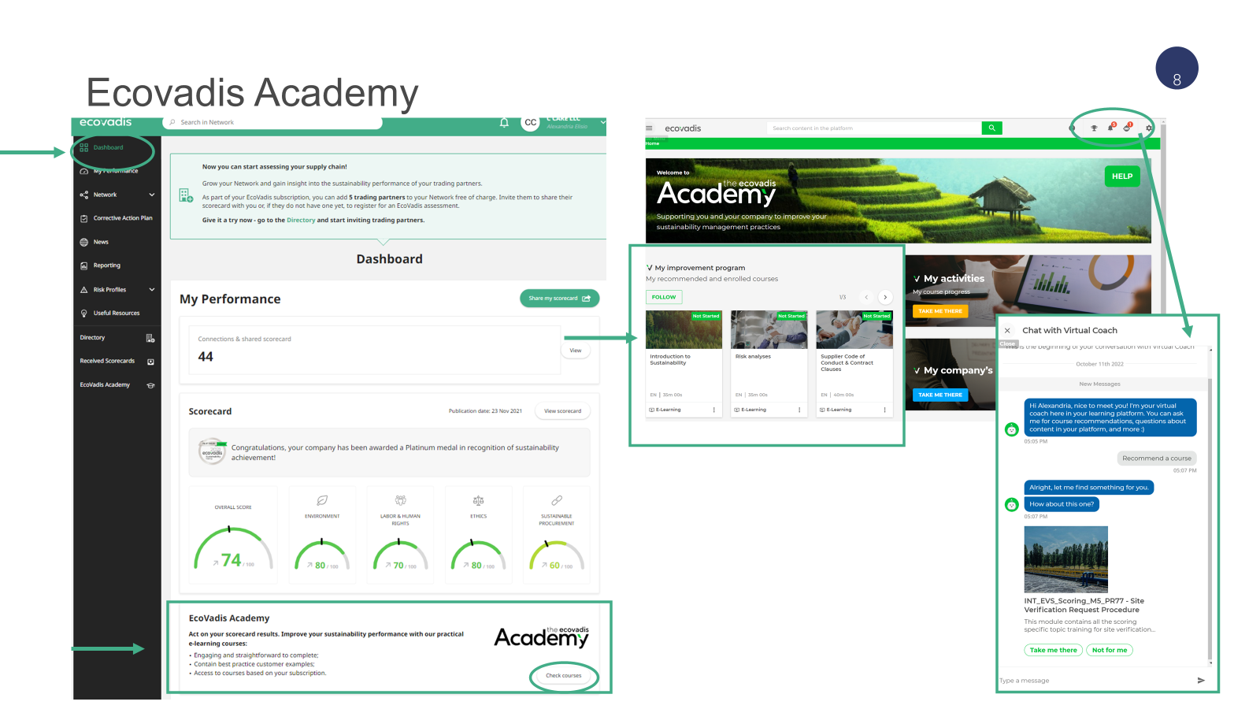

Slide 32


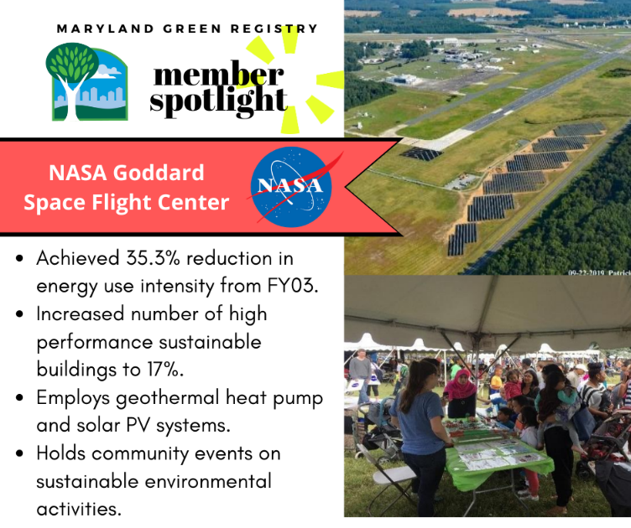

Recognition and Support
600 online member profiles
Enhanced search engine optimization
Member spotlights on social media
Annual Sustainability Leadership Awards
www.green.maryland.gov

