Slide 1

Clean Air for Maryland's Kids
How to start an idle reduction program at your school
Notes:
Removed several slides on observation.

Slide 2
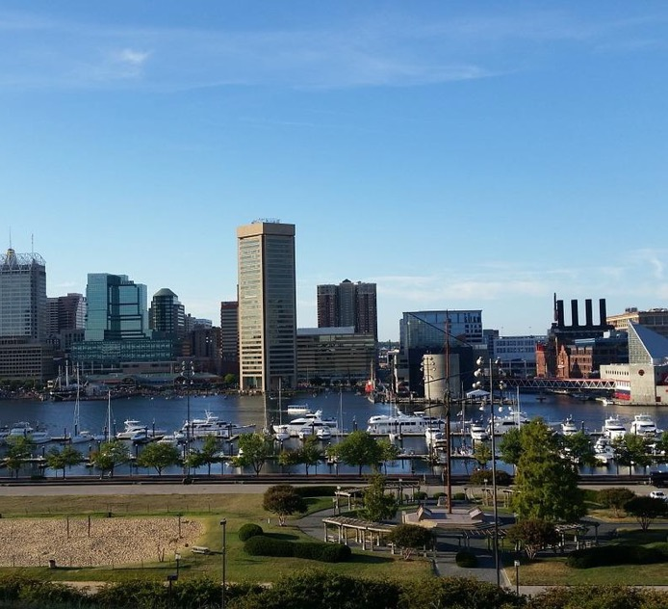
Air Pollution Primer
The air we breathe is polluted by activities we do every day.
These activities add gases and particulates to the air, which can accumulate in high enough concentrations to harm human health and the environment.

Slide 3
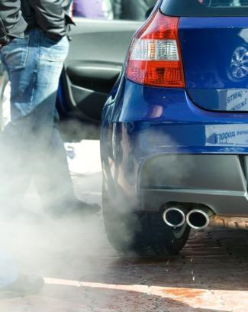
The Problem
Personal vehicle idling creates about half of all idling emissions.
Those emissions impact health, affect the environment, and waste money.
Notes:
Edited to match campaign language

Slide 4
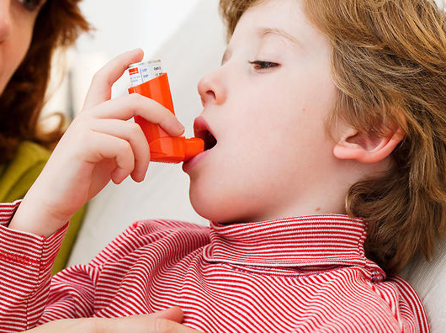
Children and Air Pollution
Because of their developing lungs and higher breathing rates, air pollution is especially dangerous to children
Car exhaust increases the symptoms of asthma—the most common chronic illness in children, and the cause of most school absences.
Notes:
So now that we’ve described why it is so important to reduce Air Toxics, in particular Mobile Source Air Toxics, lets talk about why we are focusing on air pollution at schools.

Slide 5
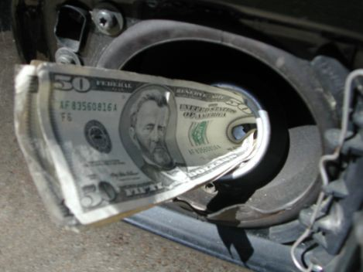
Who Wants To Buy Zero MPG Fuel?
Idling wastes approximately 6 billion gallons of fuel each year in the U.S.
Notes:
Edited to update with current info.

Slide 6
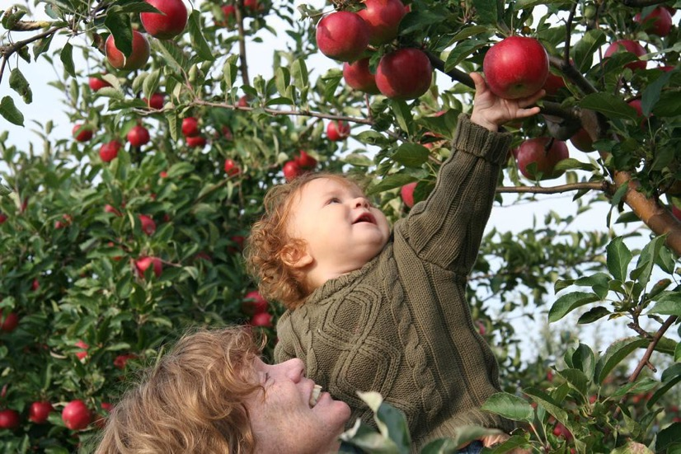
One Solution
Idle reduction is the low-hanging fruit of fuel economy.
It’s one easy habit to help you Go Green.

Slide 7
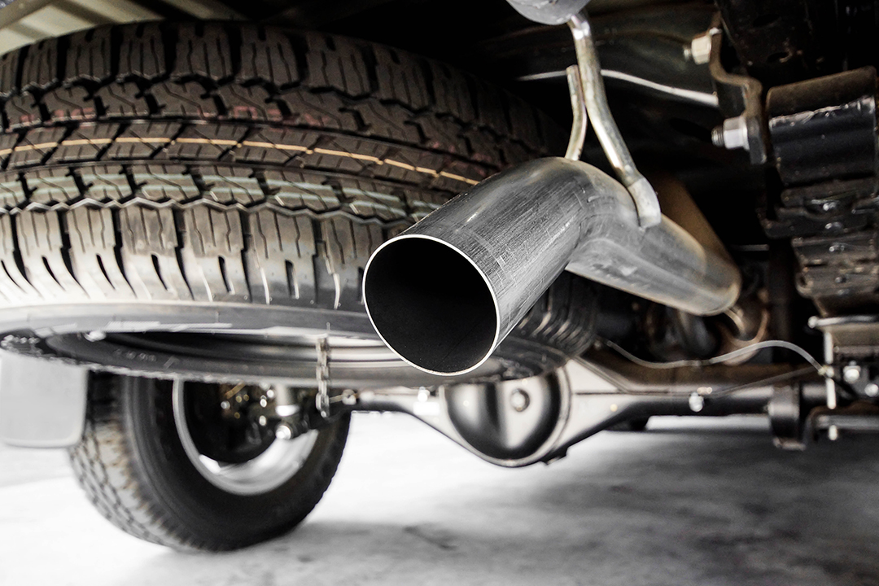
What’s the Cause for Idling?
Old Habits and Myths
“Doesn’t restarting the engine use more gas than idling?”
“Won’t I wear out the starter?”
“Isn’t idling good for the engine?”

Slide 8

“Doesn’t restarting my engine use more gas than idling?”
Idling for more than 10 seconds uses more fuel and results in the production of more CO₂ than stopping and restarting your engine.

Slide 9
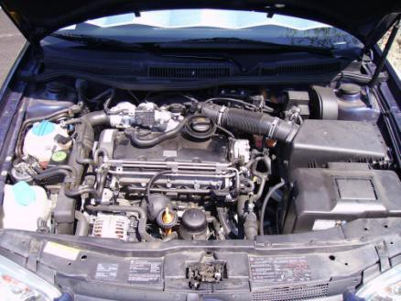
“Won’t I wear out my starter?”
Under normal use, drivers of passenger cars can turn their engines on and off without concern about wearing out the starter motor or the battery prematurely.

Slide 10
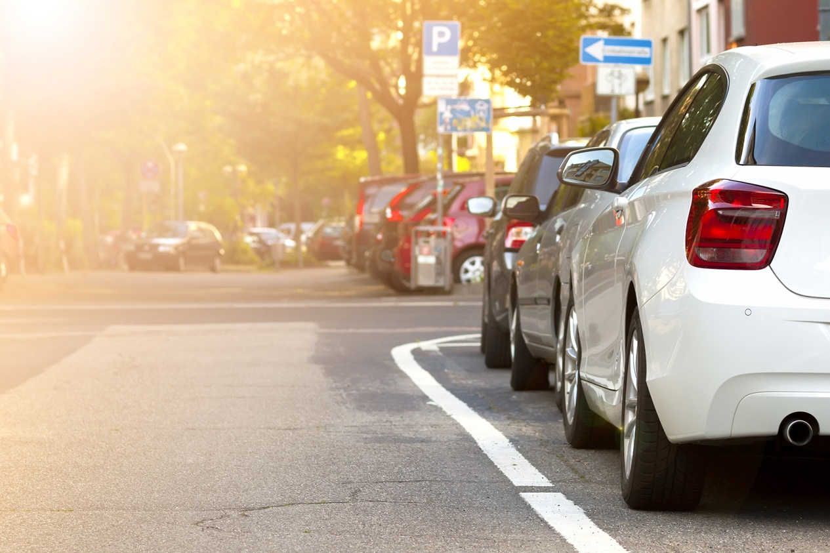
“Isn’t idling good for your engine?”
Idling damages engines and decreases engine life.
Modern cars warm up faster by being driven than by idling.
Notes:
Edited comment on engines to be consistent with current language.

Slide 11

“Isn’t idling good for your engine?”
Idling can produce sulfuric acid, which eats away at the engine and other components.
Idling results in lower temperatures in the cylinders, which can build up unburned fuel in the engine and cause unnecessary engine wear.
Idling leaves residue on spark plugs that decrease performance and increase fuel consumption.
Notes:
Added third bullet

Slide 12

Idle Free MD Schools
Implementing an Idle Reduction
Campaign at your school

Slide 13
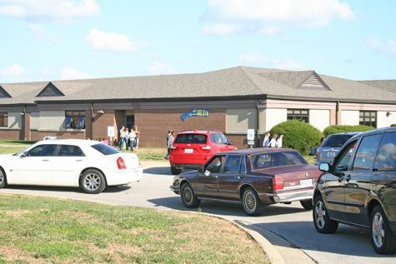
Vehicle Idling at Schools
The Problem:
Monitoring at schools have shown elevated levels of air toxins during the afternoon hours coinciding with school dismissal.
Personal vehicles,
buses and delivery
trucks all contribute to
the pollution.

Slide 14
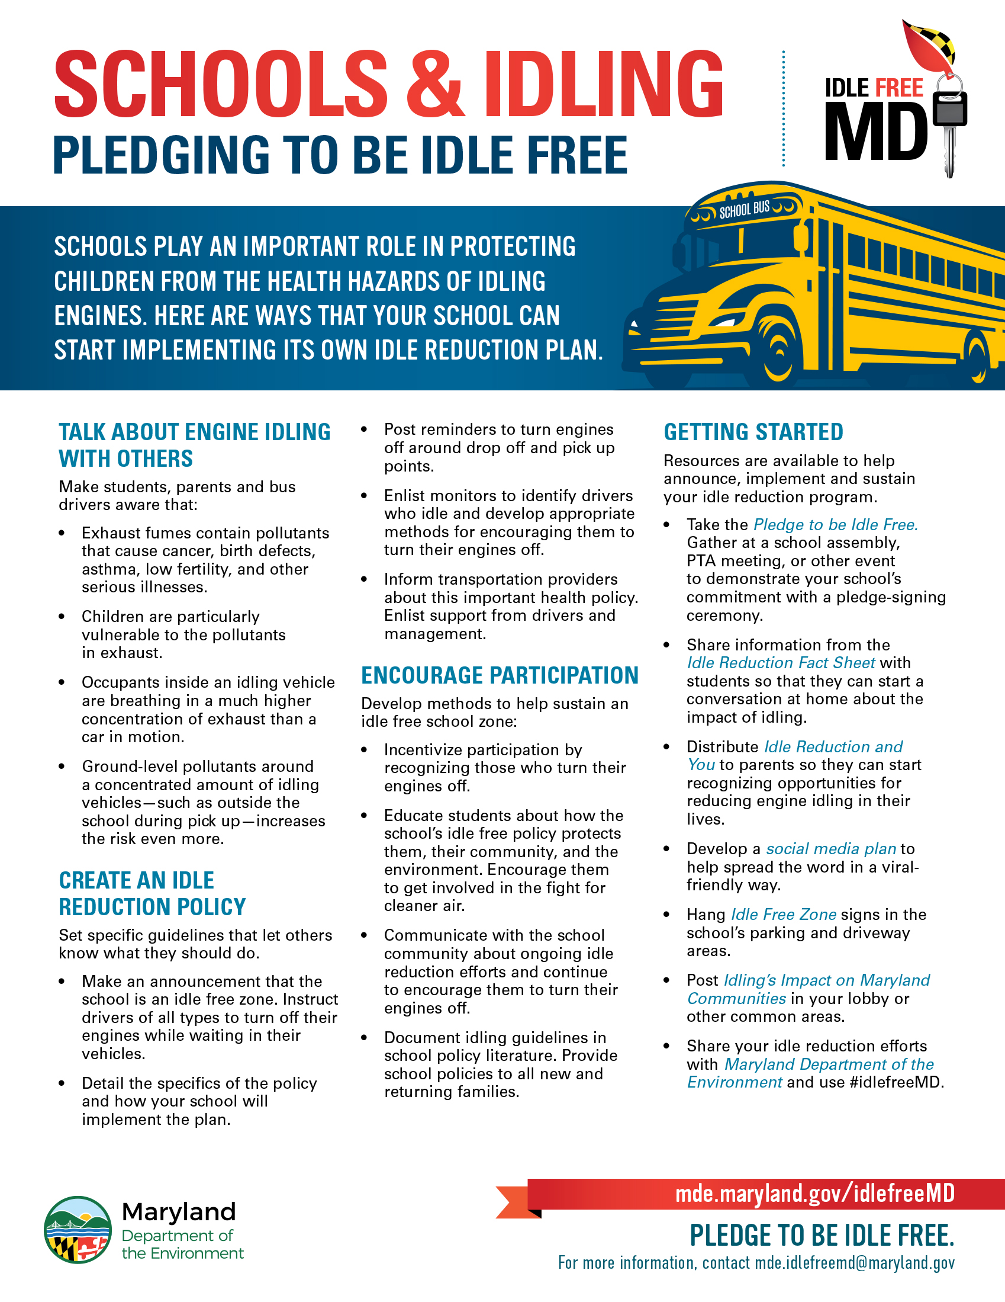
What Schools Can Do
to Reduce Idling
Schools can play an important part in protecting children from the health hazards of idling by:
Starting the conversation.
Creating a policy.
Encouraging participation.
A summary of steps schools can take are available by downloading Schools & Idling: Pledging to Be Idle Free.
Notes:
Added new slide

Slide 15
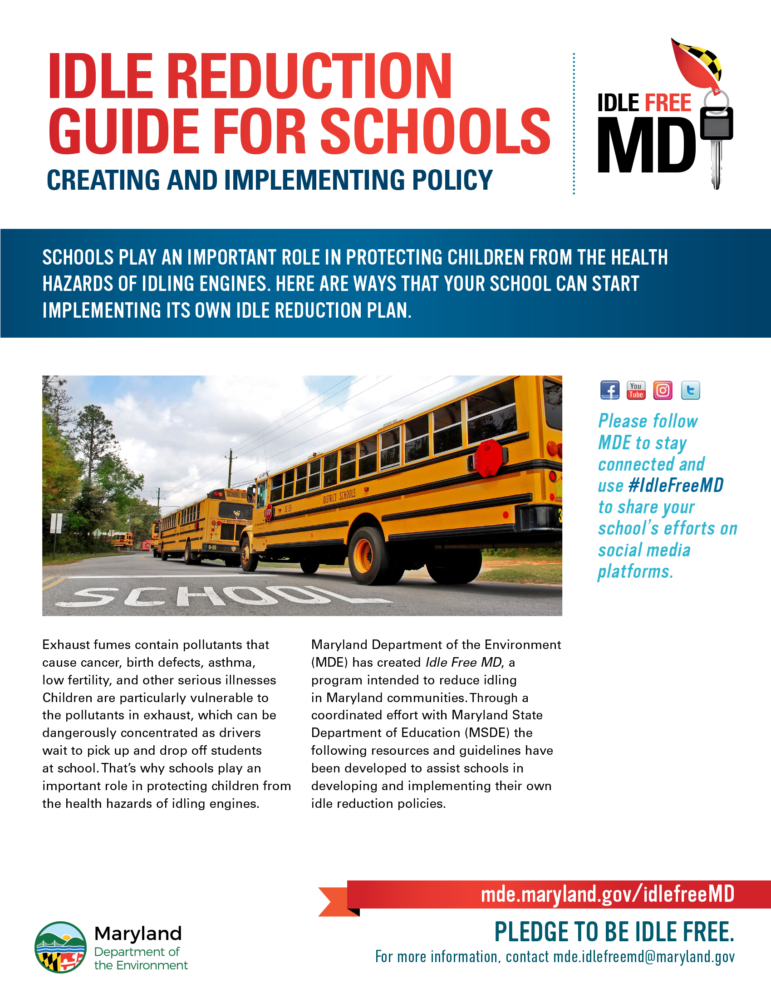
Idle Reduction Toolkit
Idle Free MD is an MDE program that helps Maryland communities address idle reduction.
Resources in the Idle Free MD Toolkit are available to help schools educate the school community about the hazards of idling and create idle reduction policies.
The Idle Reduction Guide for Schools
provides schools with guidance on how
to use the resources in the toolkit to
implement an idle reduction policy.
Notes:
Edited whole slide. Will need the hyperlinks to both products (in red) added once uploaded to the site.

Slide 16

Making it a Student Project
Students can:
Help to implement your
school’s idle reduction
policy
Learn how to run a
public service campaign.
Learn about air
quality issues.
Coordinate and measure participation.
Learn interpersonal skills.
Collect and present real life data.
Notes:
Edited all to be consistent with our Teacher’s Guide

Slide 17

Idle Free MD Schools Toolkit
Idle Reduction Guide for Schools
Clean Air for Maryland Kids presentation
Schools and Idling flier
Idling’s Impact on Maryland Communities poster
Sample Idle-Reduction Policy
Idle Reduction Fact Sheet
Sample letters to parents, bus drivers, and teachers
Signage and decals
Pledges for individuals and administration
Teacher’s Guide to Idle Reduction
Spreading the Word About Idle Reduction Through Facebook
The entire Idle Free MD toolkit is located at mde.maryland.gov/idlefreeMD.
Notes:
Revised to align with our products. Will need the hyperlinks to products in red added once they are uploaded to the site.

Slide 18
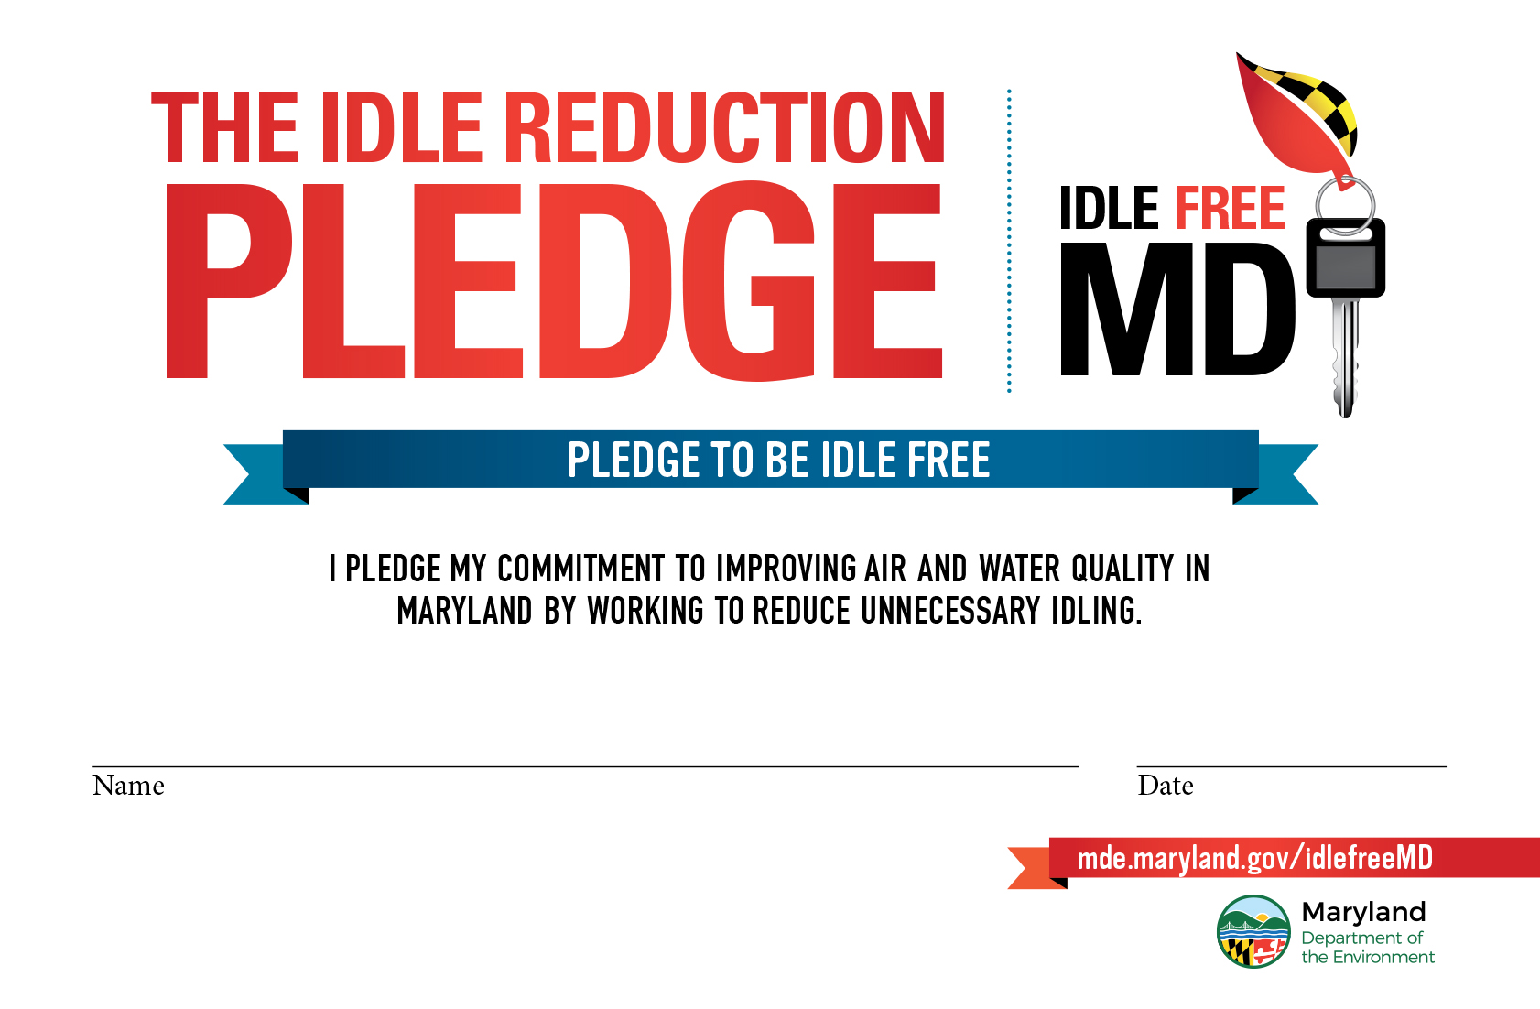
Policies, Letters and Pledges
Set up policies: Include an Idle-Reduction Policy in the student handbook and provide to bus drivers.
Inform all drivers: Regularly tell parents, teachers, staff, delivery truck drivers and bus drivers about the new policy and the campaign.
Pledges: Ask all drivers to sign
a pledge not to idle unnecessarily.
Hold a contest to see which
class returns the most pledges.
Notes:
Will need the hyperlinks to products in red added once they are uploaded to the site.

Slide 19

Idle Free MD School Signs
Install external idling signs:
Where parents will easily see them when picking up students.
Where buses congregate.
Where truck drivers stop to make deliveries.
Notes:
. Will need the hyperlinks to products in red added once they are uploaded to the site.

Slide 20

Idle Free School Decal
Hang idle-free school window decals in a prominent window to announce your pledge to be idle free to visitors. Distribute them to school admin, bus drivers and parents to place in the rear-view windows of their vehicles and show their support.
Notes:
New slide. . Will need the hyperlinks to products in red added once they are uploaded to the site.

Slide 21
Incentives
Provide incentives to encourage participation from drivers and students.
Incorporate your idle reduction rollout into classroom learning. Refer to the Teacher’s Guide to Idle Reduction on ways to get started. In addition to assigning a grades for student’s effort, track the number of pledges collected by class or group through a competition. Reward the winning class with a pizza or ice cream party, if appropriate.
Recognize participants in your idle reduction program through social media. Create key chains, t-shirts, coffee mugs, or other specialty media with the school’s logo and/or the Idle Free MD logo as additional incentives, or collect gift cards from local establishments to give out.
Notes:
Removed Driver Participation Event. Revised to align with suggestions in the guides. . Will need the hyperlinks to products in red added once they are uploaded to the site.

Slide 22

Recommended Schedule
Month 1: Pre-campaign preparations
Month 2: Announce campaign to the school
and PTA
Month 3: Publish
policies, send
home letters,
conduct pledge
drive, publish
articles in school
newsletter.

Slide 23
Green Certification &
Literacy Standards
Fulfills 2.6 of MAEOE “Responsible Transportation” requirements.
Maryland Green Schools' environmental efforts can be used as a platform to apply for U.S. Green Ribbon School recognition.
Schools may also joint certify with Eco-Schools USA as they work towards Maryland Green School status.

Slide 24

Keep MDE in the Loop
Share your idle reduction efforts with MDE via Facebook, Youtube, Instagram, and Twitter. Use #idlefreeMD when posting about on social media.
Let us know about your efforts, and
contact us with any questions at
mde.idlefreemd@maryland.gov
Notes:
Edited to align with our calls to action.

Slide 25

Additional Assistance
For more information visit:
mde.maryland.gov/idlefreeMD
turnyourengineoff.org
epa.gov/schools/idle-free-schools-toolkit-healthy-school-environment
epa.gov/cleandiesel/clean-school-bus
Michael Stricker
Maryland Dept of the Environment
michael.stricker@maryland.gov
410.537.3270
Notes:
Removed old, broken link

