Slide 1

The Greenhouse Gas Emission Reduction Act of 2009
Where We Are and What Has Already Been Accomplished
A Brief Overview of Maryland’s Climate Change Efforts and Current Status
Tad Aburn, Air Director, MDE
Mitigation Working Group Meeting – May 6, 2015
Notes:
Frequently, presenters must deliver material of a technical nature to an audience unfamiliar with the topic or vocabulary. The material may be complex or heavy with detail. To present technical material effectively, use the following guidelines from Dale Carnegie Training®.
Consider the amount of time available and prepare to organize your material. Narrow your topic. Divide your presentation into clear segments. Follow a logical progression. Maintain your focus throughout. Close the presentation with a summary, repetition of the key steps, or a logical conclusion.
Keep your audience in mind at all times. For example, be sure data is clear and information is relevant. Keep the level of detail and vocabulary appropriate for the audience. Use visuals to support key points or steps. Keep alert to the needs of your listeners, and you will have a more receptive audience.

Slide 2

Overview
2006 to 2015 Efforts
Current Status on Reductions
Reduction Shortfalls
Agency Responsibilities
Want More Information?
Working Group Input
2

Slide 3


Earliest Actions
2006 – Maryland Healthy Air Act
  Multi-pollutant power plant reductions
  Set up a process that lead to Maryland becoming a member of the Regional Greenhouse Gas Initiative (RGGI) in 2007
2007 – Maryland Clean Cars Act
  Comprehensive effort to reduce a host of emissions from vehicles
  Toughest standards allowed by law
  Significant GHG reductions
3

Slide 4
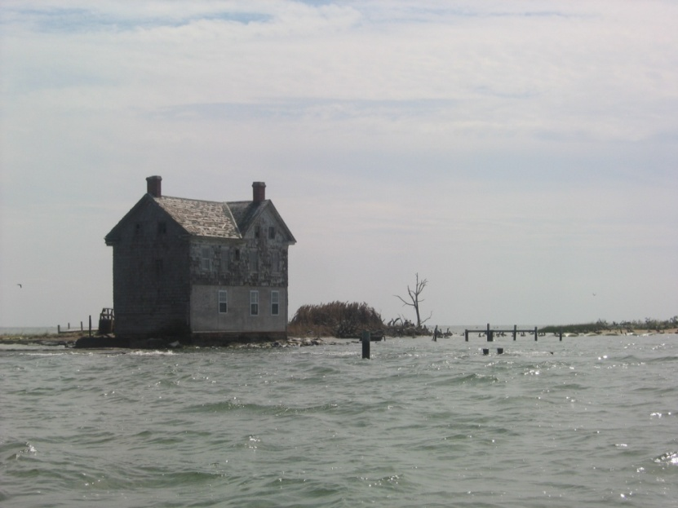
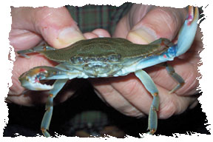
Maryland Commission on Climate Change
Established in 2007 by Governor’s Executive Order 01.01.2007.07
Cabinet Secretaries and six members from the General Assembly
Charged with addressing Maryland’s climate change challenge on all fronts
Three specific areas of concern:
  Mitigation (MDE)
  Adaptation (DNR)
  Science and effects in Maryland (UMD)
Mandated that a State Climate Action Plan be developed by 2008
4

Slide 5
The Climate Action Plan
Finalized in August, 2008
Includes reports from the three Working Groups
Addresses Five Sectors:
  Energy Supply
  Residential, Commercial, and Industrial
  Transportation and Land Use
  Agricultural, Forestry, and Waste
  Cross Cutting
Other sections on:
  The cost of inaction
  Maryland’s effort into a future Federal program
5

Slide 6
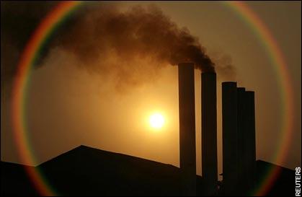
The Greenhouse Gas Emissions Reduction Act
… of 2009
The Greenhouse Gas Emission Reduction Act (GGRA) signed into law in April 2009
Requires the State to develop and implement a Plan to reduce GHG emissions 25% from a 2006 baseline by 2020
Must have a positive impact on Maryland’s economy and jobs
Climate Action Plan used as a “roadmap”
6

Slide 7
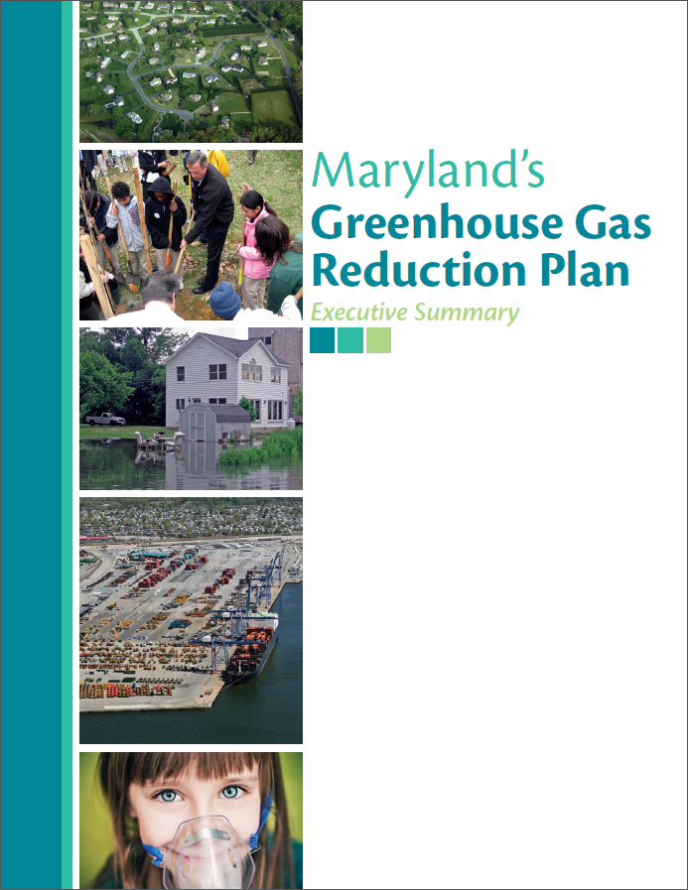
GGRA – The 2012 Plan
2008 Climate Action Plan used as a “roadmap”
The Plan is comprehensive, multi-sector, and involves multiple State agencies
Implementation of the 150-plus programs and initiatives described in the Plan will achieve 25% reduction required by GGRA
  Must reduce Maryland’s GHG emissions by 55 million metric tons of carbon dioxide-equivalent (MMtCO₂e) annually
    This reduction includes offsetting growth that is expected to occur between 2006 and 2020
7

Slide 8

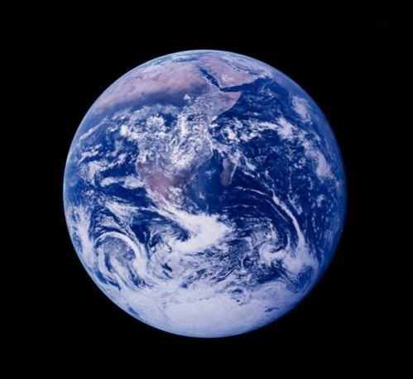
GGRA – The 2012 Plan - Continued
Jobs, the Economy, Science Updates and More
Current analyses project that the Plan would result in estimated economic benefits of $1.6 billion and support over 37,000 jobs.
Provides an update on climate change science
  Based on materials provided by the University of Maryland Center for Environmental Science
    Included an update on the cost of inaction in Maryland based on materials provided by the University of Maryland Center for Integrative Environmental Research.
8

Slide 9

More Recent Activities
2014: Executive Order 01.01.2014.14
  Signed on November 19, 2014
  Expanded the mission and membership of the Maryland Commission on Climate Change
  Added new tasks
2015: Senate Bill 258
  Maryland Climate Commission Act of 2015
  Expected to be signed into law soon
  Established the Maryland Commission on Climate Change as statute
  Adds new members and new tasks
Additional information provided during May 6 meeting
9

Slide 10
Critical Upcoming GGRA Activities
Totally separate from the E.O. and SB 258, the GGRA of 2009 also requires major efforts in late 2015
  By October 1, 2015 MDE must submit a report to the Governor that includes:
    A summary of the State’s progress toward achieving the 2020 emissions reduction goal.
    An update on emerging technologies to reduce GHG emissions.
    A review of best available science regarding the level and pace of GHG emissions reductions and sequestration needed.
    Recommendations on the need for adjustments to the requirement to reduce statewide GHG emissions by 25% by 2020.
    A summary of additional revised regulations/control programs/incentives that are necessary to achieve the 25% reduction goal.
    The state of any federal program to reduce GHG emissions.
    An analysis of the overall economic costs and benefits to the state’s economy, environment, and public health of a continuation or modification of the requirements to achieve a 25% reduction.
In 2016, the General Assembly must take an action to keep, change or enhance the goals of the GGRA or the laws requirements sunset
10

Slide 11
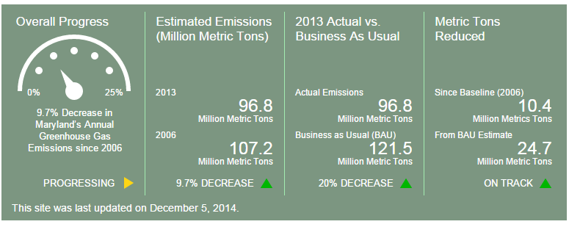
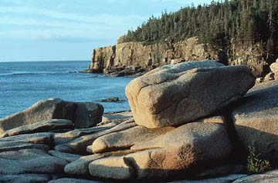
Current Status of Reductions
11

Slide 12
How We Might Succeed
Policy Scenario (all in MMtCO₂e) | Initial GGRA Plan Reductions | With Plan Enhancements
Total GHG Emissions Reductions | 38.87 | 55.47
Revised Minimum GGRA Goal | 55.26 | 55.26
Goal Shortfall without Market Trends (in red) | 16.39 | 0.21
Forecasted Fuel Switching Reductions | 4.44 | 4.25
Transportation Plans and Programs VMT Update | 2.78 | 2.78
Goal Shortfall including Market Trends (in red) | 9.17 | 7.24
Revised NET Goal Status that will include upper and lower bounds on projected progress (2015) | To be determined later this summer after state agency data is received and processed | To be determined later this summer after state agency data is received and processed
We expect the final status to show that we are very close … or just below … reduction goals with enhancements completed to date and other data updates
* The “more optimistic” estimate includes updated benefits from fuel switching, changes in VMT trends, reducing the level of caution in discounted reductions from double counting, increased benefits in the carbon intensity of imported energy and other assumptions
12

Slide 13
Assignments - MDE
Agency | Program
MDE | C. The Regional Greenhouse Gas Initiative
MDE | D.1.A. Boiler Maximum Achievable Control Technology (MACT)
MDE | D.1.B. GHG New Source Performance Standard
MDE | D.1.C. GHG Prevention of Significant Deterioration Permitting Program
MDE | E.1.A. Maryland Clean Cars Program
MDE | E.1.C. National Fuel Efficiency and Emission Standards for Medium and Heavy-Duty Trucks
MDE/MDOT | H.1. Evaluating the GHG Emissions Impact of Major New Transportation Projects
MDE | L. Zero Waste: Maryland's Long-Term Strategy to an 85% Reduction in Generation of Solid Waste by 2030
MDE | M.2. Leadership-By-Example: Maryland Colleges and Universities
MDE | M.3. Leadership-By-Example: Federal Government
MDE | M.4. Leadership-By-Example: Local Government
MDE | N.1. Voluntary Stationary Source Reductions
MDE/MDOT | O.1. The Transportation and Climate Initiative
MDE | O.2. Clean Fuels Standard
MDE | Q. Outreach and Public Education
13

Slide 14
Assignments - MEA
Agency | Program
MEA | A. EmPOWER Maryland
MEA | A.1. EmPOWER Maryland: Energy Efficiency in the Residential Sector
MEA | A.2. EmPOWER Maryland: Energy Efficiency in the Commercial and Industrial Sectors
MEA | A.3. EmPOWER Maryland: Energy Efficiency in Appliances and Other Products
MEA | A.4. EmPOWER Maryland: Utility Responsibility
MEA | A.5. Combined Heat and Power
MEA | B. The Maryland Renewable Energy Portfolio Standard (RPS)
MEA | B.1. The Maryland Renewable Energy Portfolio Standard (RPS) Program
MEA | B.2. Fuel Switching
MEA | B.3. Incentives and Grant Programs to Support Renewable Energy
MEA | B.4. Offshore Wind Initiatives to Support Renewable Energy
MEA/MDOT | E.3. Electric and Low Emitting Vehicle Initiatives
14

Slide 15
Assignments - MDOT
Agency | Program
MDOT | E.1.B. Corporate Average Fuel Economy Standards (CAFÉ): Model Years 2008 – 2011
MDOT | E.1.D. Federal Renewable Fuels Standards
MDOT | E.2. On Road, Airport, Port and Freight/Freight Rail Technology Initiatives
MDOT | E.2.A. On Road Technology
MDOT | E.2.B. Airport Initiatives
MDOT | E.2.C. Port Initiatives
MDOT | E.2.D. Freight and Freight Rail Programs
MDOT | E.3. Electric and Low Emitting Vehicle Initiatives
MDOT | F. Public Transportation
MDOT | F.1. Public Transportation Initiatives
MDOT | F.2. Intercity Transportation Initiatives
MDOT | G. Pricing Initiatives
MDOT | H.2. Bike and Pedestrian Initiatives
MDOT/MDE | O.1. The Transportation Climate Initiatives
15

Slide 16
Assignments – DHCD, DNR and MDA
Agency | Program
DHCD | D.2. Main Street Initiatives
DHCD | D.3. Energy Efficiency for Affordable Housing
DHCD | K. Building and Trade Codes in Maryland
DNR | I.1. Managing Forests to Capture Carbon
DNR | I.2. Planting Forests in Maryland
DNR | I.3. Creating and Protecting Wetlands and Waterway Borders to Capture Carbon
DNR | I.4. Biomass for Energy Production
DNR | I.6. Increasing Urban Trees to Capture Carbon
DNR | I.7. Geological Opportunities to Store Carbon
DNR | J.1. Creating Ecosystems Markets to Encourage GHG Emission Reductions
MDA | I.5. Conservation of Agricultural Land for GHG Benefits
MDA | J.2. Nutrient Trading for GHG Benefits
MDA | N.2. Buy Local for GHG Benefits
16

Slide 17

Assignments – DGS, MIA, DBED, MDP
Agency | Program
DGS | M.1. Leadership-By-Example: State of Maryland Initiatives
MIA | N.3. Pay-As-You-Drive Insurance in Maryland
DBED | N.4. Job Creation and Economic Development Initiatives Related to Climate Change
MDP | P. Land Use Programs
MDP | P.1. Reducing Emissions through Smart Growth and Land Use/Location Efficiency
MDP | P.2. Priority Funding Area (Growth Boundary) Related Benefits
17

Slide 18

Our Challenge – MWG Schedule
May 6 – MDE Programs
May 21 – MEA and DNR Programs
June 4 – MDOT and other Agency Programs
June 24 – With SWG … the science and goal setting, the cost of inaction and environmental justice and climate change (all third party contractual support)
July 16 - Focus on RESI economic analyses, other contractor supported efforts on economic messaging and blending cost of inaction analyses with traditional economic analysis (all third party contractual support)
August 14, 2015 – MWG “Mega-Meeting” … Draft Reports
  4 to 6 major reports, draft reports for GGRA (MDE lead) and Commission (MDE and MWG) and third party contractor reports
MWG establishes meeting schedule (post-August 14) to finalize reports by September/October time frames
18

Slide 19

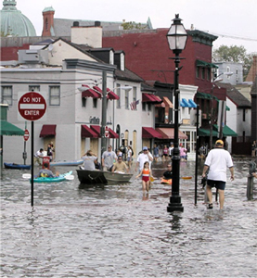
What We Need From Working Group
Ways to Strengthen Programs
  GHG reductions and jobs and the economy
New Programs
Potential New Program Components
Missed Opportunities
Thoughts on Goals and Programs for the 2030 to 2050 Timeframe
Other Suggestions and Comments
19

Slide 20

For More Information
Maryland Department of the Environment
http://www.mde.state.md.us/Pages/Home.aspx
Maryland Smart, Green & Growing
http://climatechange.maryland.gov/
20

