Slide 1
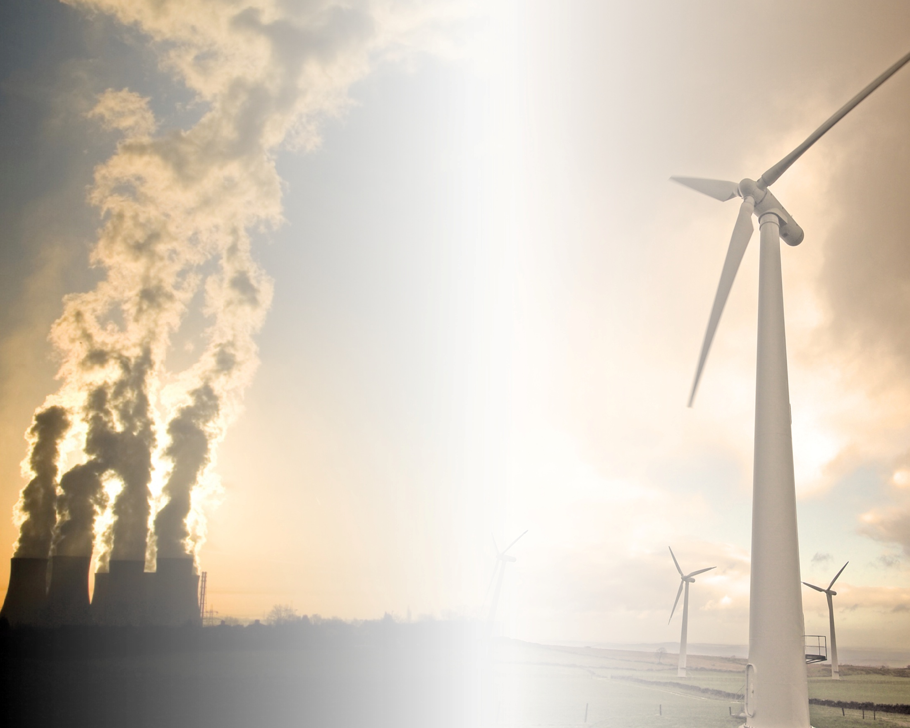

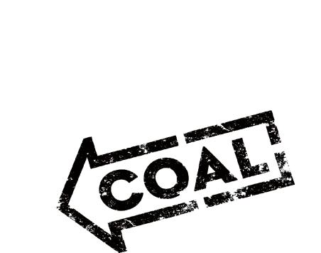
Maryland Commission on Climate Change 5/23/16
Mark Kresowik
Deputy Director

Slide 2

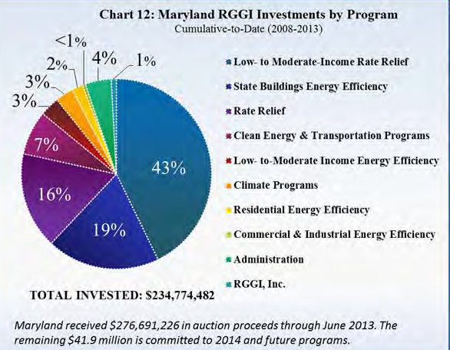
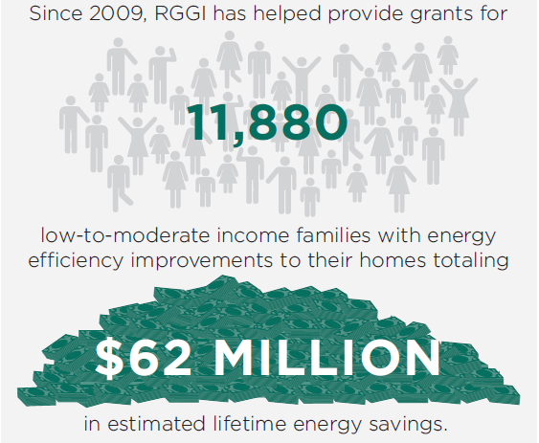
RGGI has been a success for Maryland
“RESI’s 2015 Study estimated that RGGI, once fully operational, would support a total of 96 to 1,015 jobs by 2020, $94,970,706 to $322,862,295 in net economic output and $117,721,558 to $770,226,749 in wages over the lifetime of the program.” - Maryland Department of the Environment

Slide 3
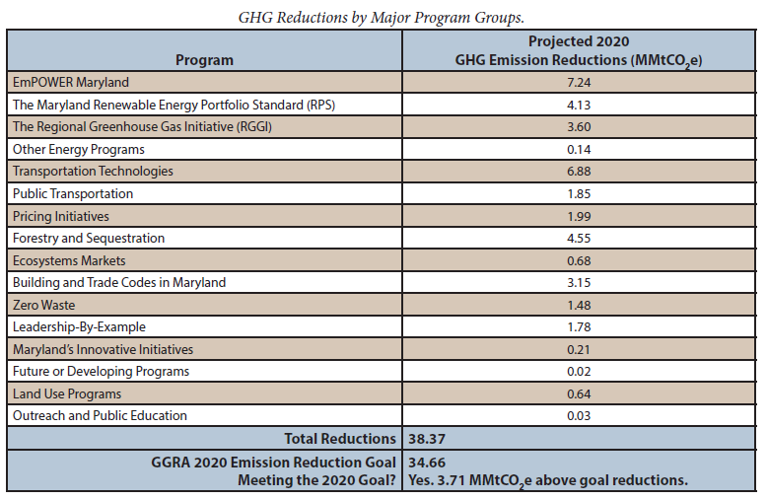
RGGI has been a success for Maryland

Slide 4
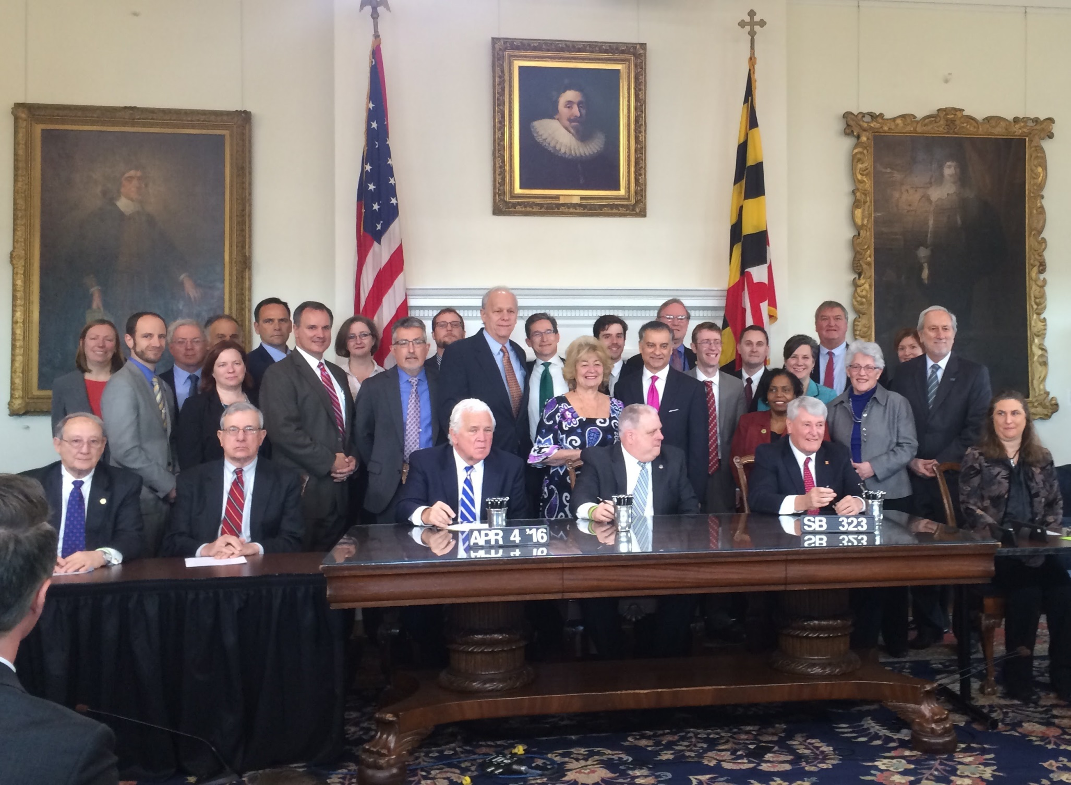
More success – state adopts MCCC 2030 goal

Slide 5
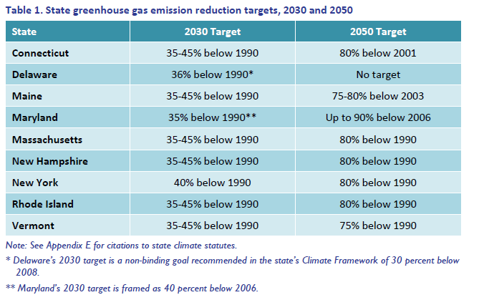
Maryland’s goal is in line with other states

Slide 6
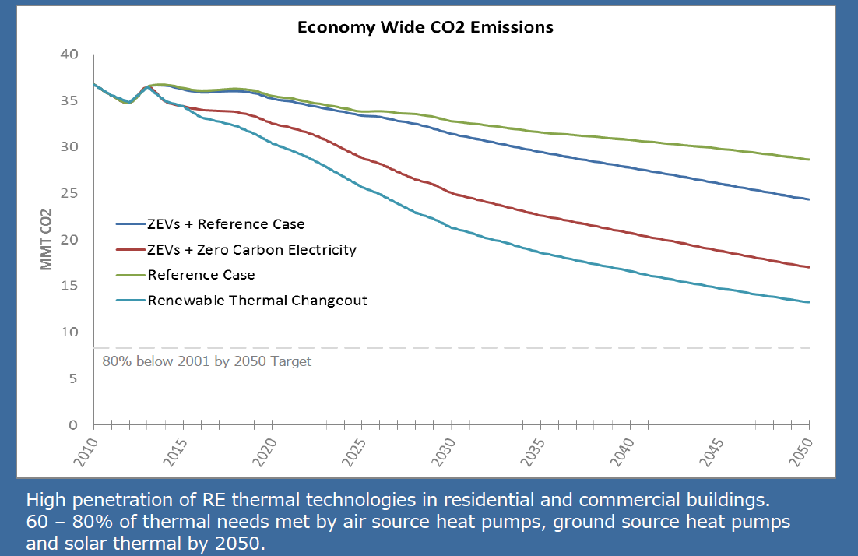
Those states are figuring this out too
“the only viable path to deep reductions in GHG emissions is through a combination of reduced energy consumption (through increased energy efficiency in vehicles and buildings), expanded availability of clean electricity, and electrification of the transportation and heating sectors… The scope of the challenge can be summarized in three words: reduce, electrify, and decarbonize.” - MA Clean Energy and Climate Plan
- Connecticut Governor’s Council on Climate Change

Slide 7
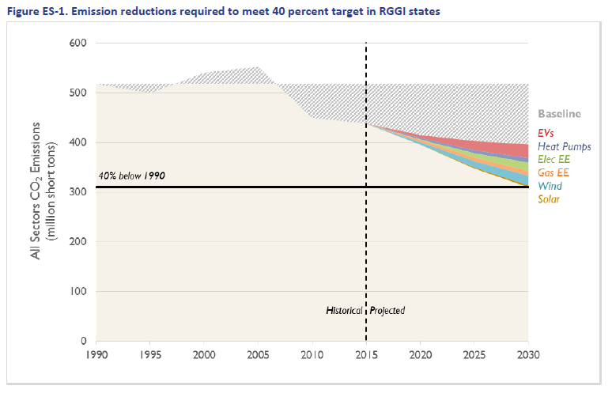
So we looked at the most cost effective path
Synapse analysis: RGGI limits aligned with Maryland’s goal and electrifying vehicles and heating will save customers $25.7 billion through 2030 and create an average of nearly 60,000 new jobs annually

Slide 8
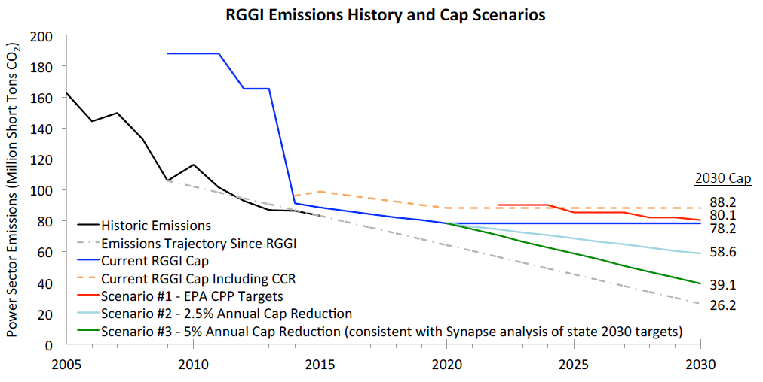
MCCC should support RGGI cap consistent with goal
Equivalent RGGI cap would be 5% annual decline from 2020 levels through 2030: slightly less ambitious than pollution reduction trajectory achieved to date in region
- Natural Resources Defense Council comments to RGGI stakeholder process

Slide 9
Other elements
Partnering outside the region: require comparable stringency
RGGI covers both existing and new pollution sources
RGGI caps pollution and invests revenues (100% auction)
RGGI has a floor price for allowances
Cost Containment Reserve Needs Reform
Can allow pollution above the necessary targets
Can perversely drive prices up in the short term
Better mechanisms to protect businesses and families exist
Offsets not a solution
Need to reduce pollution from all sectors to hit Maryland goals
Not allowed under the Clean Power Plan
Better mechanisms to protect businesses and families exist

Slide 10
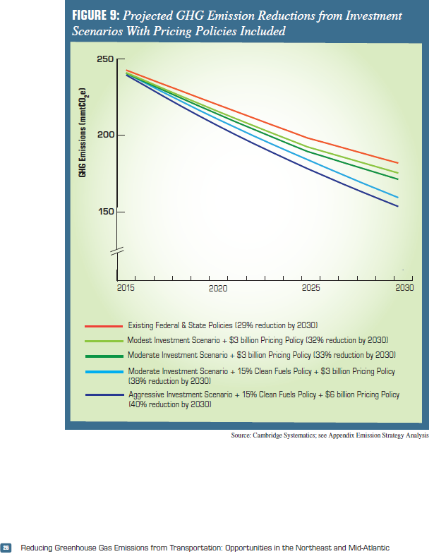
Learn lessons from RGGI for transportation

Slide 11
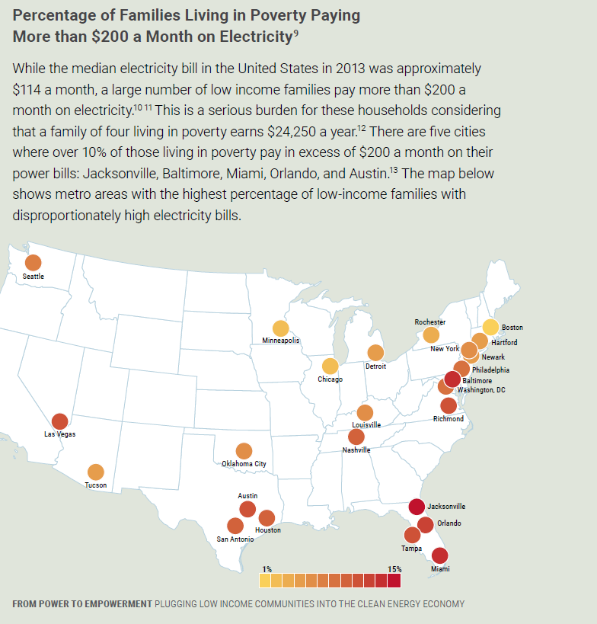
Equity needs to be front and center

Slide 12
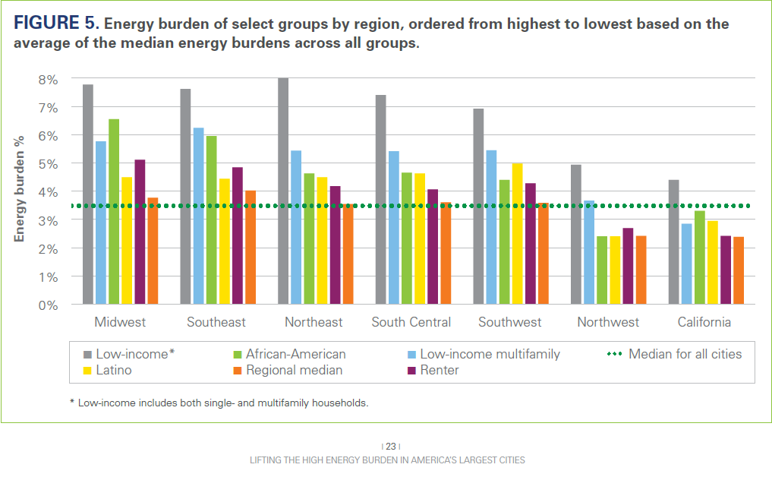
Equity needs to be front and center

Slide 13
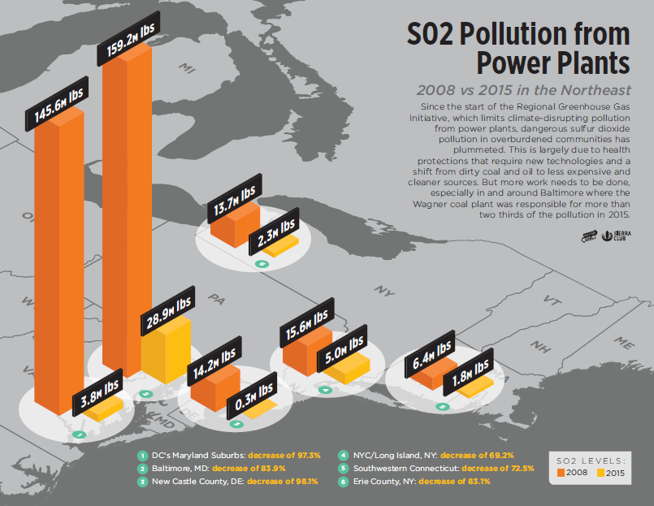
Equity needs to be front and center

Slide 14
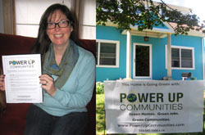

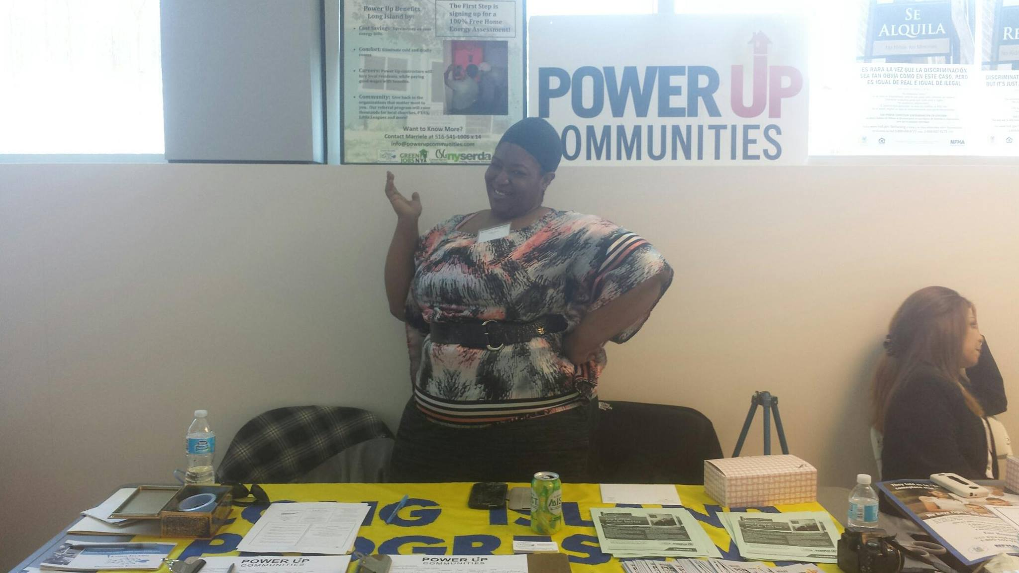
Engage overburdened and underserved communities

Slide 15
Increasing equity and empowerment
Cap and reduce both pollution and energy cost burden
2. Conduct environmental justice and cumulative impact analyses on policies
3. Direct revenues from RGGI and transportation pricing to overburdened and underserved communities
4. Enact apprenticeship and workforce development programs
5. Enable clean renewable energy (shared solar), electric buses, and charging infrastructure investment in underserved communities

Slide 16

Discussion:
- Feedback on Plan
- Next Steps

