Slide 1
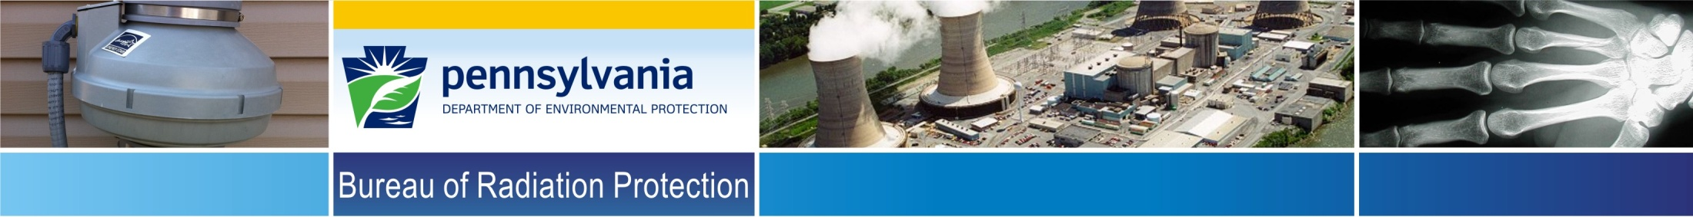
PA DEP/BRP, Radon Division
Mid-Atlantic States Radiation Conference
September 19, 2018
Targeted Survey
leads to HIGH HOMES
Denise Bleiler
Radiation Protection Program Supervisor
Tom Wolf, Governor
Patrick McDonnell, Secretary

Slide 2

Objectives
Radon Basics
Targeted Surveys
High Development data
Continued Outreach
Geology
Challenges

Slide 3

DEP/BRP Radon Division
Rn-222 Characteristics, Implications
  Naturally Occurring- Occurs in all soil and rocks, worldwide.
  Colorless, odorless, tasteless- Out of sight, out of mind.
  Gas- Provides for transport and mobility.
  Half-life- ~ Four days
  Radioactive- Carcinogenic property, increases risk of Lung Cancer

Slide 4
DEP/BRP Radon Division
More Basics
  Ambient Air: 0.4 pCi/L
  National Indoor Conc. (whole house avg.): 1.3 pCi/L
  U.S. EPA Guideline: 4 pCi/L
  PA Basement Avg.: 7.0 pCi/L
  PA First Floor Avg.: 3.5 pCi/L
Notes:
ER = (WL x 100)/ Rn

Slide 5
Radon Basics in Perspective
Reference values
Radon Concentration | W.B. Effective Dose
0.4 pCi/L | 57 mRem/yr.
1.3 pCi/L | 173 mRem/yr.
4.0 pCi/L | 577 mRem/yr.
7.0 pCi/L | 1000 mRem/yr.
500 pCi/L | 72 Rem/yr.
Notes:
Assumptions: ER equals 0.4, DCC equals 1000 mRem/WLM, time spent on first floor equals 6,132 hrs/yr, QF= 20, Tissue weighting factor equals 0.08.

Slide 6
DEP/BRP Radon Division
Targeted surveys- previous and ongoing
  Lehigh, Berks, York, Clearfield, Lancaster, Montgomery, Chester, Lackawanna, Potter, Luzerne, Dauphin, Cumberland, Lebanon, Bucks, ….
  These surveys are used to increase awareness in higher risk areas.
    Radon Data
    Geology

Slide 7
Upper Saucon Twp Survey
Letters sent | 512
Tests supplied | 294 | 57%
Tests analyzed (to date) | 243 | 83%
Our goal is for 100% response
* Figures current as of May 15, 2015

Slide 8
PA Radon Division
Upper Saucon Twp. Lehigh Co. Radon Survey
Radon Levels | Targeted Survey Data | State-Wide Data
< 4.0 pCi/L | 50.2% (128) | 60.8%
4.0 – 10.0 pCi/L | 23.9% (61) | 22.7%
10.1 – 20.0 pCi/L | 5.5% (14) | 9.2%
20.1 – 50.0 pCi/L | 6.3% (16) | 5.3%
50.1 – 100.0 pCi/L | 3.9% (10) | 1.3%
100.1 – 1,000.0 pCi/L | 6.7% (17) | 0.44%
> 1,000 pCi/L | 3.5% (9)
% > 4 pCi/L | 49.8% (127) | 39%
% < 4 pCi/L | 50.2% (128) | 60.8%
N = | 255 | 878,600

Slide 9
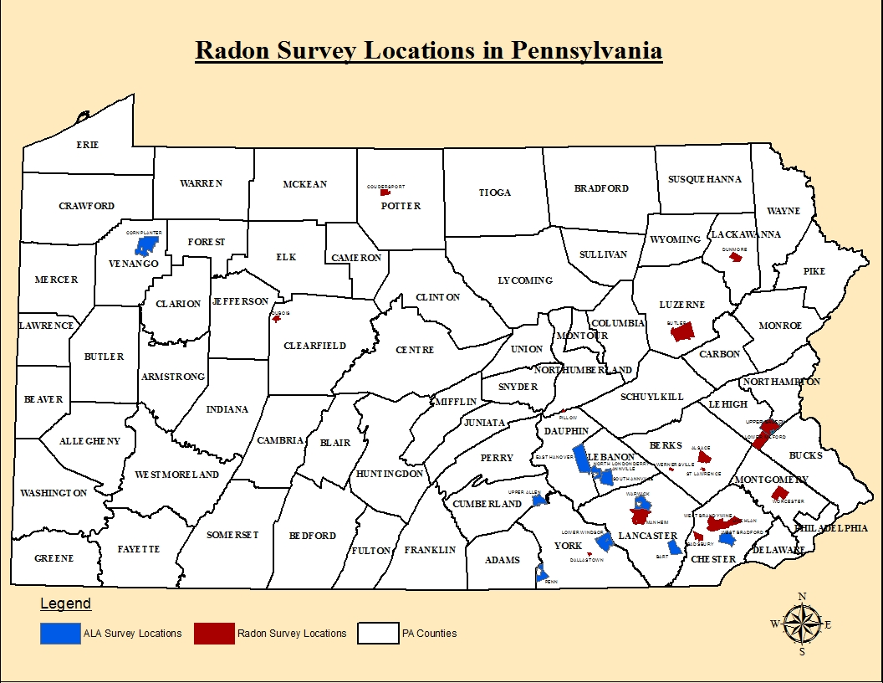

Slide 10
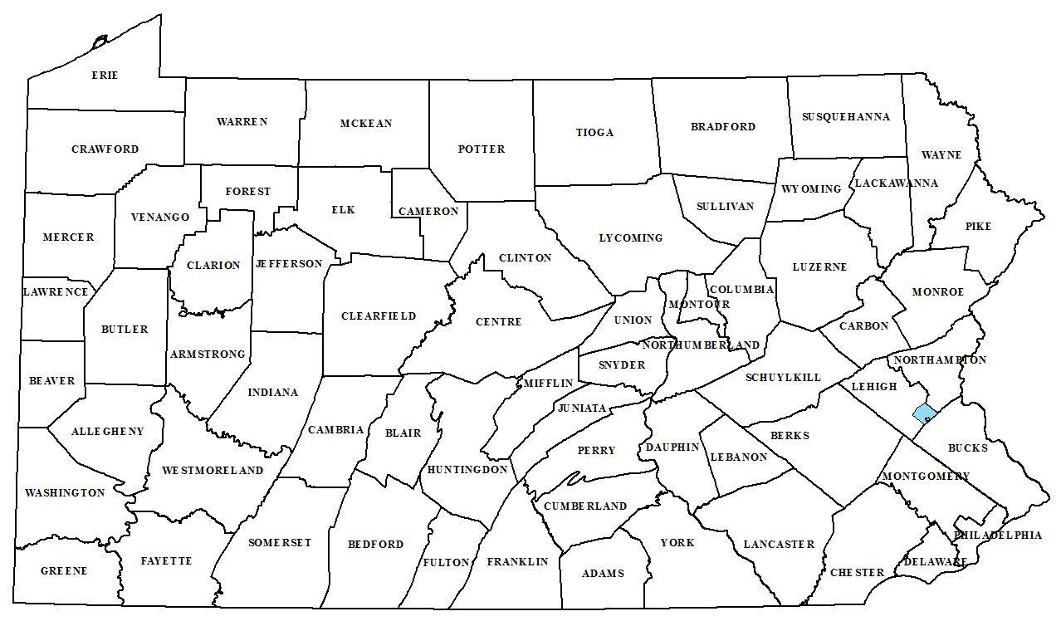
Upper Saucon Twp. Survey Area

Slide 11
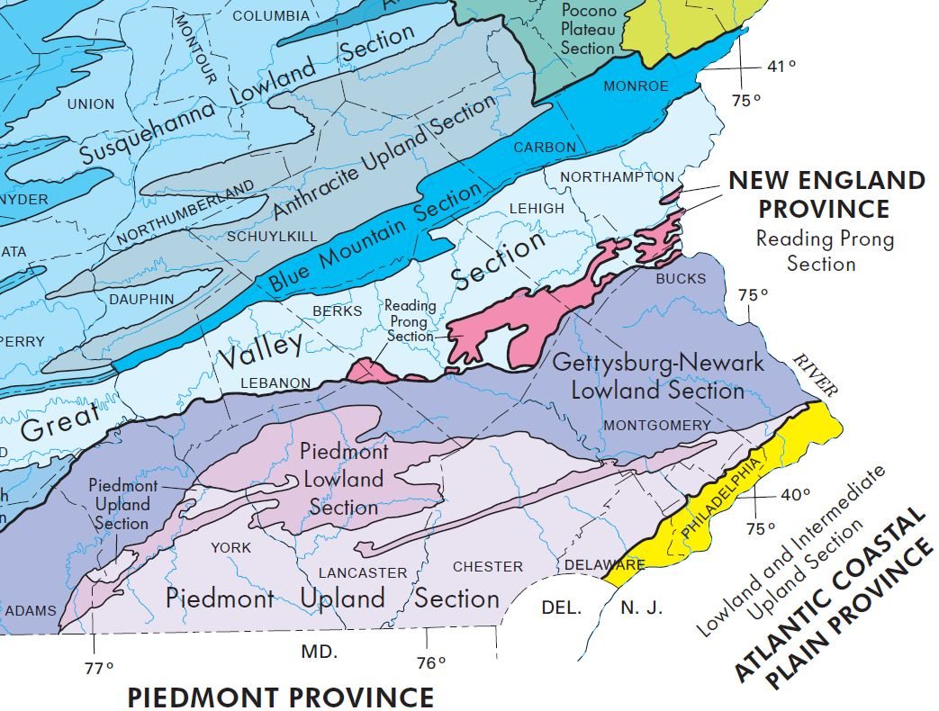

Slide 12
Outreach Efforts
Worked with Township
Initial Mailing (512)
Follow-up mailing (265) *
Reminder letters sent (three separate times) *
Final letter with enclosed test kit *
Local school district contacted
PA Dept. of Health updated *
* Unique to this Survey

Slide 13
Outreach Efforts- continued
Township Bldg. “Open House” *
State Rep. and State Sen. Informed *
Conference call with EPA Region III and Headquarters. *
DEP Press Release.
Two local builders informed.
* Unique to this Survey

Slide 14
Outreach Efforts- continued
Town Meeting – Dec 4, 2014 *
  About 400 people in attendance
  At least 4 mitigators present
  Handed out over 100 radon test kits ( DEP and ALA)
Town Meeting – 2016 *
Continue to measure homes before occupancy *
* Unique to this Survey

Slide 15
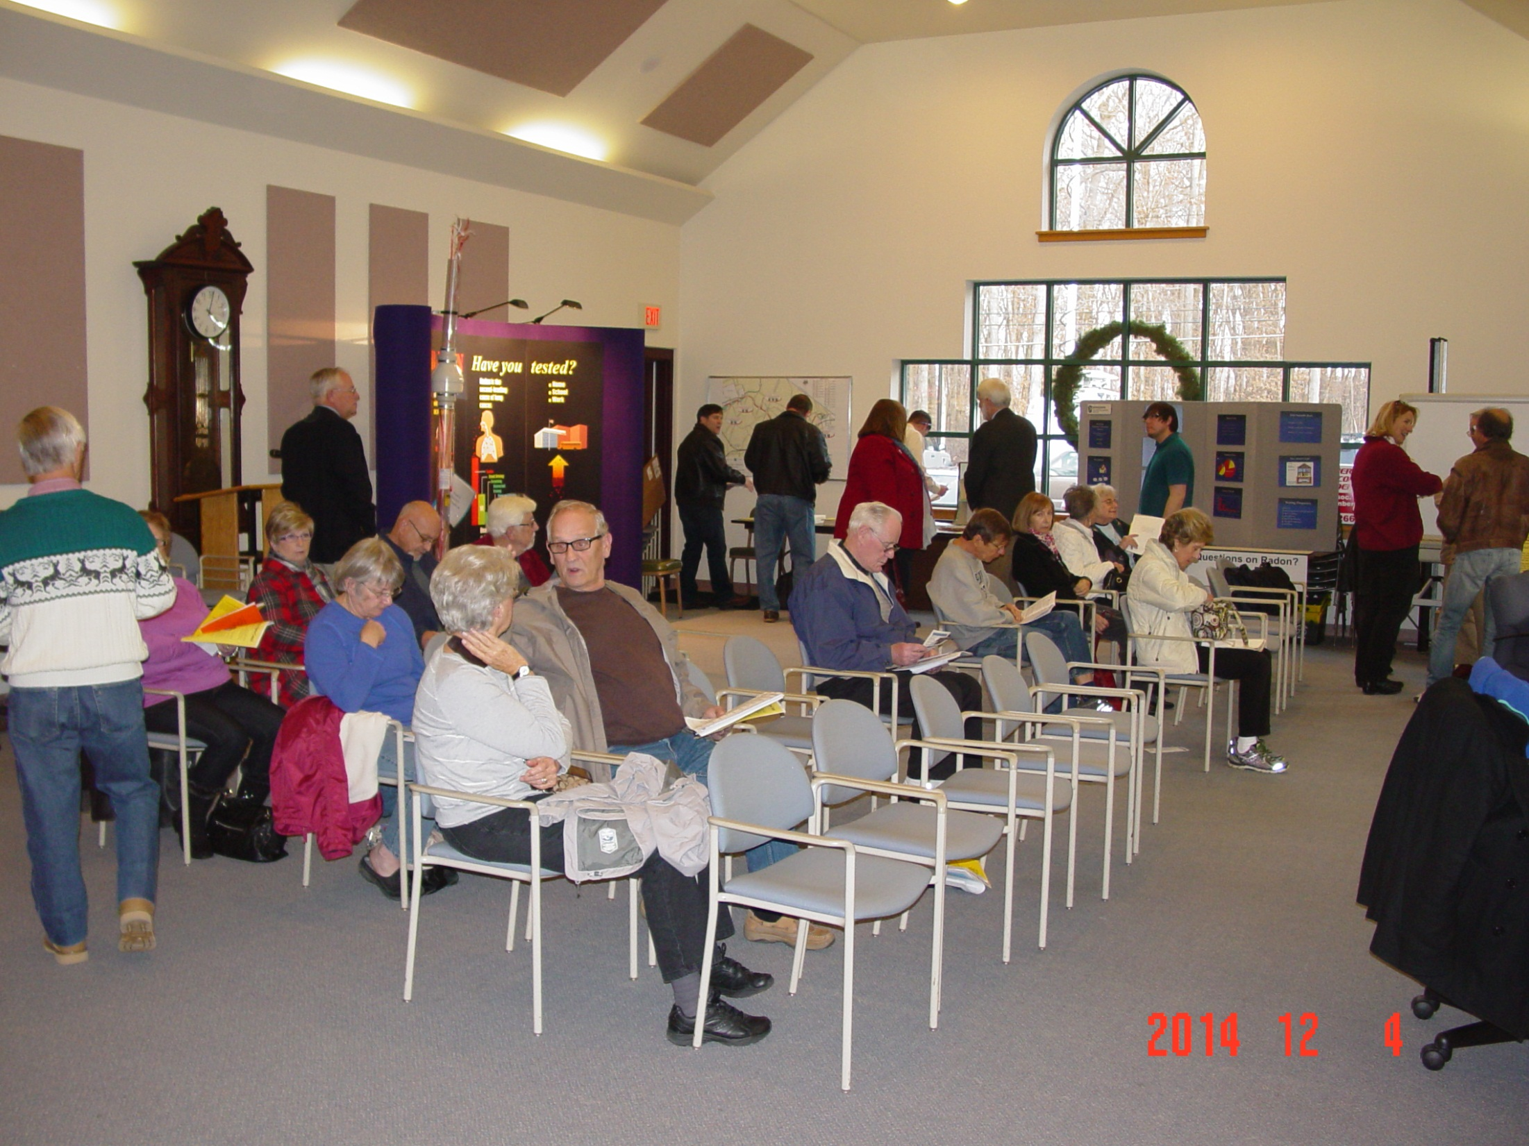

Slide 16
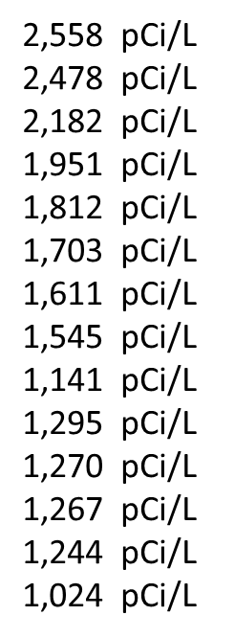
19 Results Greater than 1,000
17,518 pCi/L - highest in world
6,176 pCi/L
5,336 pCi/L
3,715 pCi/L
2,748 pCi/L-higher than index house

Slide 17
DEP/BRP Radon Division
Pre-Mitigation (pCi/L) | Post-Mitigation (pCi/L) | Percent Reduction
3715 | 2.8 | 99.92
2748 | 2.0 | 99.92
2478 | 2.3 | 99.90
1951 | 2.4 | 99.87
1812 | 1.3 | 99.92
1545 | 1.9 | 99.87
1703 | 6.6 | 99.60
1611 | 5.8 | 99.60
1400 | 2.1 | 99.85
1295 | 1.6 | 99.87
1024 | 3.0 | 99.70
1244 | 1.1 | 99.91
1270 | 3.1 | 99.75
1267 | 3.6 | 99.71

Slide 18
DEP/BRP Radon Division
Typical high development home, backyard, and basement excavation Gamma readings
Background Gamma (MicroR/hr)
Basement & first floor before mitigation- ~110
Outside yard- ~115 to 150
Basement excavation- ~100-360 & ~800-900
8-10 microR/hr = average PA outdoor

Slide 19
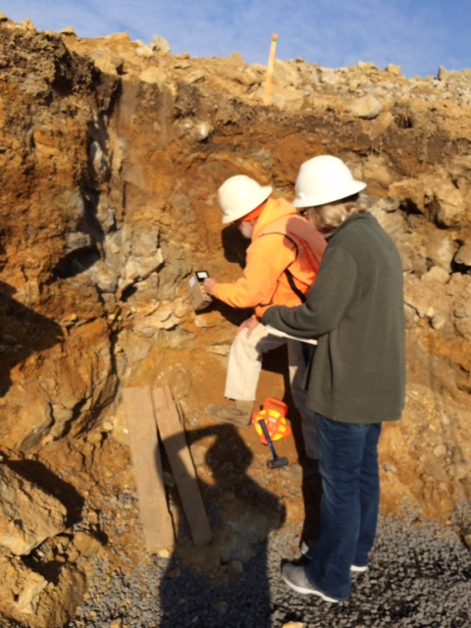
Gamma Survey in basement excavation
Notes:
Lot 7, Whispering Pines Development, basement excavation

Slide 20
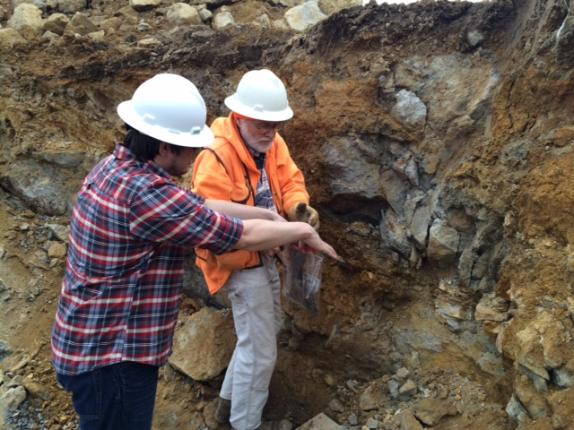
Soil/rock sample collection
Notes:
Lot 7, Whispering Pines Development, Basement excavation

Slide 21
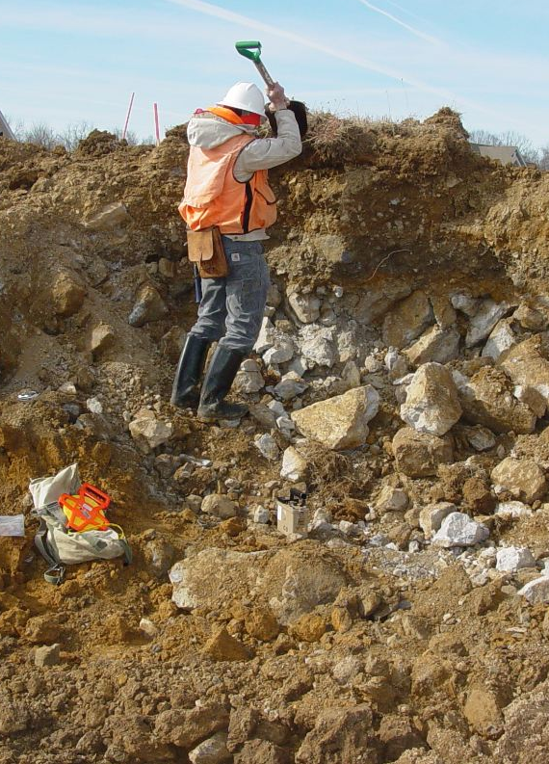
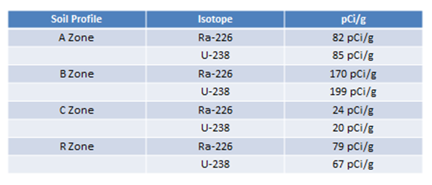
Collecting a Soil Profile
Ongoing Soil and Rock
Sampling and Rad Analysis
Above data March 2015.
Typical soil and rock contain 1 pCi/g U and Ra on the average

Slide 22
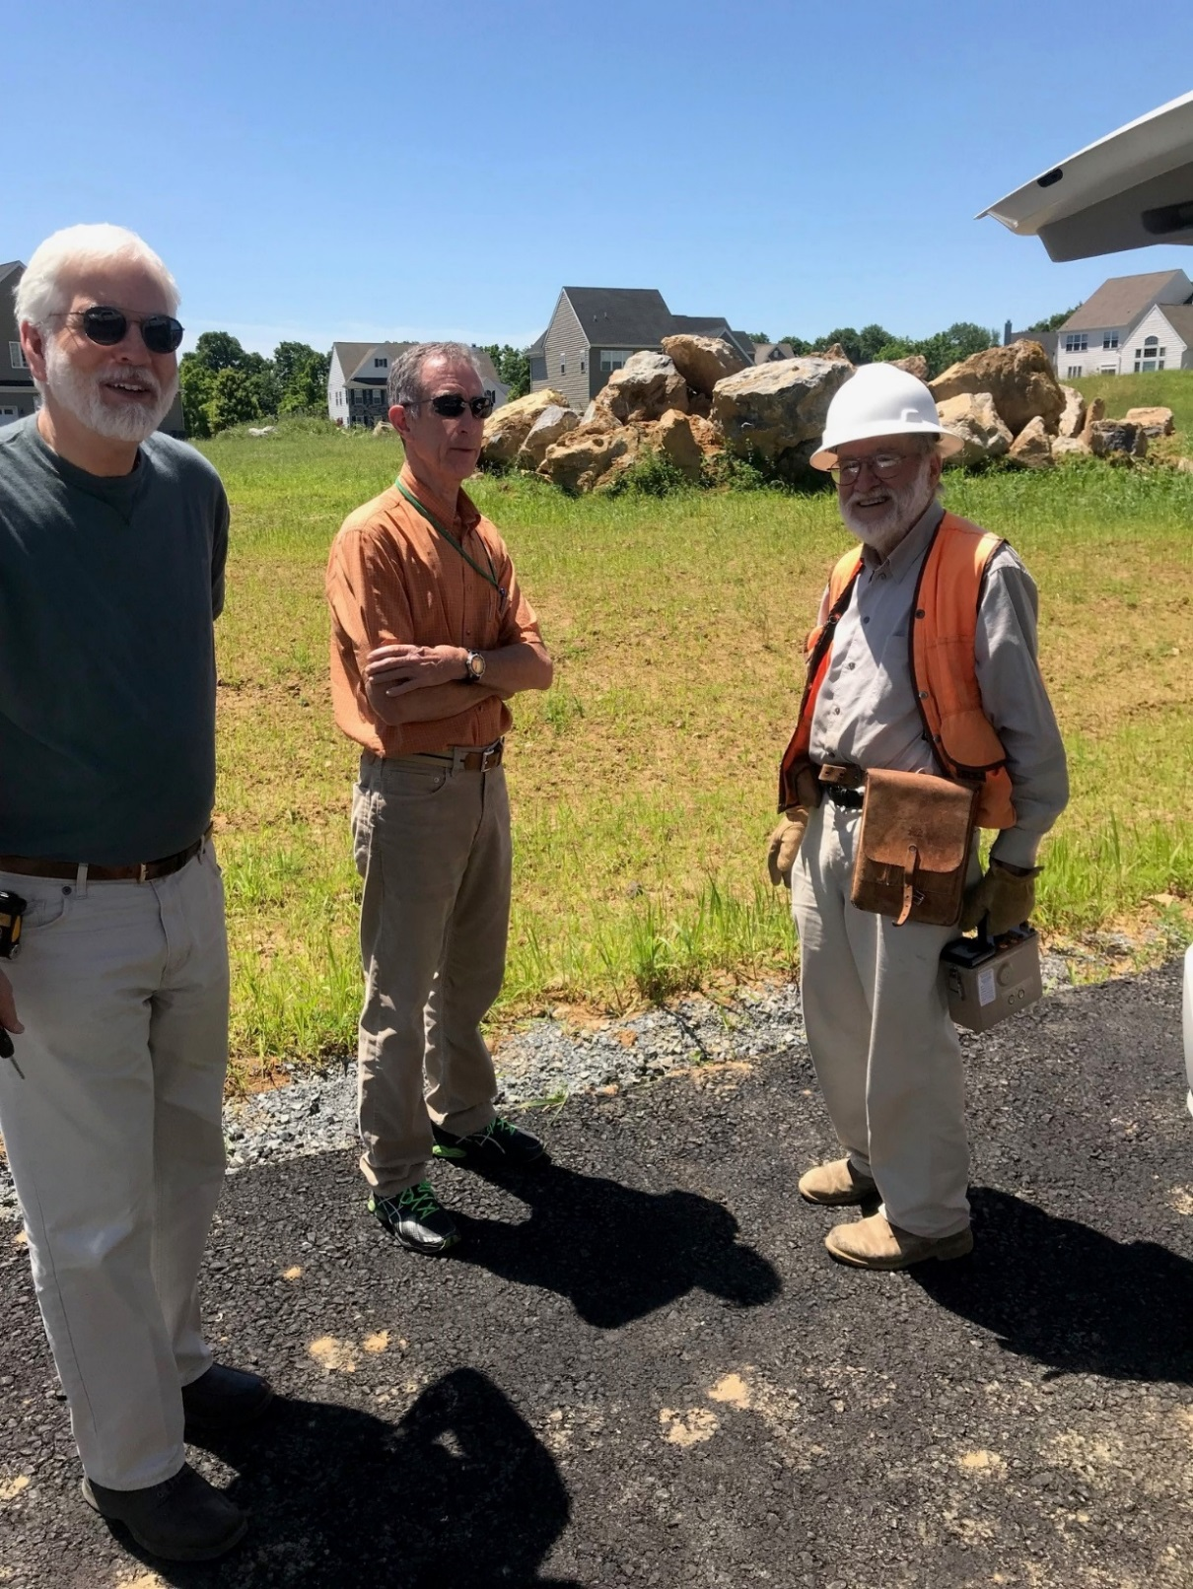

Slide 23
The Perfect Storm: Geology
Epler Formation-Limestone, Dolomite
These extremely high radon levels are due to the unique geology of the area.
Notes:
Brecciated- rock formed from another rock that is broken and shattered.
Carbonate soils come from limestone's and Dolomite

Slide 24
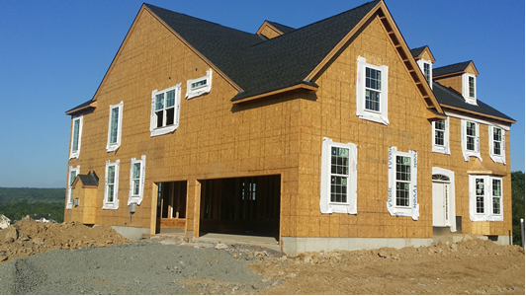
The Perfect Storm: Geology
We put basements into the very elevated radium enriched soils

Slide 25
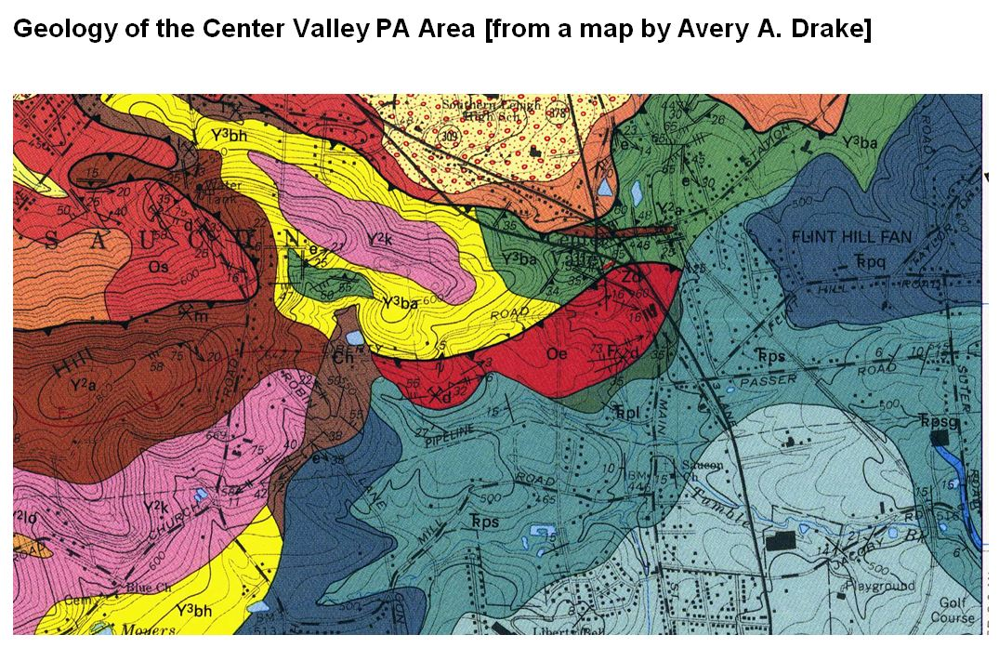
The Perfect Storm: Geology

Slide 26
DEP/BRP Radon Division
Latest Tally in this development
82 homes and empty lots
19 Homes > 1,000 pCi/L
32 Homes between >100 pCi/L <1,000 pCi/L
12 Empty Lots

Slide 27
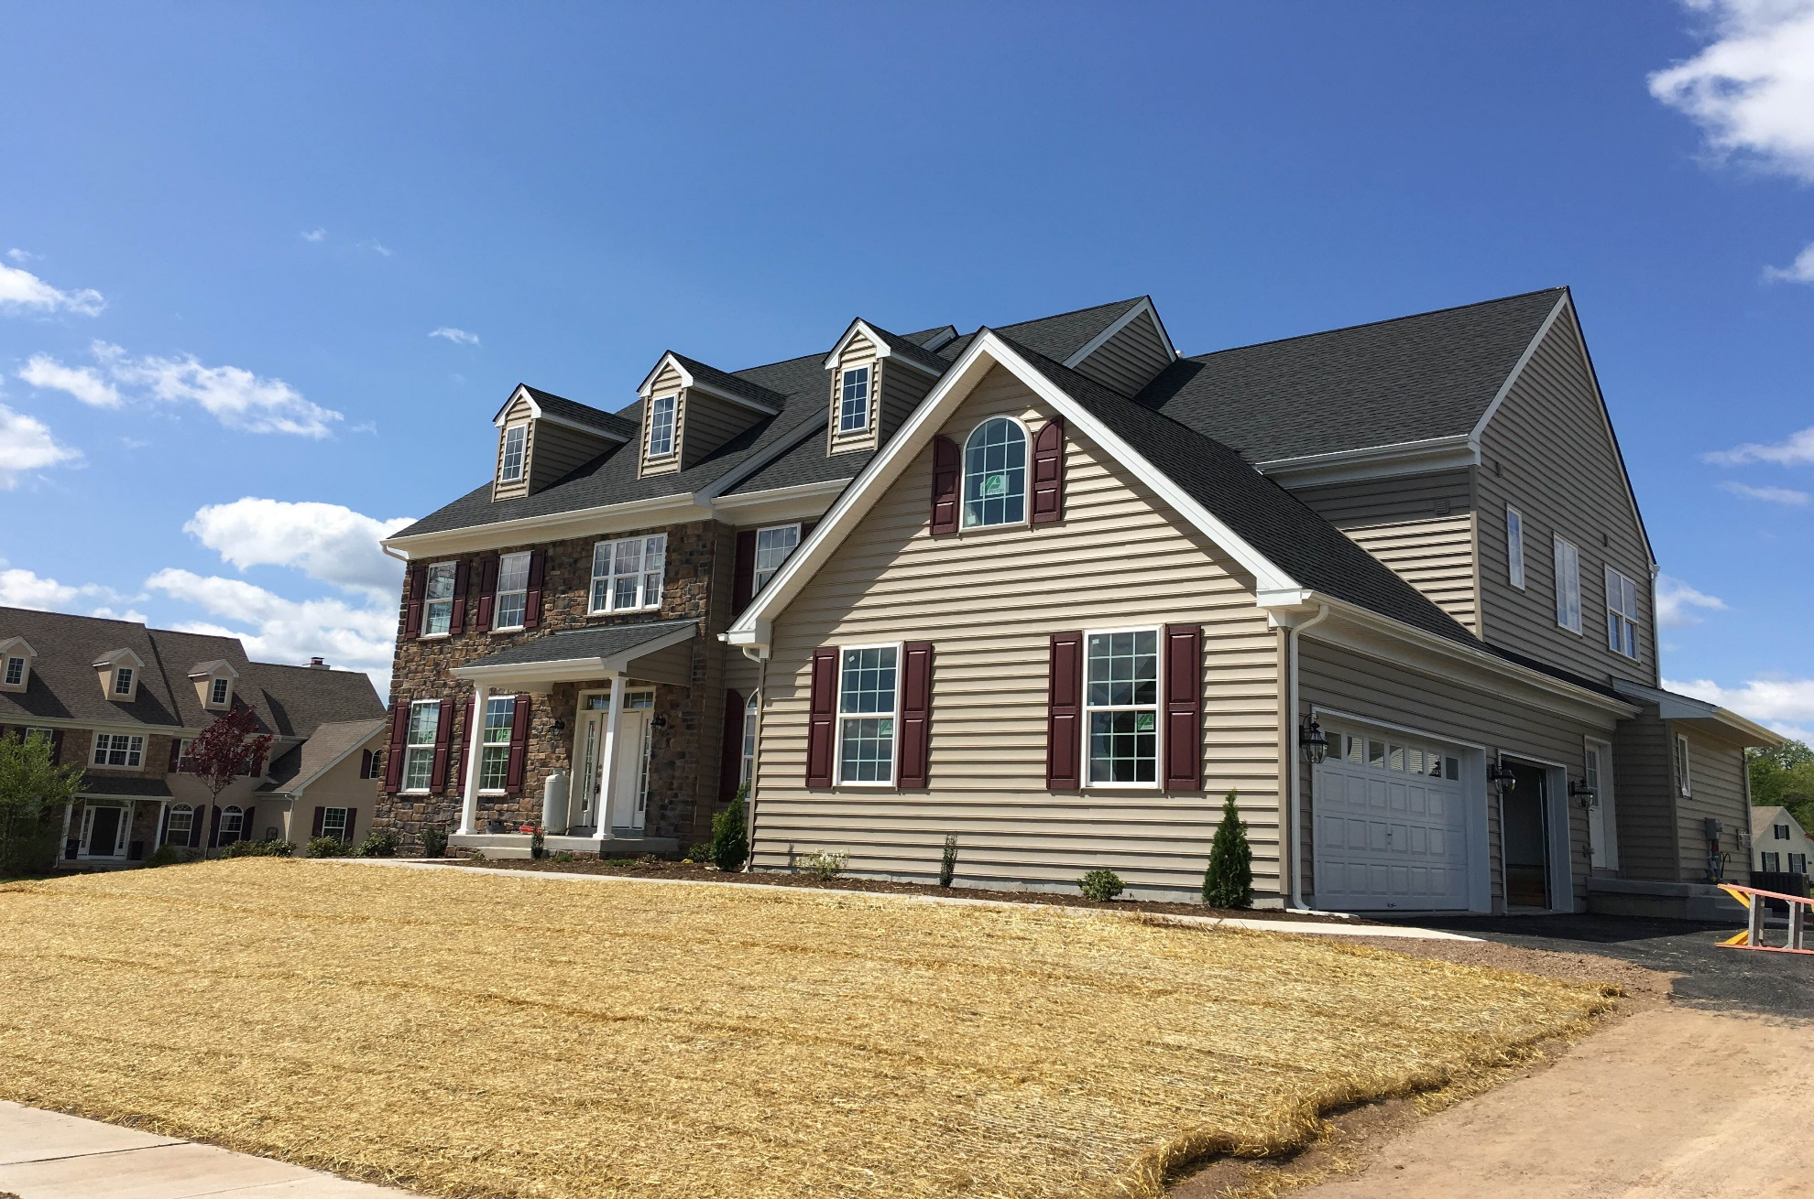
Typical Home

Slide 28
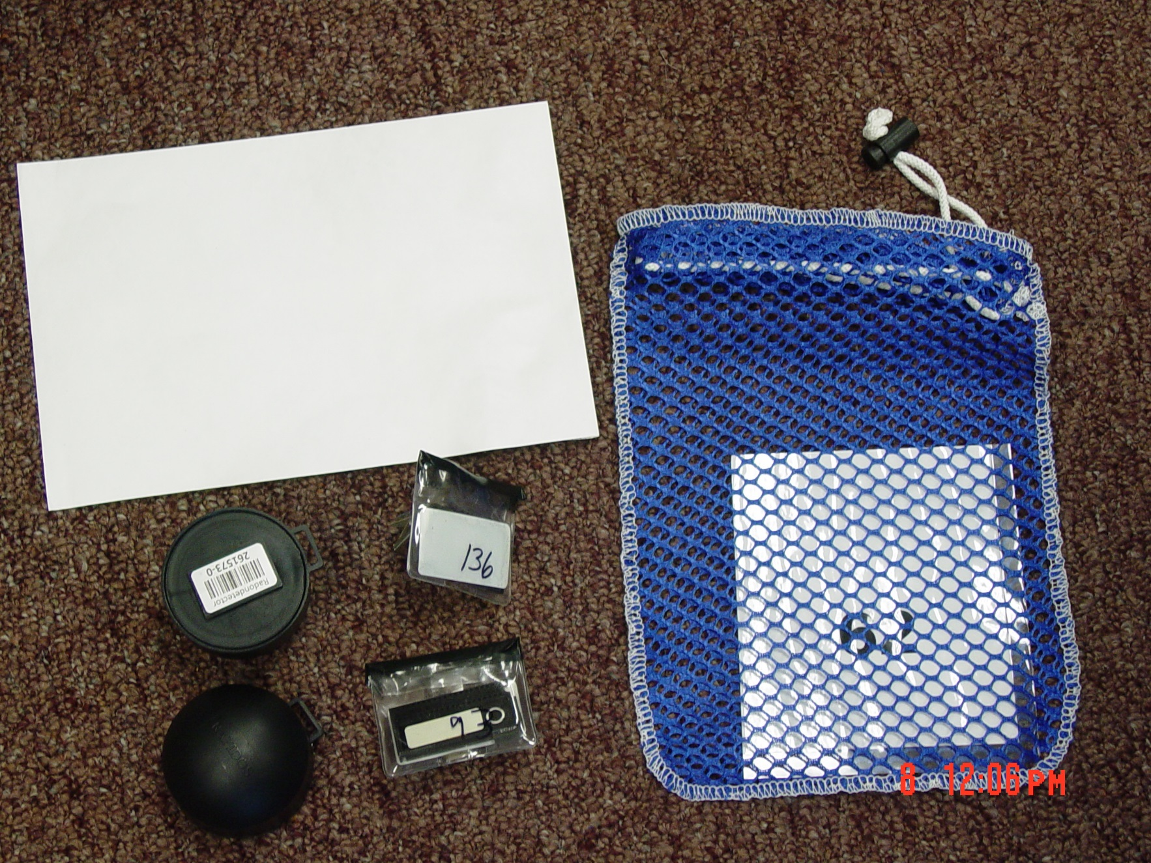
PA Radon Division

Slide 29
Ambient Radon/Gamma
Location | Radon Conc. pCi/L | mrem/yr.
Lot 24-Street B | 2.1 | 651
Cul De Sac- Street B | 0.6 | 204
Street A | 2.2 | 462
Street A | 1.6 | 401
Street B | 3.1 | 389
Riegelsville (control) | 0.5 | 203
Township Bldg. (control) | <0.4 | 171
Harrisburg (control) | <0.4 | 154

Slide 30
Challenges
Reaching EVERY homeowner
  One occupied home finally tested- ? mitigated
  One letter translated into Chinese and Mandarin- help from EPA
Builders installing mitigation systems
  Builder installing audible alarm on fan
  Homeowner maintaining system
Testing prior to occupancy
Minimal ambient testing - complete

Slide 31
Conclusions
These high homes are showing 99% radon reduction
Elevated levels of radon can be fixed
Continued Outreach to increase awareness

Slide 32
DEP/BRP Radon Division
Questions?
Contact Information:
www.dep.pa.gov
Click Radiation Protection
then click Radon
    800 237-2366
    717 783-3594

