Slide 1
Delaware’s ArcGIS App for REP using FirstMap
Mid-Atlantic States RadCon Conference 2018
Frieda Fisher-Tyler, MHS, CIH

Slide 2
Introduction
Renee Hupp, M.S.
  Terrorism Preparedness Planner
  Delaware Emergency Management Agency (DEMA)
Kim Cloud, GISP
  Software Engineer
  Department of Technology & Information (DTI)
Frieda Fisher-Tyler, CIH, MHS
  Radiation Control Program Director
  Department of Health and Social Services (DHSS)
Radiological Emergency Preparedness Technical Assessment Center
  REP-TAC
Notes:
30

Slide 3
Overview
What did we create?
Business Need
Development Process
Application Usage
Successes
Lessons learned
Future steps
Notes:
30

Slide 4
What Did we Create?
Radiological Emergency Preparedness (REP) Web Mapping Application
Designed for Technical Assessment Center (TAC)
Shows all fixed site radiological risks to Delaware
Includes layers for:
  Emergency Response Planning Areas (ERPA)
  Population
  Demographics
  Modifiable wind direction
  Site locations
Notes:
Radiological Response Application
Covers all fixed site radiological risks to Delaware
Shows layers for Emergency Planning Zones, populations, editable wind direction. And site locations
1

Slide 5
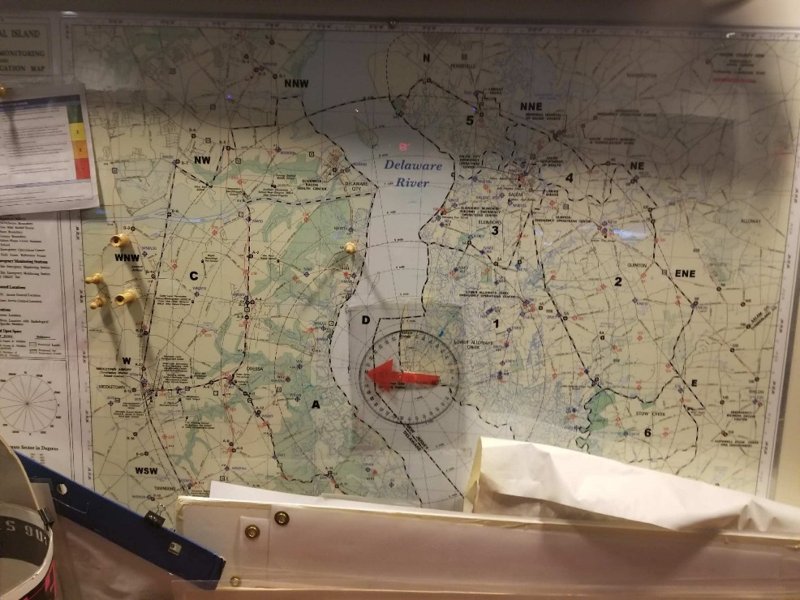
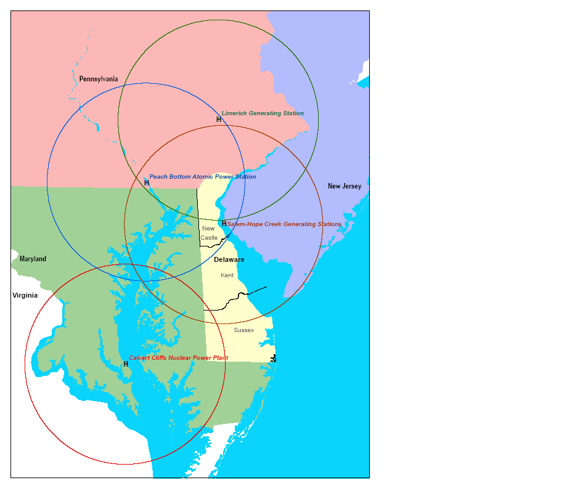
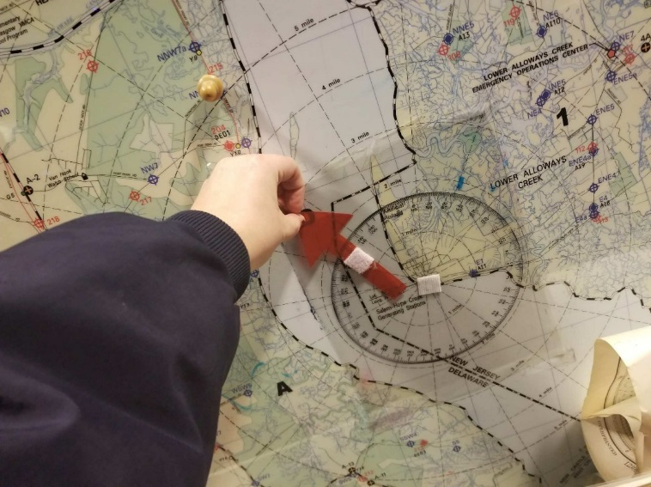
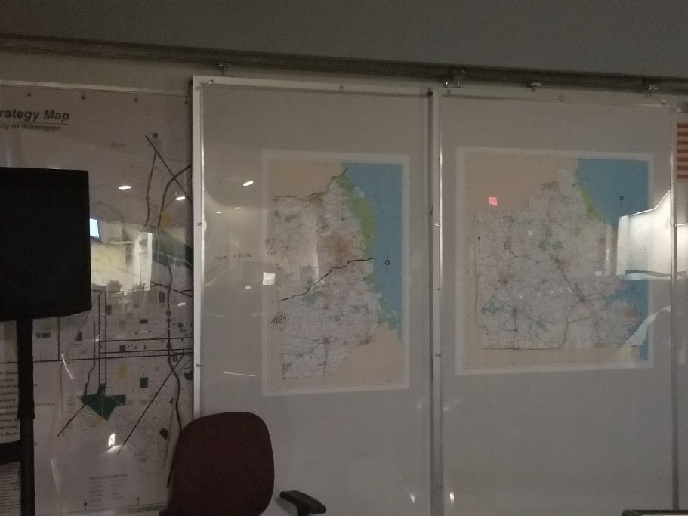
From This…
Velcro arrow...
Notes:
30

Slide 6
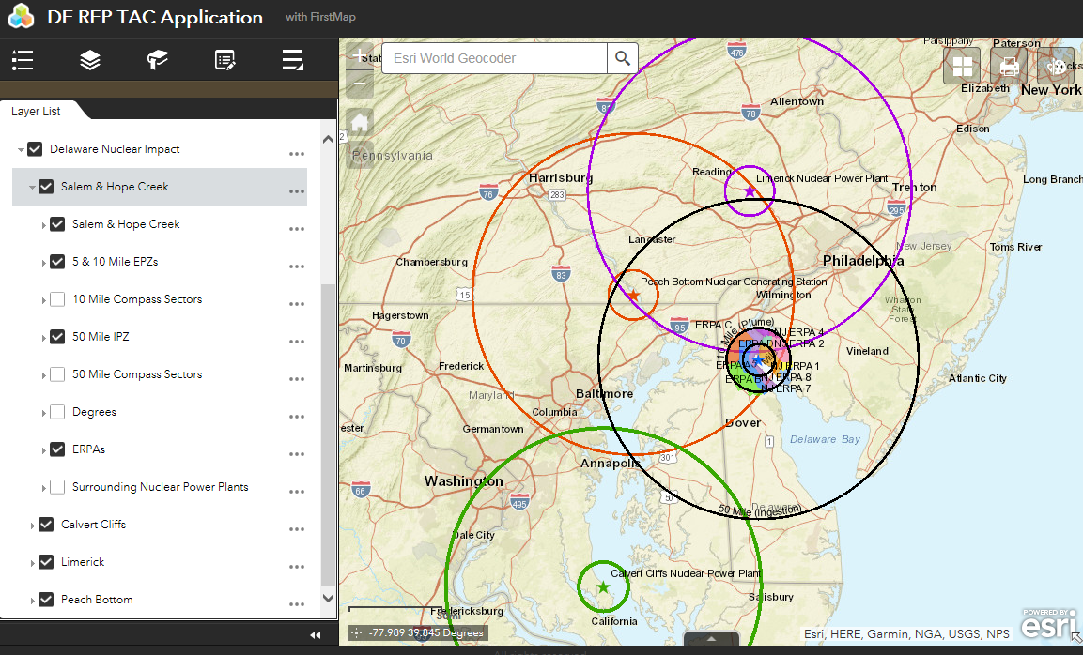
To This…
Notes:
30

Slide 7
Business Drivers
Need a comprehensive integrated response from all players
Need a new way to look at shared situational awareness
Near real-time updates of decisions essential
  Technical Assessment Center (TAC) shares process with Planning & Operations
  Standardized visuals help the process
Notes:
Allows for integrated response from all players in a comprehensive manner
Push for shared situational awareness and understanding in a new way
Keep everyone up to date
Our Technical Assessment Center was able to share decision making process clearly with Planning and Operations Sections; clear symbolization really aided process
Better and more accurate decisions from command and control that were more concisely communicated to the field
Field data that could be more accurately reported to the EOC/TAC
2min

Slide 8
Business Drivers
Recommendations made from TAC to Command and Control based on various data display visually on the map
Command and Control makes decision, displays on map as guidance
EOC partners and Field unit act on decisions, data show up in near real time on maps
Command and Control, and TAC are able to react faster to visual data together, as well as take proactive steps
Communications
and
Work Cycle
Notes:
Allows for integrated response from all players in a comprehensive manner
Push for shared situational awareness and understanding in a new way
Keep everyone up to date
Our Technical Assessment Center was able to share decision making process clearly with Planning and Operations Sections; clear symbolization really aided process
Better and more accurate decisions from command and control that were more concisely communicated to the field
Field data that could be more accurately reported to the EOC/TAC
Command and Control communicate with users in the field
Decisions out of date in the past
Decisions change quickly
Mistakes happen
Communicate field operations back to EOC and TAC
The more accurate, the better
Near real-time helps improve decisions
2

Slide 9
Business Drivers
REP program had multiple data sources with geospatial dependencies
Not taking advantage of newer, existing technology
Need integration of mapping data from federal partners
  Federal Radiological Monitoring and Analysis Center (FRMAC)
  US Department of Agriculture (USDA)
Notes:
Allows for integrated response from all players in a comprehensive manner
Push for shared situational awareness and understanding in a new way
Keep everyone up to date
Our Technical Assessment Center was able to share decision making process clearly with Planning and Operations Sections; clear symbolization really aided process
Better and more accurate decisions from command and control that were more concisely communicated to the field
Field data that could be more accurately reported to the EOC/TAC
2

Slide 10

We can build an app for that!
-esri
ESRI
  Delaware’s GIS software provider
  Built demo application to show what was possible
  App use demonstrated during exercise
  Solid proof of concept, but needed more…
Notes:
30

Slide 11
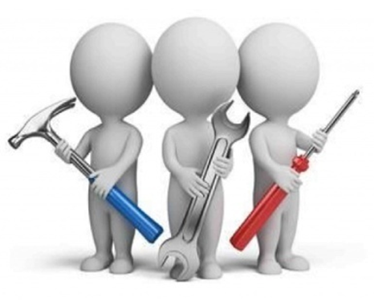

We have tools and can help with that!
- FirstMap
FirstMap
  Delaware’s Enterprise
  GIS System
  Existing repository for static and editable geospatial data
  Esri ArcGIS platform
    Oracle, ArcGIS Server REST services, ArcGIS Online, ArcGIS Open Data
  Transportation, Land Use, Basemaps, Water, Demographics
  About 250 centralized layers
https://firstmap.delaware.gov/
Notes:
1

Slide 12

We can build an app for that!
-esri
We have tools and can help with that!
- FirstMap
LET'S DO THIS!!
- TAC, DEMA
Notes:
<30

Slide 13
Development process
Limited Proof of Concept Implemented in 2017
  Partnership with DEMA, DTI and DHSS Public Health
Tested during a Plume exercise with non-GIS resources
  Salem & Hope Creek, NJ – June 2017
Tested during an ingestion pathway dress rehearsal
  August 2017
Full implementation during graded CALVEX Ingestion Pathway exercise
  Calvert Cliffs, MD – September 2017
Notes:
--Transition to Kim
Blue sky planning!
Efforts started in 2015, pulling together key members from DEMA, DTI, and Public Health
Organizing a business case of needs and wants, then creating priorities
Testing in realistic environments, such as exercises, with various participants, not just GIS professionals
Coordinating with non-traditional partners to figure out constraints
USDA data sets have different use cases for visibility, but we did determine and codify when those could happen
Worked with Federal data sets, such as FRMAC, to get inputs and then refine views for Delaware decision makers
<30

Slide 14

Development process
Blue Sky Planning!
Requirements Planning Sheet
  Map settings
  Data layers
  Popup settings
  Editable features
  Users and use cases
  Analysis requirements
  Data workflows
Notes:
---Kim
Blue sky planning!
Efforts started in 2015, pulling together key members from DEMA, DTI, and Public Health
Organizing a business case of needs and wants, then creating priorities
Testing in realistic environments, such as exercises, with various participants, not just GIS professionals
Coordinating with non-traditional partners to figure out constraints
USDA data sets have different use cases for visibility, but we did determine and codify when those could happen
Worked with Federal data sets, such as FRMAC, to get inputs and then refine views for Delaware decision makers
1

Slide 15
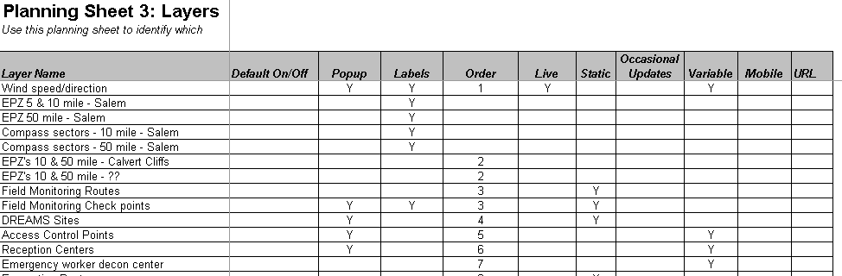
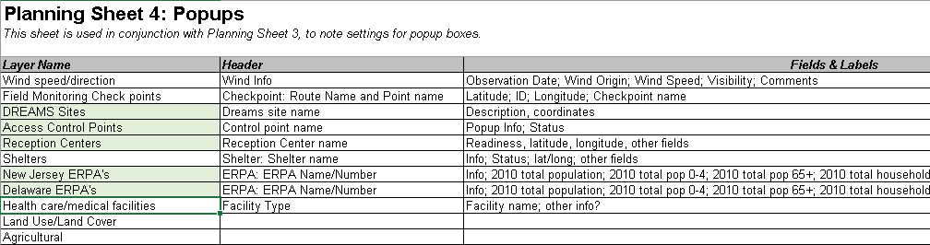
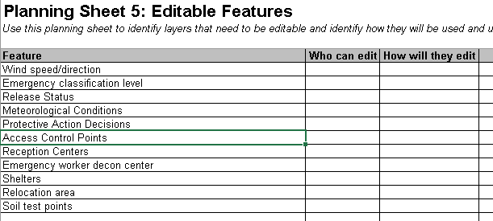
Development Process
Notes:
1--- Kim

Slide 16
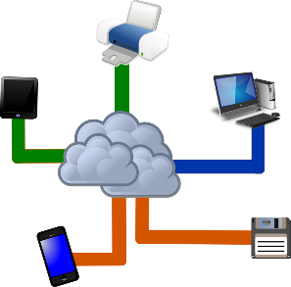
Development process
Prioritized Needs and Wants
Divided into stages
Usage of existing tools wherever possible (FirstMap, ArcGIS Online)
Data, data, data
  Inventory of what we had
  Outreach to data owners for what we didn’t have
  Migration of what we had to the new technology
  Brainstormed and prioritized
Notes:
---Kim
Blue sky planning!
Efforts started in 2015, pulling together key members from DEMA, DTI, and Public Health
Organizing a business case of needs and wants, then creating priorities
Testing in realistic environments, such as exercises, with various participants, not just GIS professionals
Coordinating with non-traditional partners to figure out constraints
USDA data sets have different use cases for visibility, but we did determine and codify when those could happen
Worked with Federal data sets, such as FRMAC, to get inputs and then refine views for Delaware decision makers
1

Slide 17
Development process
Coordinated with non-traditional partners to identify constraints
  USDA datasets have tighter data classification requirements
    Shared sub-set of data with a limited group
  Received example of federal data from FRMAC
    Refined to meet requirements for Delaware decision makers
    Pre-loaded to save time
    Identified workflow for actual emergencies
Notes:
--- Kim
1-2

Slide 18
Technology
Leveraged FirstMap for data storage and services
  Added static radiological layers
Used esri’s ArcGIS Online Web Application Builder
  Suite of standard configurable application templates
  Added analysis, printing, and drawing tools
Application integrates FirstMap and ArcGIS Online data together
  Allows for ad hoc addition of data
  User friendly and secure
Notes:
--- Kim
2

Slide 19
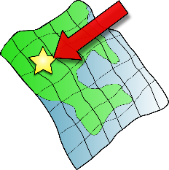

Application usage
Communication with senior leaders & resource providers
  Protective action recommendations
  Courses of action
  Current conditions
Updates for all participants
  Maps displayed on Emergency Operations Center monitors
  Concise and easy to understand
Notes:
--- Transition to Renee
Presented courses of actions and protective action recommendations to senior leaders and resource providers
Give concise and easy to understand briefing to the whole group by displaying the data on the EOC screens
Plan out embargo areas for various industries, relocation zones, locations for disaster assistance centers, and infrastructure impacts
Determine population and demographics, such as likelihood to have vehicles, poverty rates, and age ranges for the affected area, as well as home ownership versus rental
1

Slide 20
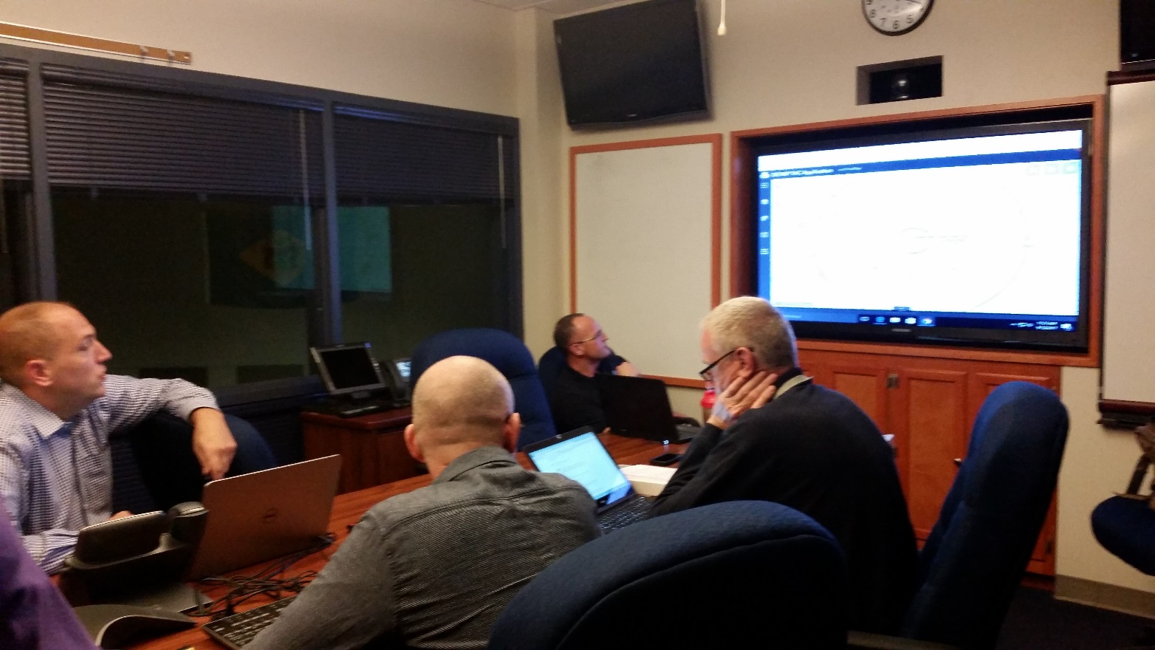
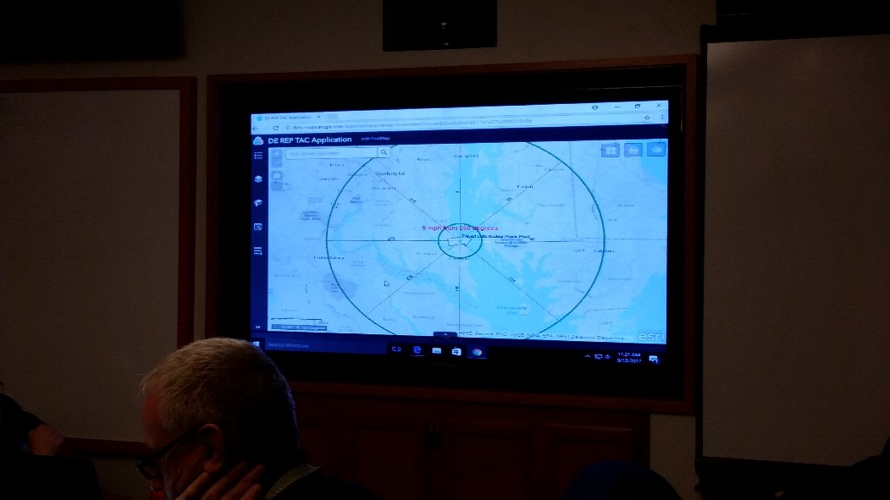
Leadership Briefings

Slide 21
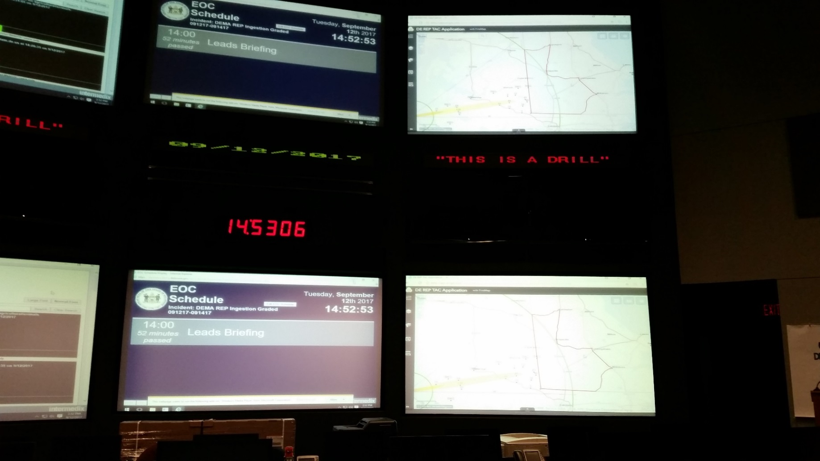
Emergency Operations Center
There’s the REP Map!

Slide 22






Application usage
Planning
  Embargo areas for various industries
  Relocation zones
  Locations for disaster assistance centers
  Infrastructure impacts
Human Impact assessment
  Population and demographics
  Vehicle owners, home owners vs. renters
  Poverty rates, age groups
Notes:
Presented courses of actions and protective action recommendations to senior leaders and resource providers
Give concise and easy to understand briefing to the whole group by displaying the data on the EOC screens
Plan out embargo areas for various industries, relocation zones, locations for disaster assistance centers, and infrastructure impacts
Determine population and demographics, such as likelihood to have vehicles, poverty rates, and age ranges for the affected area, as well as home ownership versus rental
4

Slide 23
Application Usage

Slide 24
Application Usage

Slide 25
Application Usage
Final product gave everyone a good idea as to what areas were being relocated, embargoed, and how to set up control points.
Department of Agriculture had a separate map with USDA partners looking at private sector that would be impacted to begin outreach on a close level.
Preliminary look at critical infrastructure to show what could be done, gave people way to brainstorm what would like to see/who to talk to.

Slide 26

Successes
We either already had the Data, or we had identified data ahead of time. Yay!
Command and control relied on the tool
  Referred interested parties to the app for updates
GIS unit gained experience
  Worked cohesively, analysis and new data requests handled more quickly as the exercise progressed
Users preferred the visual aspect over static tables
Gained new Champions for the technology
Notes:
We found that we had a lot of the data that we needed or had talked about how data would need to be included
Command and Control relied upon the tool a lot
Referred people to content often
As the GIS unit got more comfortable with data and layers, processing of analysis and creation of new layers became faster
People wanted to use such tool and visually see the data rather than just receive tables
1

Slide 27
Lessons Learned/Opportunities
Too much work for 1 person
Received a lot of ad hoc requests
  Identified opportunities for added functionality
  App allowed users to control their layers and their view
Faster to click on a map than create a spreadsheet
Most lessons applied to All-Hazards
  Identified additional business requirements
Notes:
It is a lot of work for 1 person during a large scale event or truncated exercises
There are a lot of requests coming at you
Discovering ways to give as much power as possible to the general user
Application lets individuals control layers and their local view as needed
Convincing people that in the time that they type out latitude and longitude points or cross streets for us to plot, they can go in and click those same locations and have them appear is a whole separate marketing campaign we are now embarking on for All-Hazards
Most of our lessons from this exercise were applicable to All-Hazards, actually, and this really gave us a challenge to find new gaps to approach a new problem
Abbreviated nature of exercises puts a lot of extra stress on GIS analysts where they can’t abbreviate computer processes
Having discussions ahead of exercises to understand what tools will be used and how to ‘pre-stage’ data to match up with exercise timelines is critical
You can do all the planning in the world and there are still last minute adjustments and requirements
1

Slide 28
Lessons Learned/Opportunities
Full computer processes difficult during abbreviated exercise
  Puts stress on the GIS Analysts
  Detailed planning ahead of time important
  Pre-stage as much data as possible
  Plan ahead for new data and how to handle it
  Document procedures ahead of time
There will always be last minute adjustments and requirements
Notes:
1

Slide 29

Future Steps
Prepare for Plume exercise
Document and prioritize requirements
Additional field usage
User training
Formalize GIS Unit
Notes:
1

Slide 30
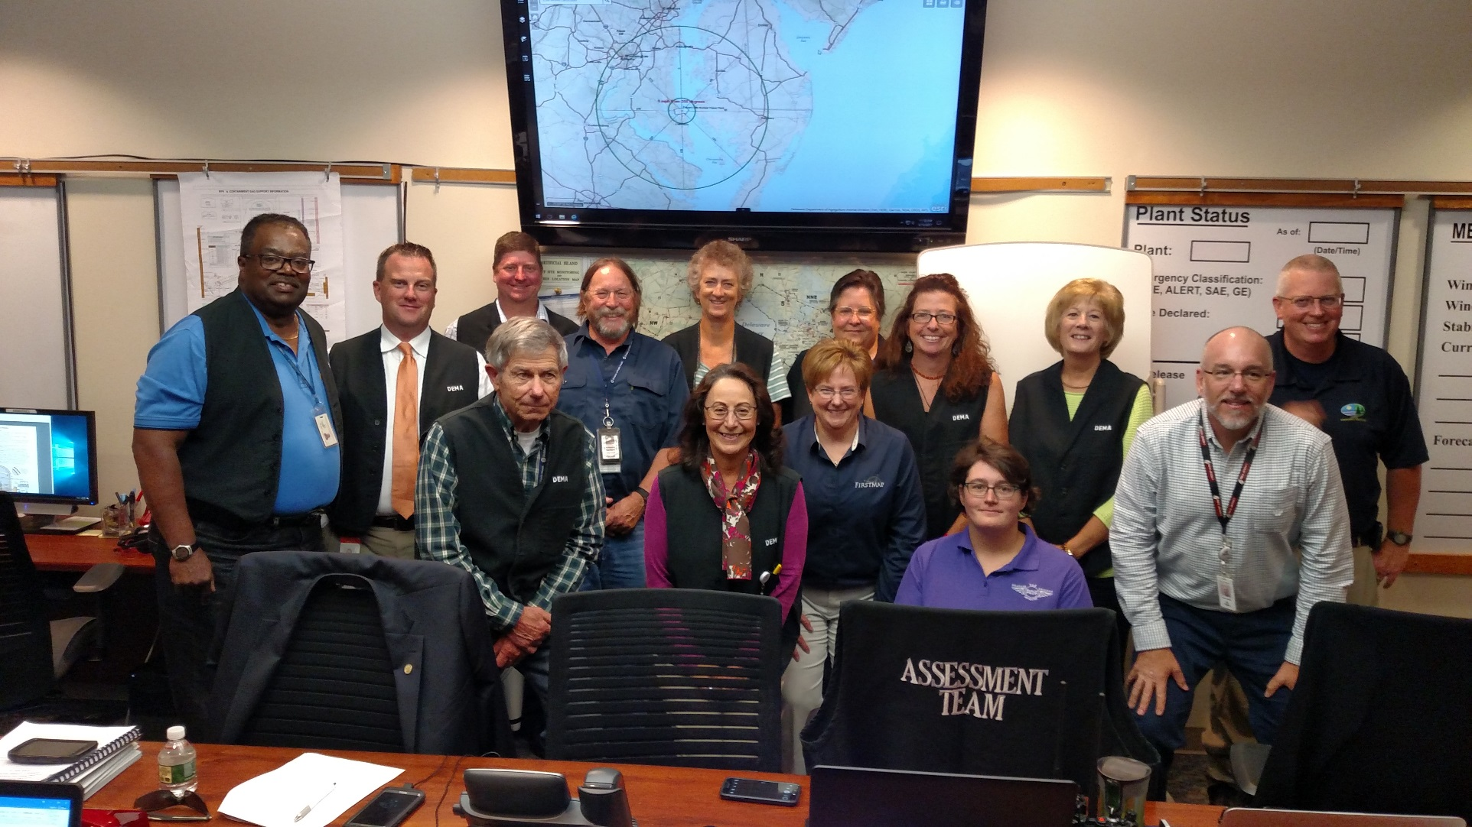
Teamwork!

Slide 31
Questions & Contact
Renee Hupp, (DEMA), Renee.Hupp@state.de.us
Kim Cloud, (DTI), Kim.Cloud@state.de.us, FirstMap@state.de.us
Frieda Fisher-Tyler, (DHSS), Frieda.Fisher-Tyler@state.de.us

