Slide 1
Left of Boom
The Preventive Response

Slide 2
Maryland State Police
PRND
Thermo RadEye PRD - 182
Thermo RadEye SPRD - 36
Polimaster PRD - 49
Mini-Rad DX PRD - 15
identiFinder RIIDs - 9
Guardian Predator - 2
Bubble Tech MDS - 2

Slide 3
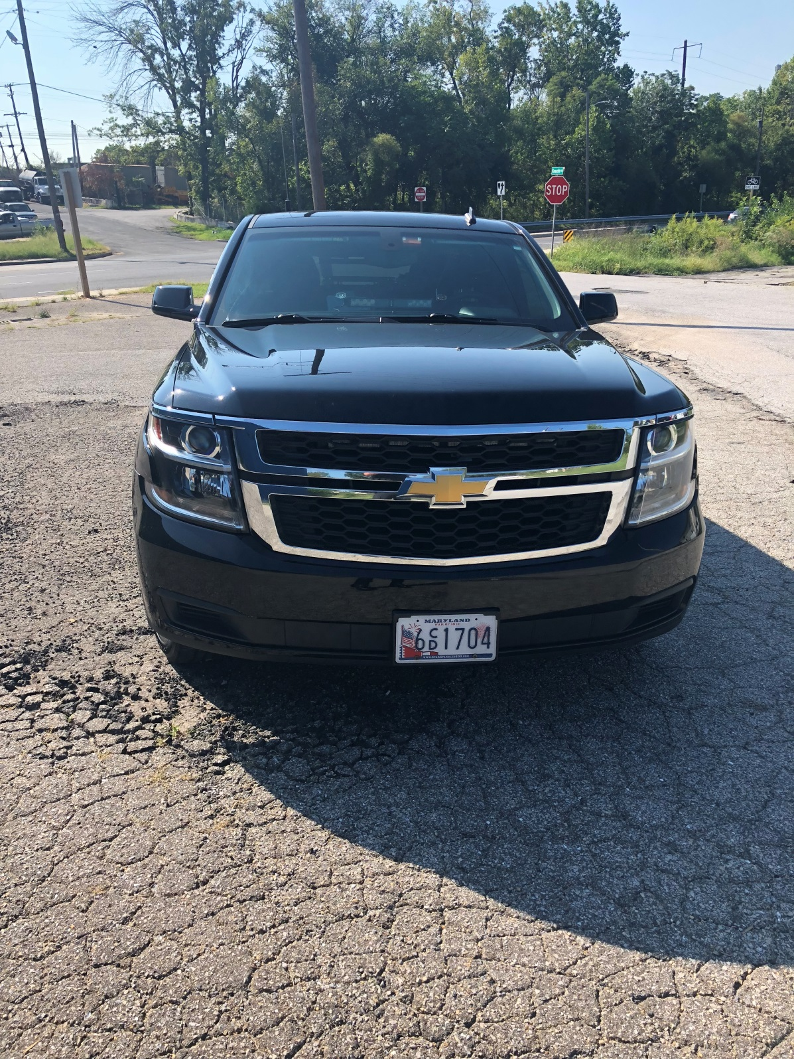

Slide 4


Slide 5
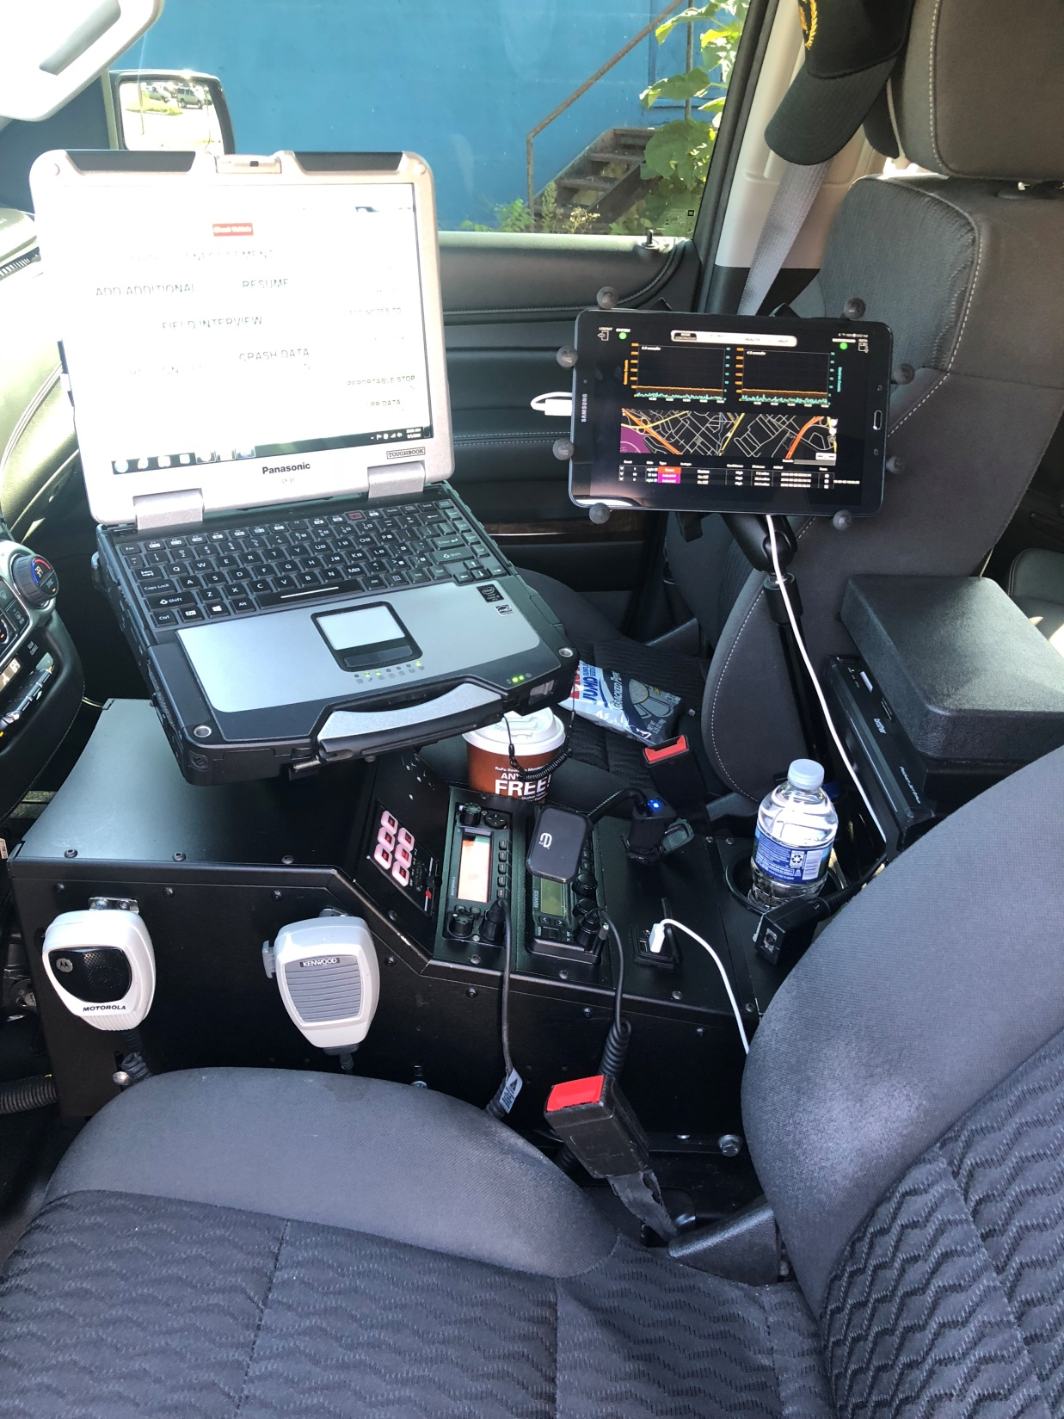

Slide 6
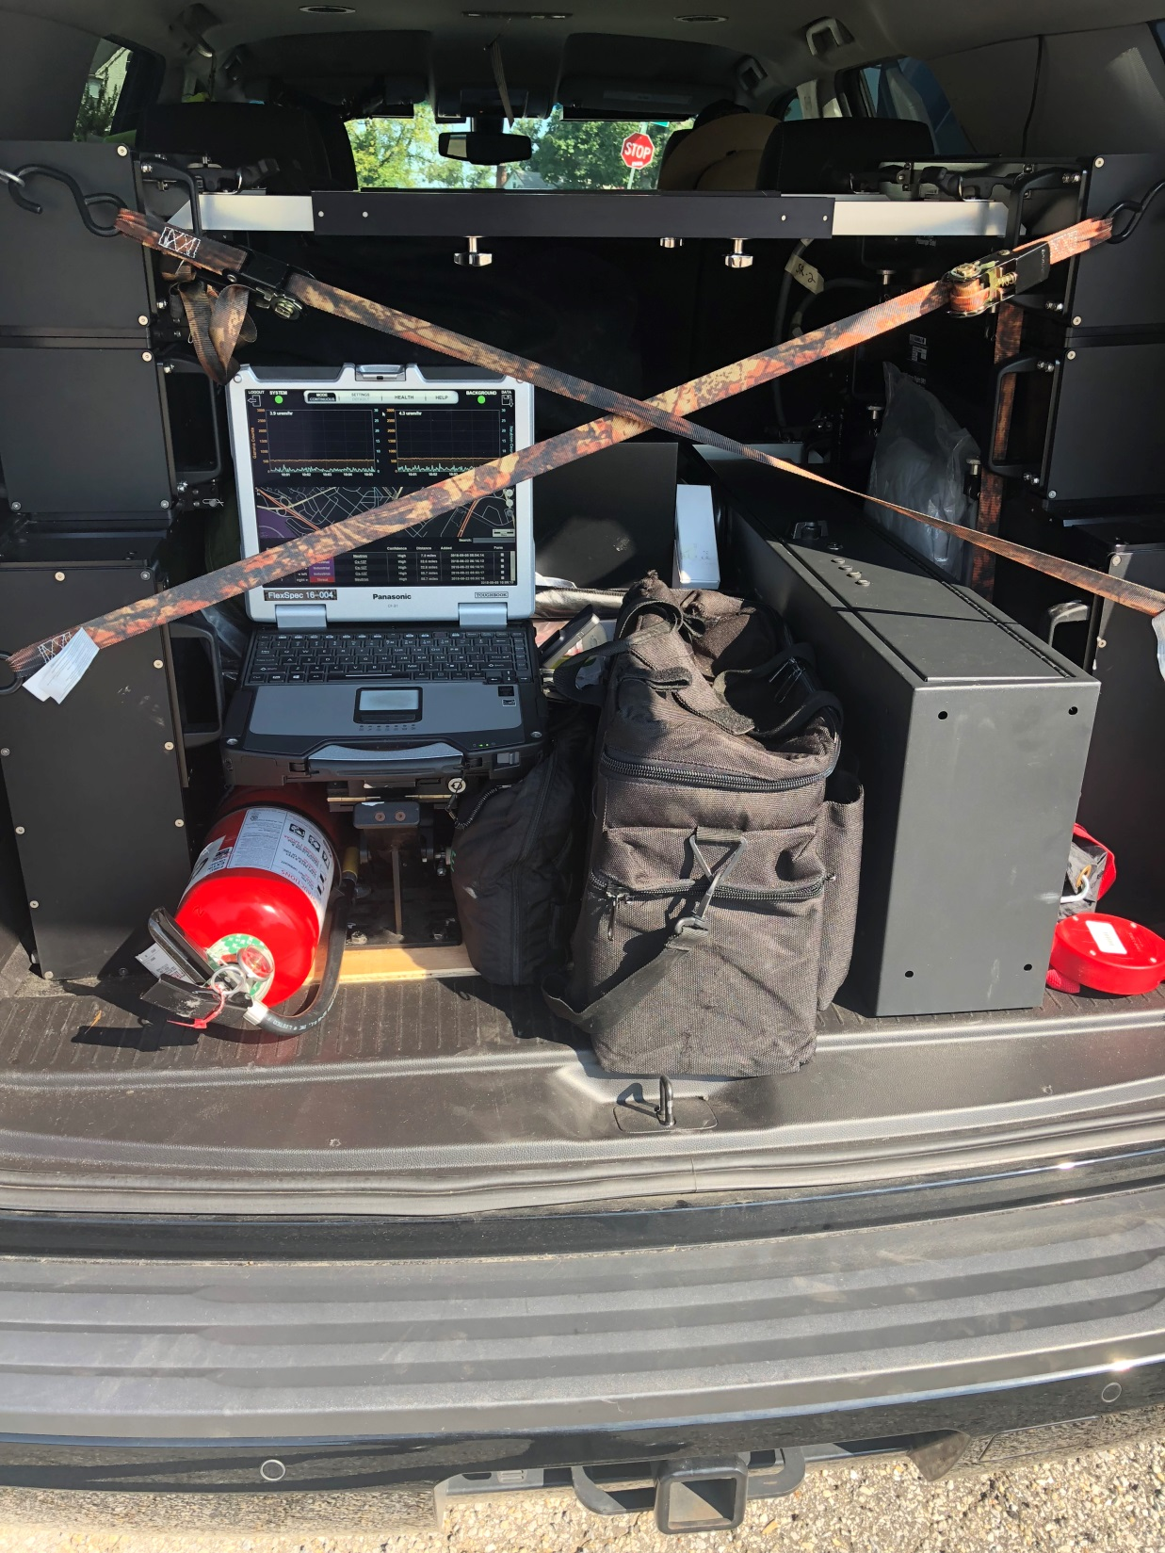

Slide 7
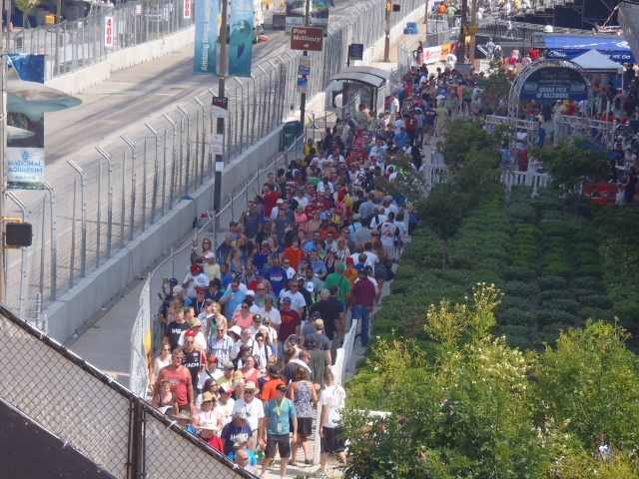

Slide 8
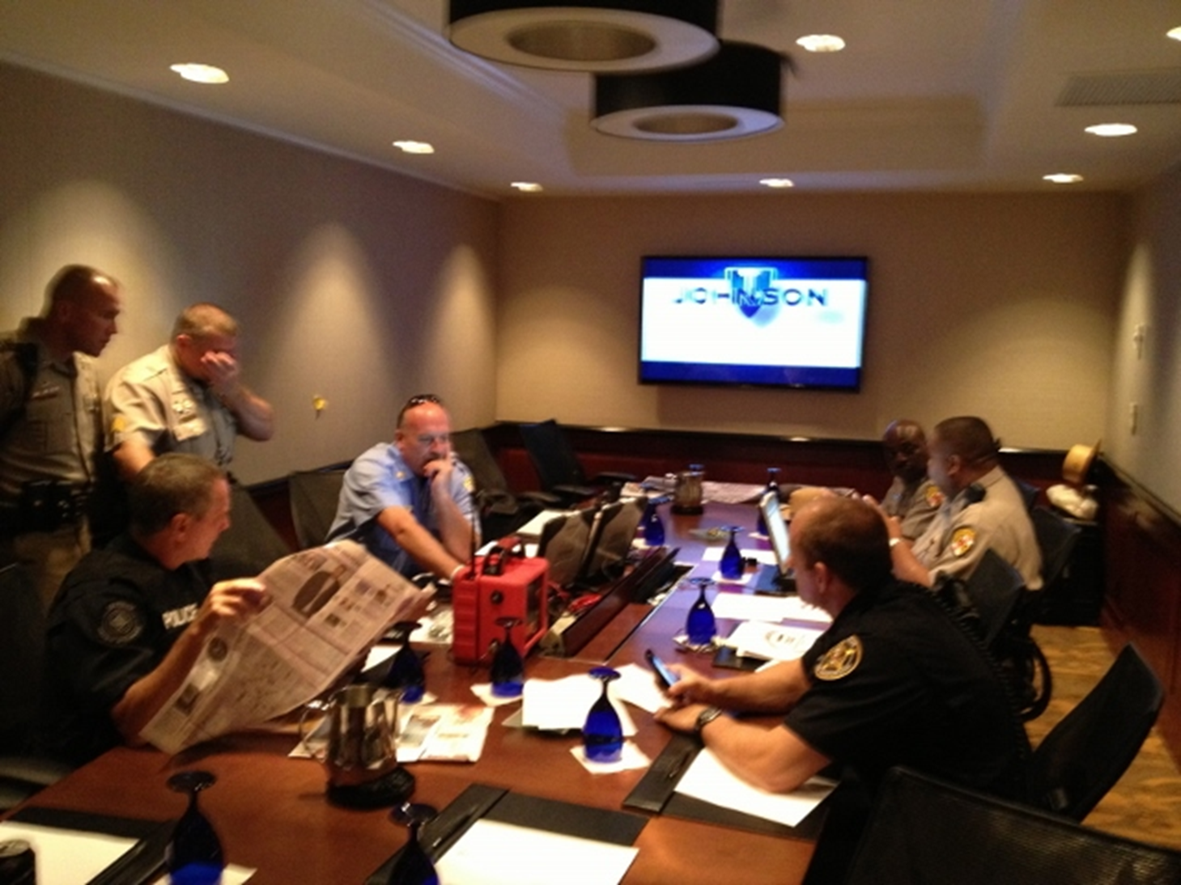

Slide 9
July 5, 2018 @ 1020hrs
P&R Facility – initial alarm from moving truck
  Detect
  Verify
  Locate
  Measure
  Identify
  Assess and Adjudicate

Slide 10
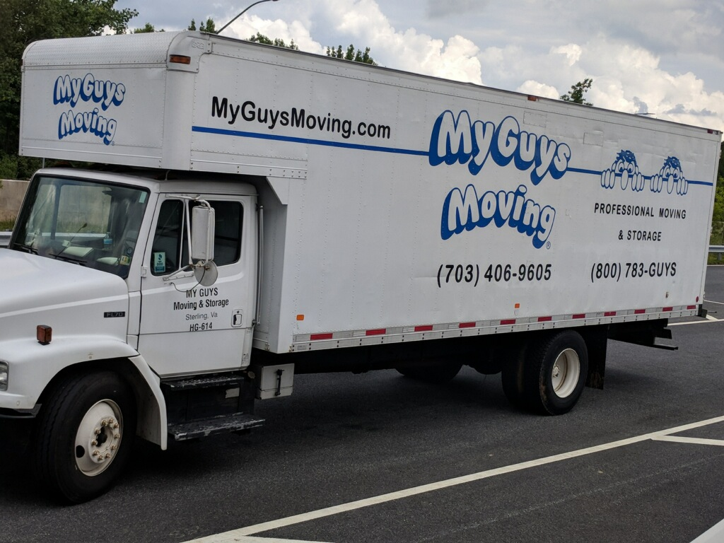

Slide 11
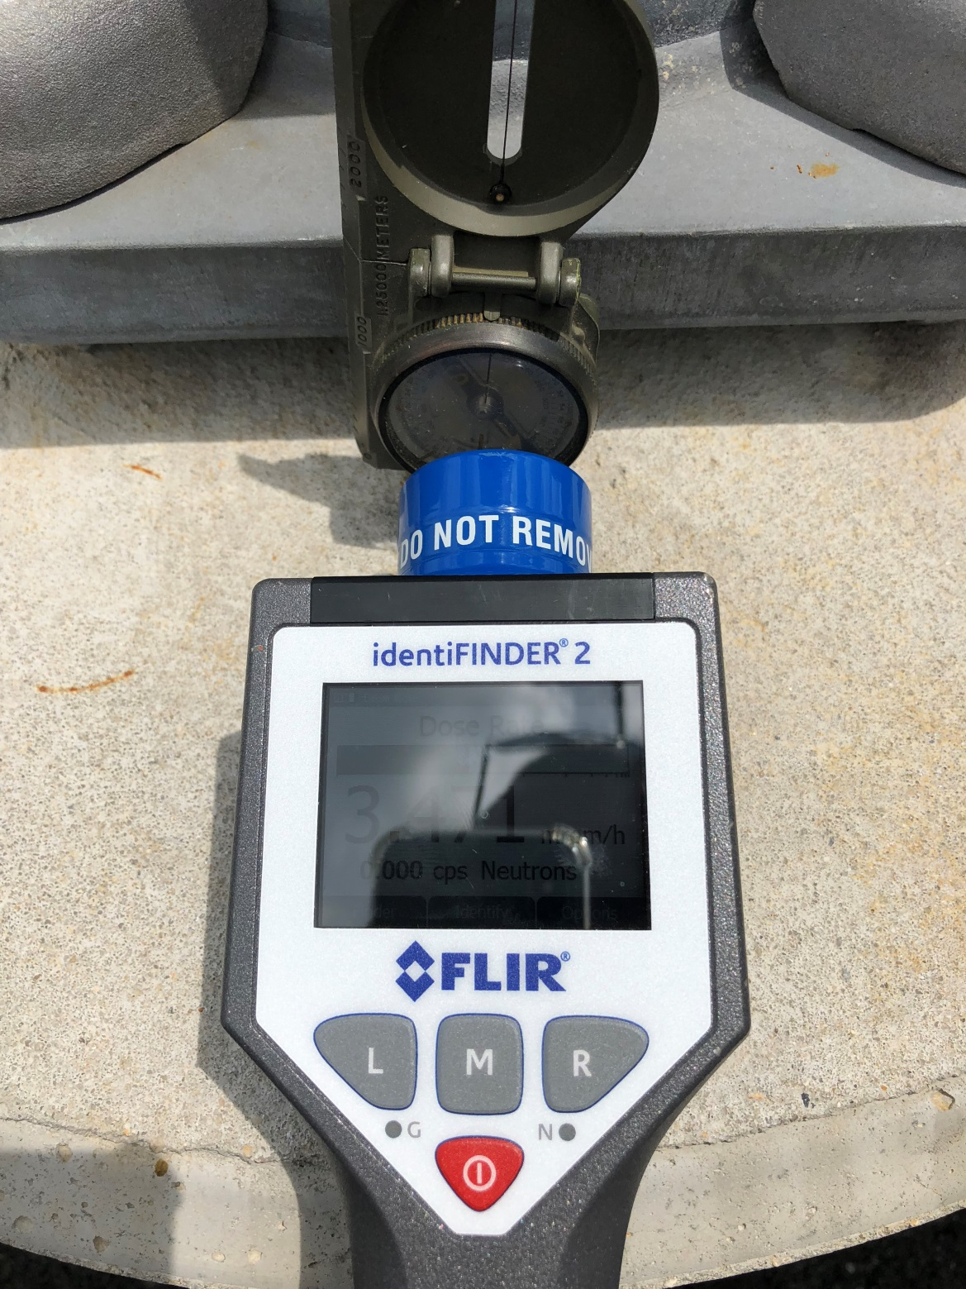

Slide 12
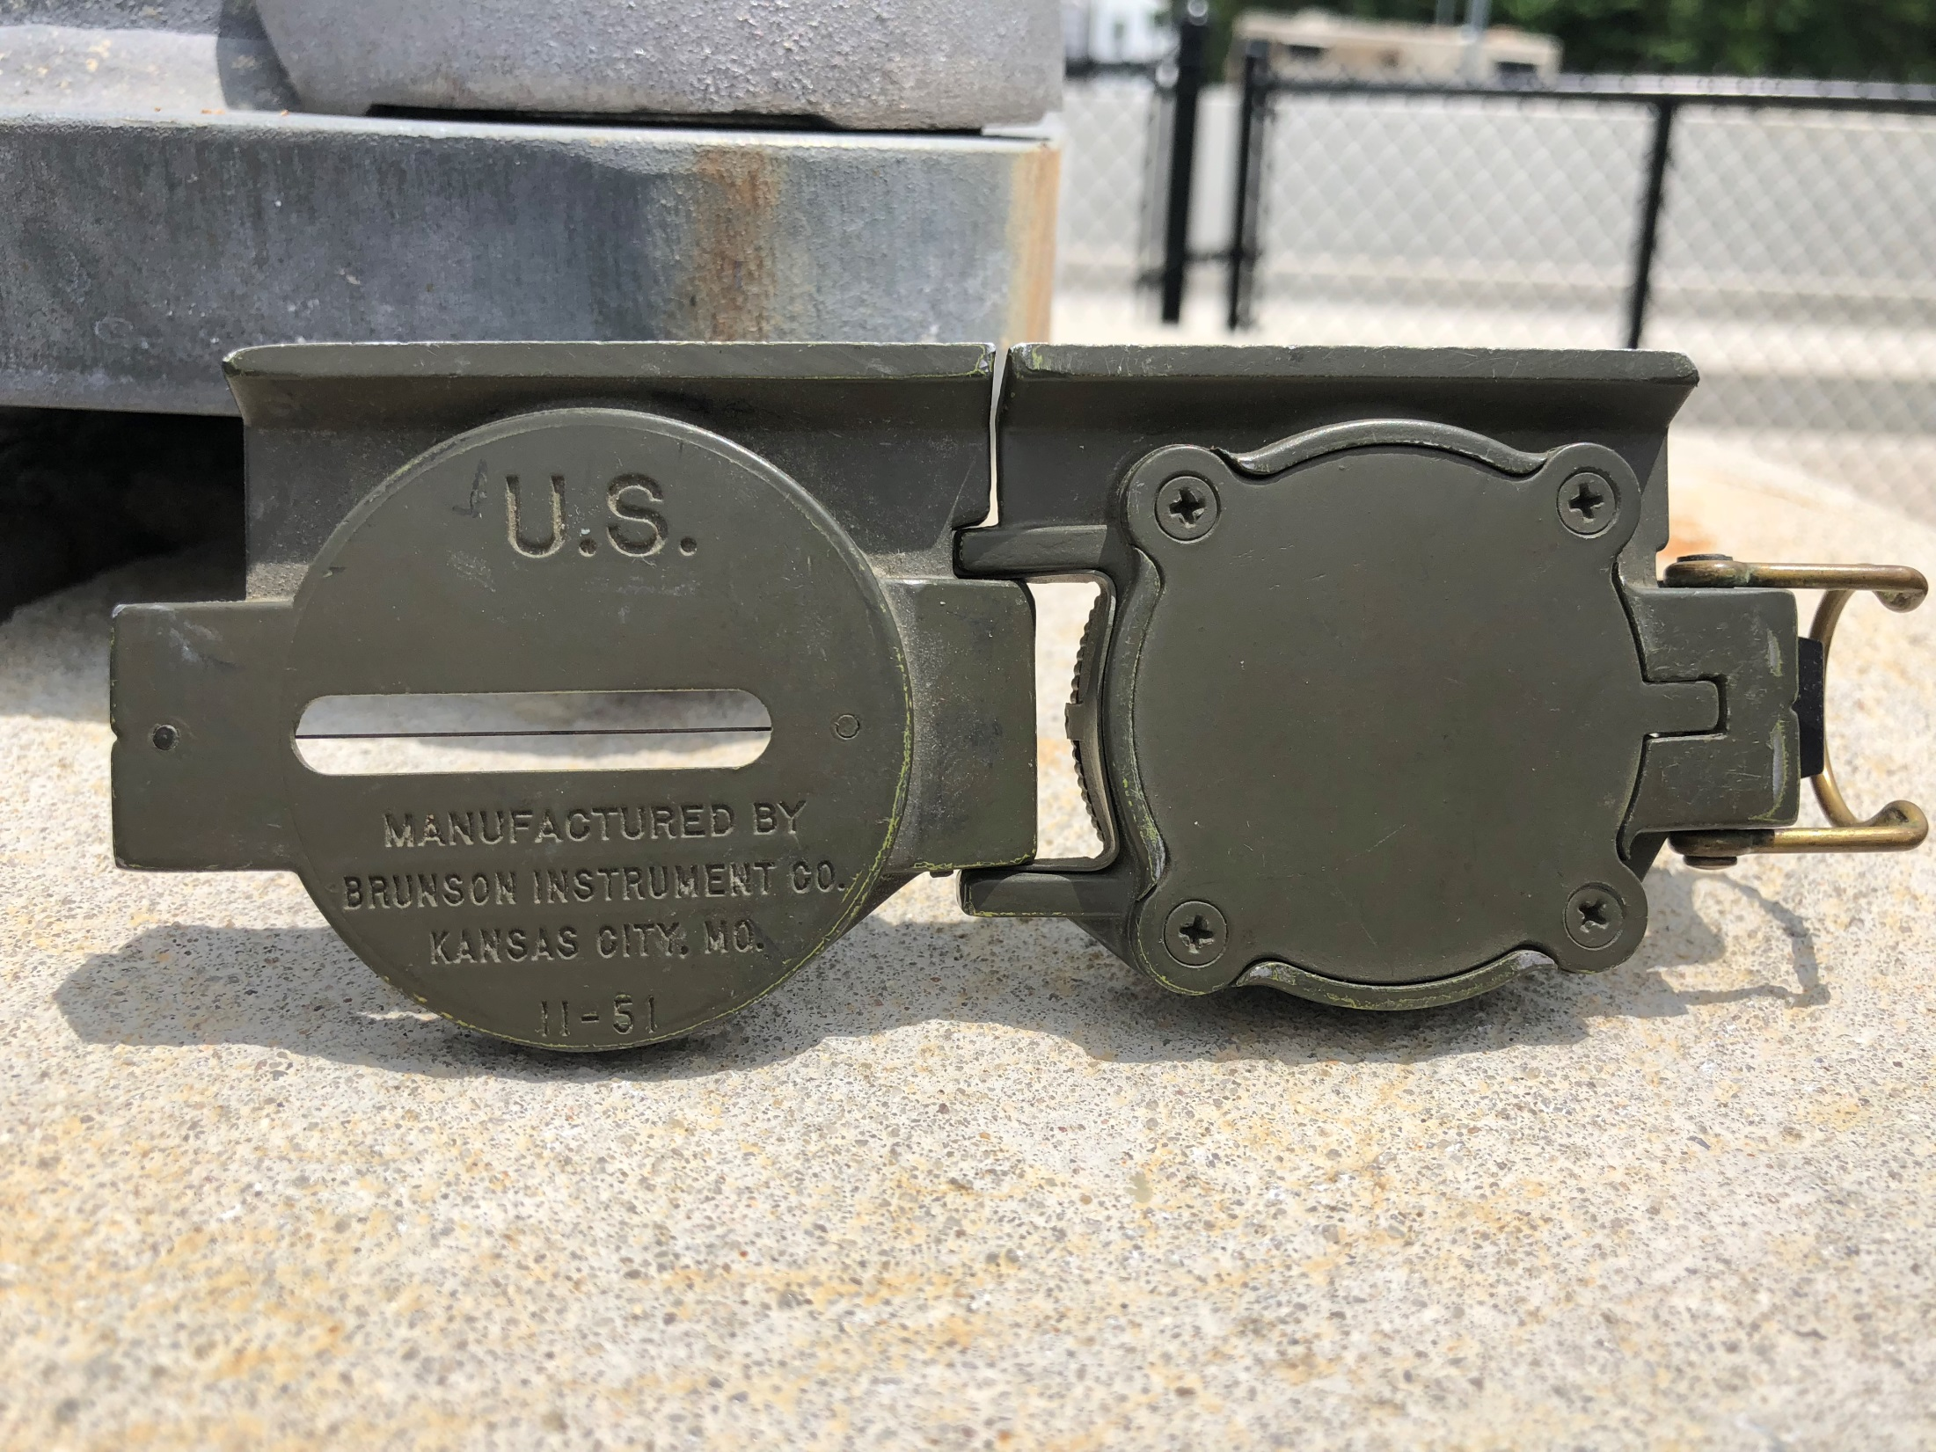

Slide 13
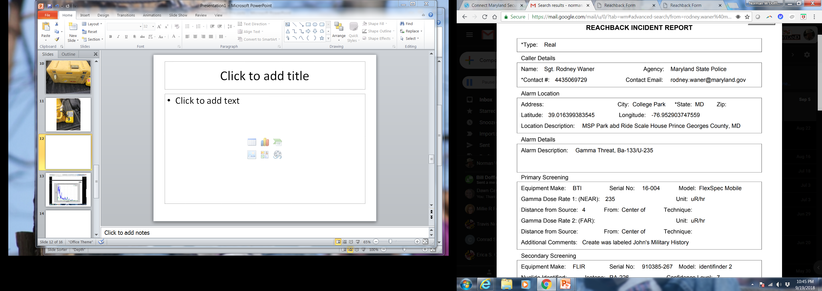

Slide 14
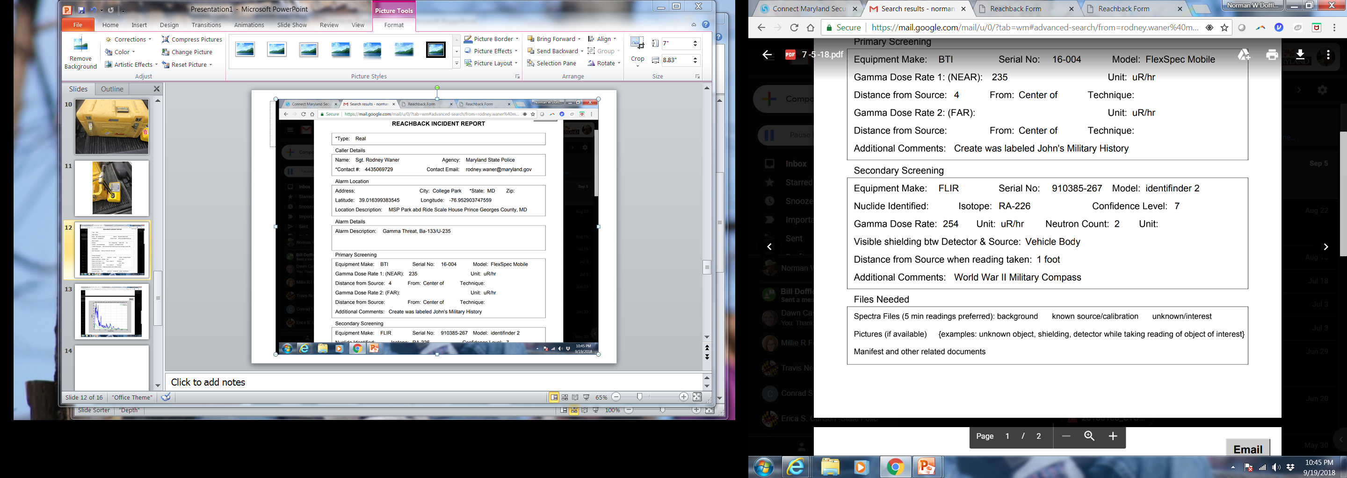

Slide 15
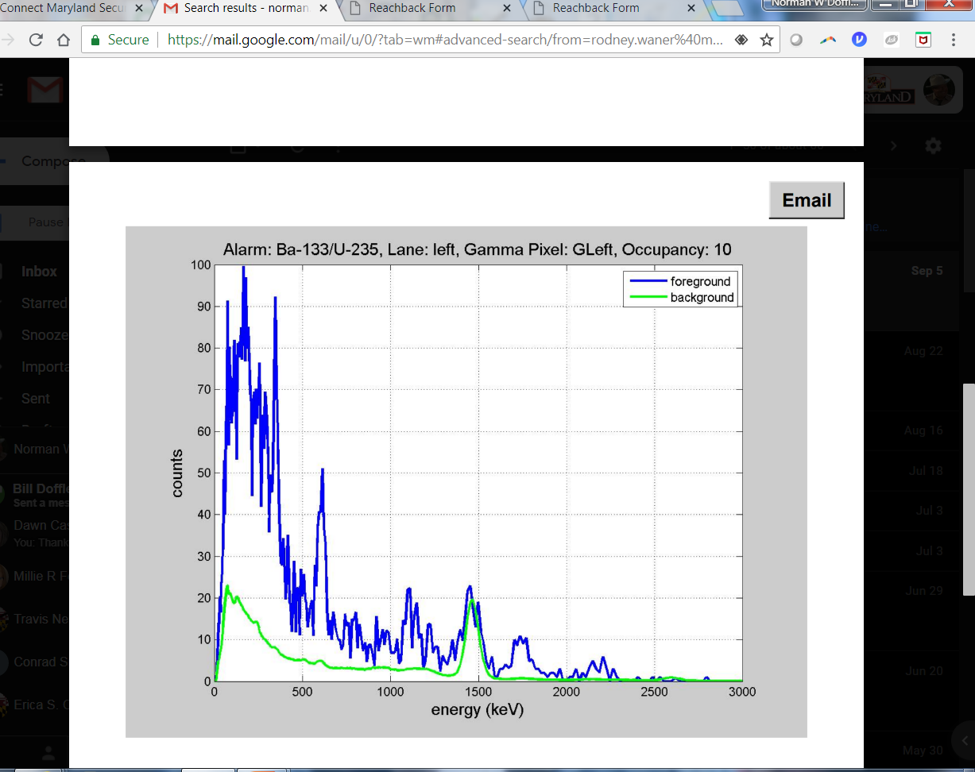

Slide 16
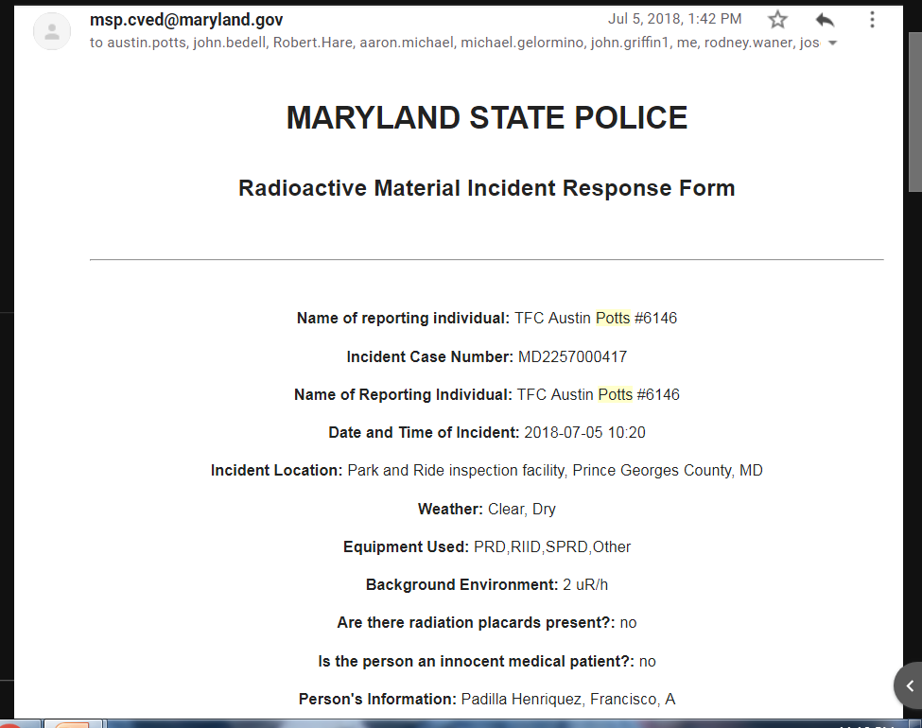

Slide 17
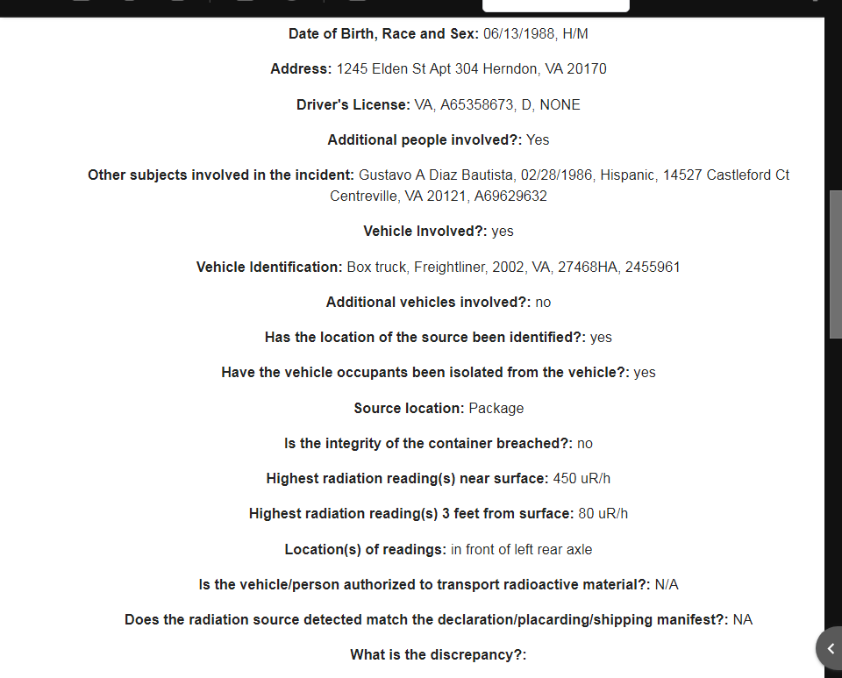

Slide 18
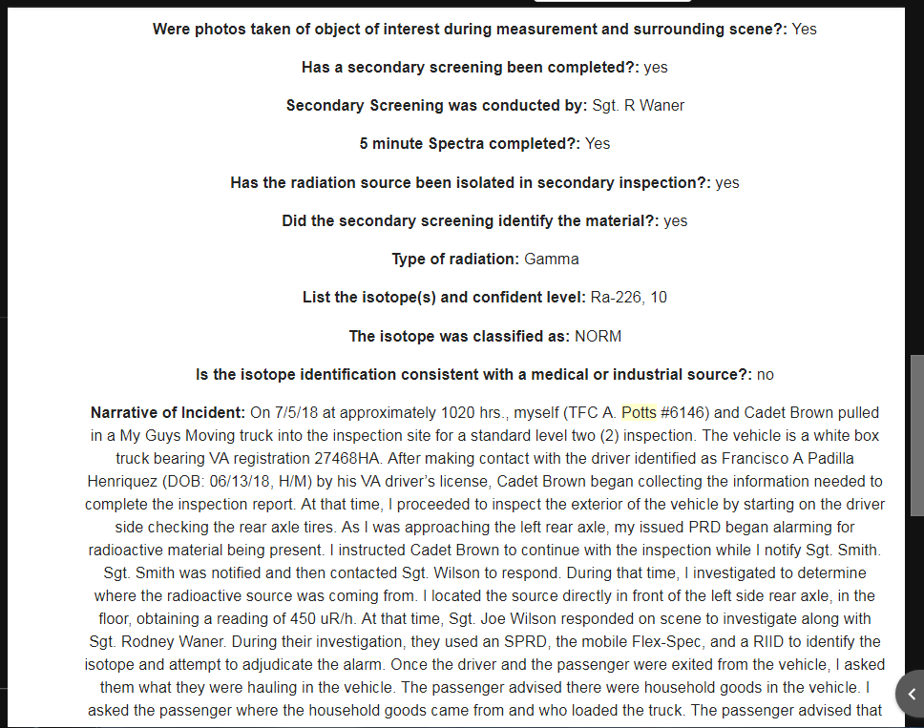

Slide 19
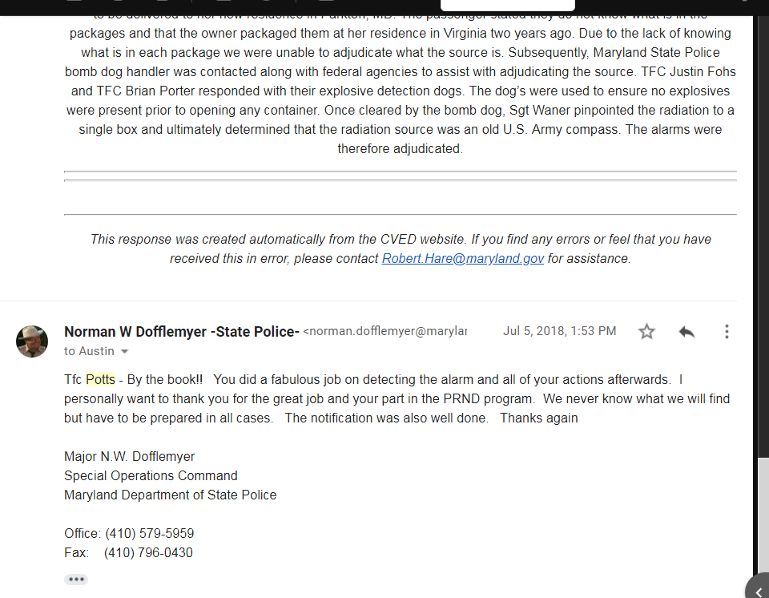

Slide 20
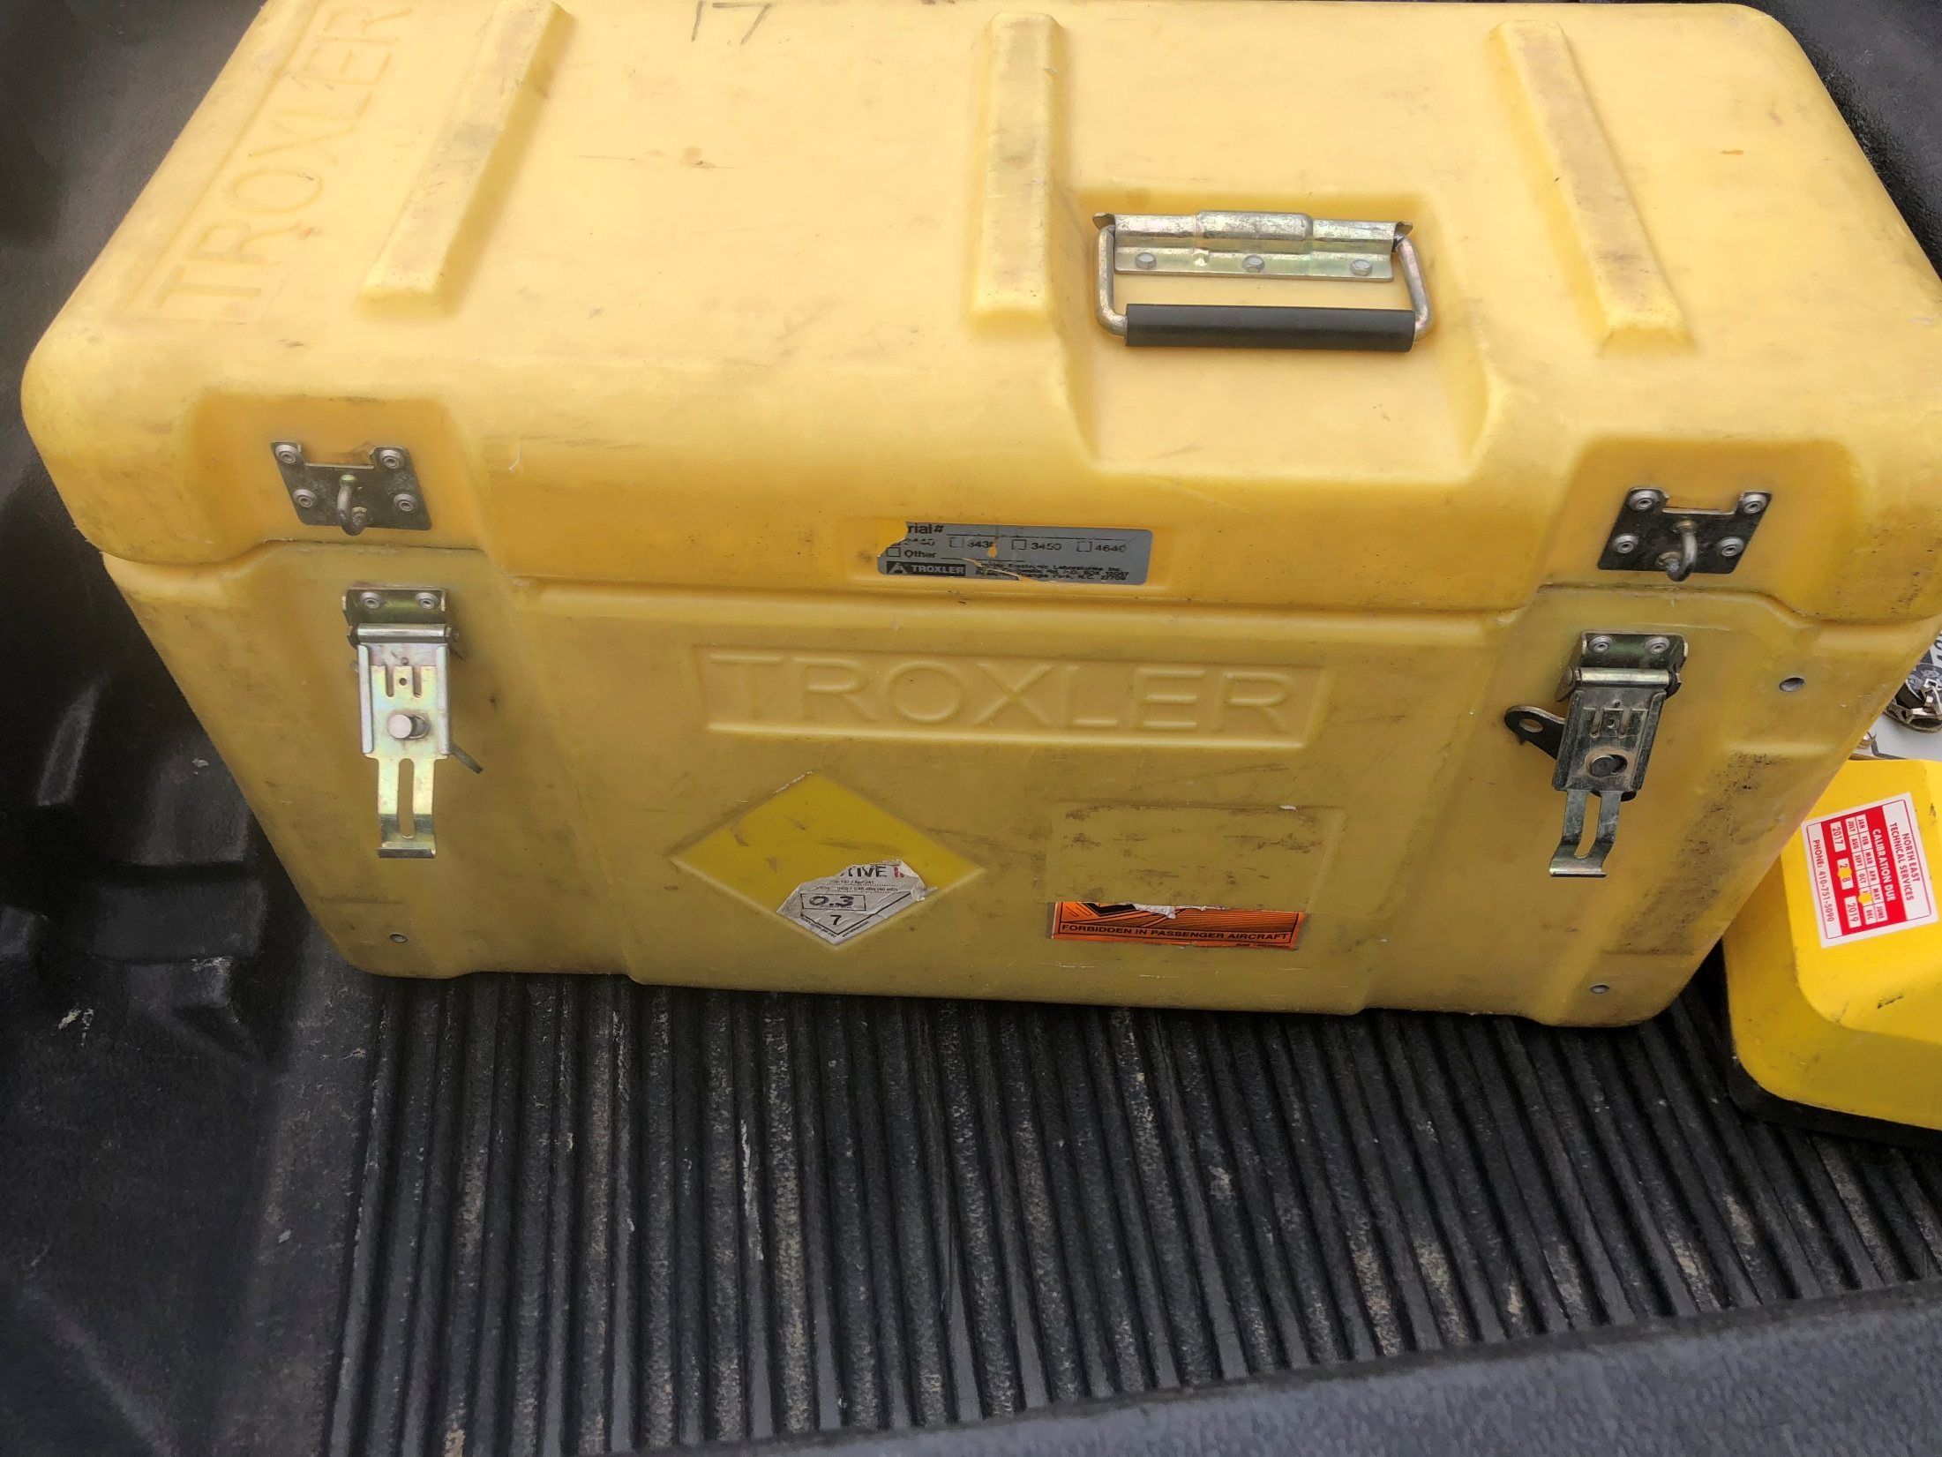

Slide 21
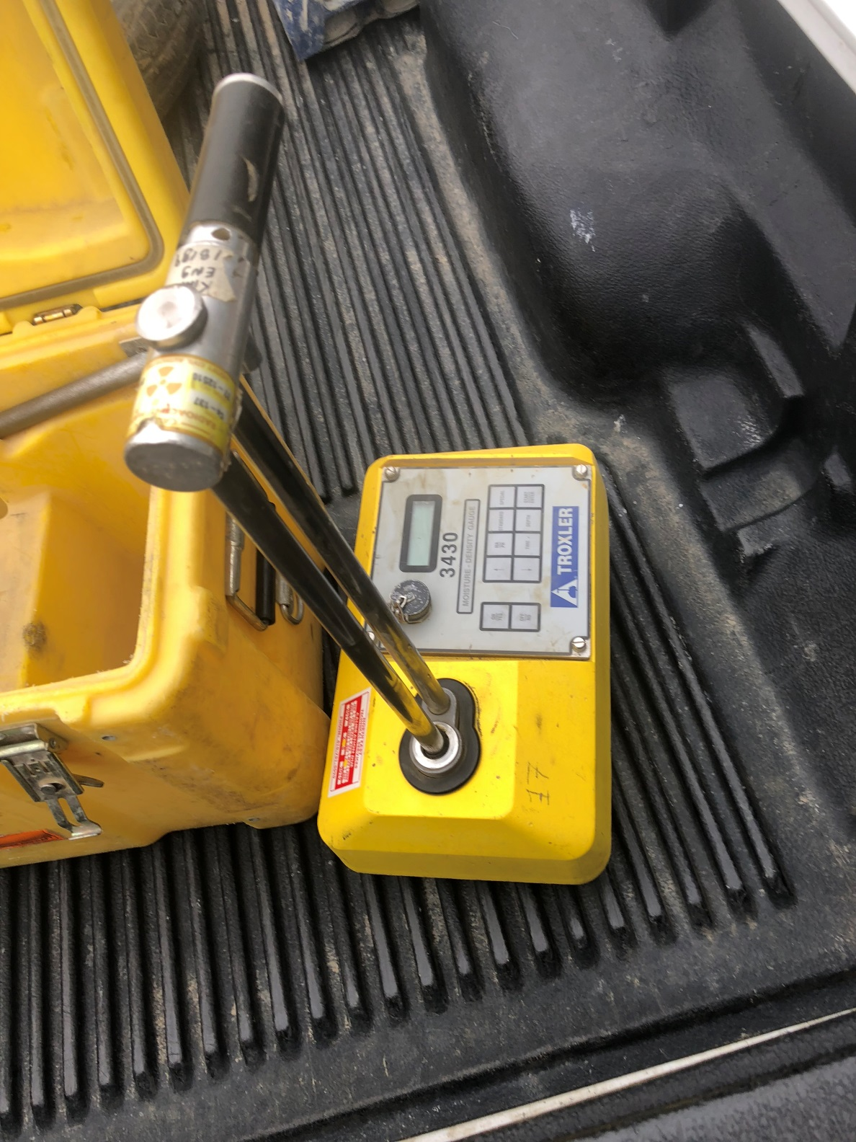

Slide 22

Major N.W. Dofflemyer
Special Operations Command
Maryland State Police
410-579-5959
Norman.dofflemyer@maryland.gov

