Slide 1

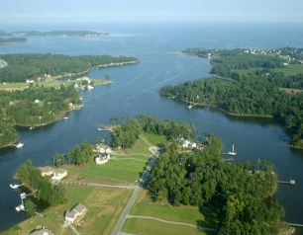
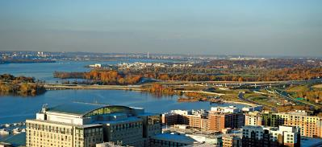

Assessing Affordability and Financial Capacity to Implement NPDES MS4 Permits
May 2019

Slide 2
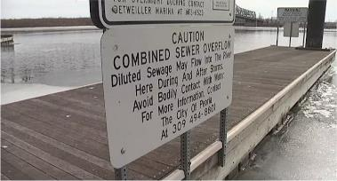
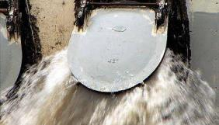
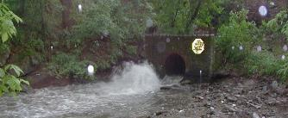
EPA CSO Guidance (1997)
  Residential indicator
    Cost Per Household
    Median Household Income
  Financial capacity indicator
    Debt indicators – bond rating and overall net debt as percent of full market property value
    Socioeconomic – unemployment rate and median household income
    Financial Management – property tax revenue collection rate and property tax revenues as percent of full market property value

Slide 3
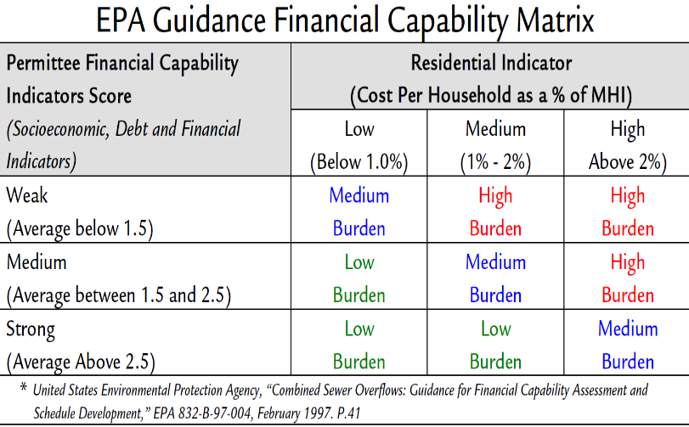

Slide 4
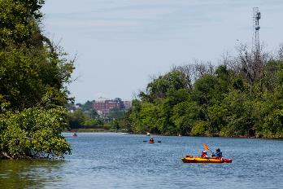

EPA integrated water planning (2012)
  A voluntary process for “...identifying efficiencies in implementing requirements that arise from distinct wastewater and stormwater programs, including how best to make capital investments.”
  “Affordability” is not a term used within the framework, but the eight principles include suggesting the plan “[e]valuate and address community impacts and consider disproportionate burdens resulting from current approaches as well as proposed options.”

Slide 5
Literature review
AWWA report (2013) - MHI is a poor indicator of economic distress; does not capture impacts across diverse populations; income levels not usually clustered around median; “snapshot” that does not account for the historical and future trends of a community’s economic, demographic, and/or social conditions
Alternative indicators – income quintiles, percentage households receiving public assistance, percentage customers eligible for water affordability programs, water service delinquency rates, needs for reinvestment in infrastructure
NACWA (2013) - suggests aligning the principles of integrated planning into the financial capacity assessment using three proposed elements:
  Water-quality based project prioritization
  Cash-flow forecasting
  Analysis of burden
PENNVEST - .25% of MHI for stormwater loans

Slide 6
Current views on water Affordability
American Water Works Association: “Given variations in local economic conditions, compositions of the customer base, and community values, defining affordability must be done at the local level.”
“Is Our Water Affordable?,” authors Jon Davis and Joe Crea corroborate this idea: “Any one-size-fits-all guidance on what constitutes affordable water service is going to be inappropriate when applied to most local considerations.”
http://efc.web.unc.edu/2019/04/22/challenges-and-innovations-current-and-future-states-of-water-affordability/

Slide 7
MS4 Community Demographic Overview
MS4 Permittee | Population Estimate 2017 | Median Household Income (2017 dollars) 2011-2015 | Persons in Poverty, percent | Persons 65 years and over, percent | Households, 2013-2017
Anne Arundel County | 573,235 | $94,502 | 6.10% | 14.40% | 205,395
Baltimore County | 832,468 | $71,810 | 8.30% | 16.80% | 312,859
City of Baltimore | 611,648 | $46,641 | 22.40% | 12.80% | 239,791
Montgomery County | 1,058,810 | $103,178 | 7.00% | 14.90% | 369,242
Prince George's County | 912,756 | $78,607 | 8.60% | 12.80% | 306,694
Source: U.S. Census Bureau QuickFacts - Population estimates, July 1, 2018, (V2018). Retreived from https://www.census.gov/quickfacts/fact/table/annearundelcountymaryland,baltimorecountymaryland,baltimorecitymaryland,montgomerycountymaryland,princegeorgescountymaryland/PST045218

Slide 8

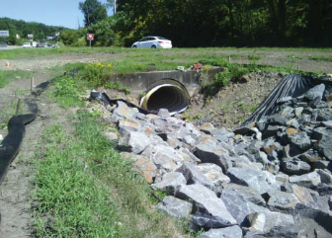
Components of a Stormwater Program
Capital Projects
Operations and Maintenance
Public Education and Involvement
Technical Support
Engineering and Planning
Regulation and Enforcement
Administration
Billing and Finance

Slide 9
Stormwater systems
County | Miles of stormwater pipes | No. Of inlets | Land area (sq miles)
Anne Arundel | 990 | 37,000 | 415
Baltimore County | 1450 | 51,370 | 598
City of Baltimore | 1100 | 53,000 | 81
Montgomery County | 1100 | 38,000 | 491
Prince George’s County |  | 65,195 (inlets, manhole, outfalls) | 483

Slide 10
Themes from Permittee Meetings
Fiscal process and allocation are not the only barriers to meeting MS4 permit requirements.
The focus on local TMDLs is important for stakeholders and appropriations moving forward.
Certainty about pollution reduction credits would help with forecasting costs.
Operations and maintenance needs are a looming financial issue and not yet fully accounted for in budgets.
The need for a comprehensive analysis of water service budgets and capacity is apparent with various departments doing work that could or should count toward watershed restoration as a whole.

Slide 11
SUmmary
Current cost information is not comprehensive of full stormwater system.
Operation and maintenance will be an increasing share of stormwater budgets over time.
Each permittee is in a slightly different situation regarding provision of water services (drinking, waste, storm) so no true apples-to-apples comparison.
A need to benchmark.
A need for other indicators/parameters.
This is a beginning.

Slide 12

Affordability
$$$$
https://www.amazon.com/Life-Journey-Not-Destination-Happiness-ebook/dp/B0792X2ZTG

Slide 13
Affordability
The EFC researched existing water service affordability literature, including relevant Environmental Protection Agency (EPA) documents, and developed a draft matrix including three considerations:
Household Cost as a percent of:
  Median Household Income
  Low-Income Brackets
Key Socioeconomic Parameters
Financial Capability Indicators

Slide 14
Mapping financial capacity to affordable
Financial capacity of municipalities is the ability to take on debt, generate revenue, or otherwise cover cost of services.
For stormwater- a new water infrastructure need – how do we do this?
What to include in metrics if we are assessing affordability vs budget and financial assurance planning?

Slide 15
Affordabilty = Fianancial capacity
The affordability assessment is not based on the municipal 5-year implementation costs alone within the Financial Assurance Plan (FAP).
Affordability estimates the current (and potential expected) burden of total water service/utility expenditure by households.
Costs of implementation are being covered by multiple revenue sources.
Costs within the FAP may not include long term maintenance costs or other costs to support the stormwater program.
The data captured in the matrix will help assess the long-term sustainability of stormwater funding through recognition that the cost of implementation (and subsequently operations and maintenance) are pulled (pooled) from multiple sources and that all of these costs need to be teased out and tracked to measure affordability to households.

Slide 16
Cross mapping data – first steps
Affordability for average residential customer:
How are your customers characterized?
What is the median household income of the customer?
(Why Median vs Mean?)
The Census website is a wealth of information based on certain Census blocks/County - does this meet your service area?
How are costs per household distributed for services? Water related?

Slide 17
Cross mapping data – first steps
Start to collect data!
MHI – Does this really characterize your service area?
# of households in service area? Multiple categories?
Annual average costs per household (past 5-yrs) – how will this data be collected?
Water? Stormwater?

Slide 18
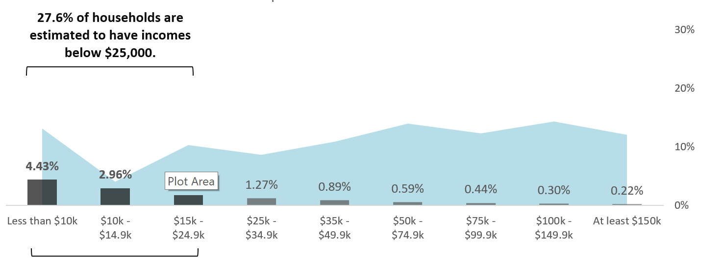
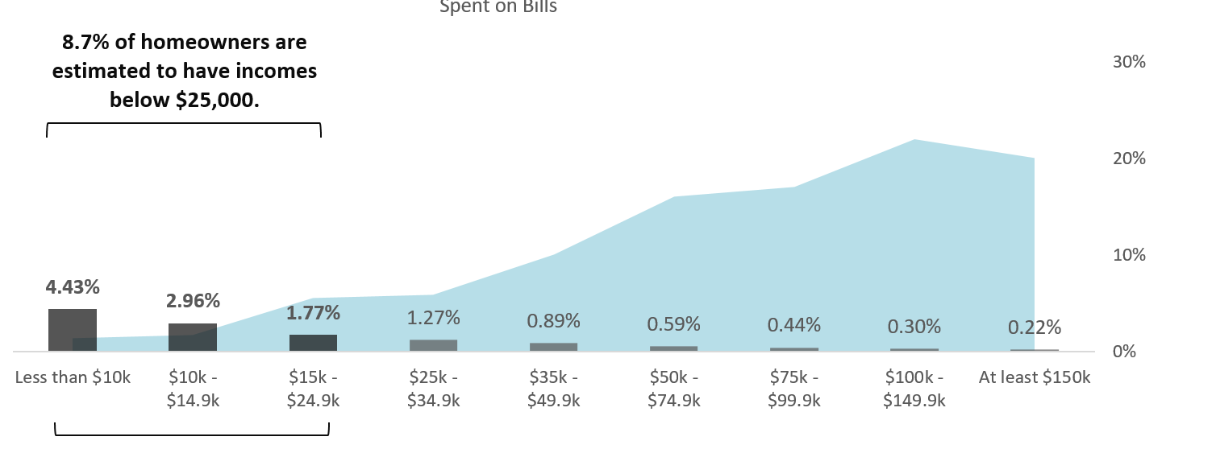
Cross mapping data – first steps
Affordability for low income customers
How is income distributed? Does MHI characterize it or is it
“bi- modal”?

Slide 19
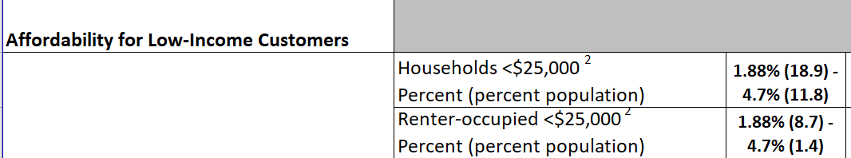
City example
What is the story here? Why are there almost 19% of households <$25,000 in income?
Who are the majority of 8.7% (renters <25,000)
Newark is a…..anyone??
So 4.7% of MHI is “water” burden based on average annual cost for the total percent of the population that is a) under $25K and b) under $25K and a renter

Slide 20
Socioeconomic
Many parameters can help tell the story of your municipality
1)Unemployment
2)Percent below poverty level
Two parameters that help distinguish the community and characterize what the burden may be.

Slide 21
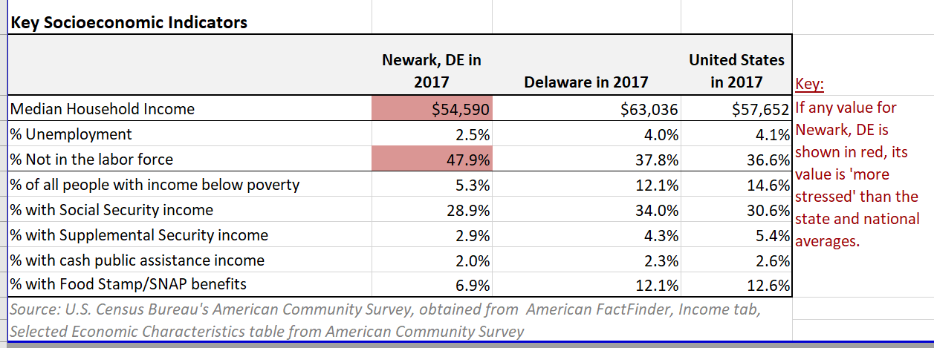
City example

Slide 22
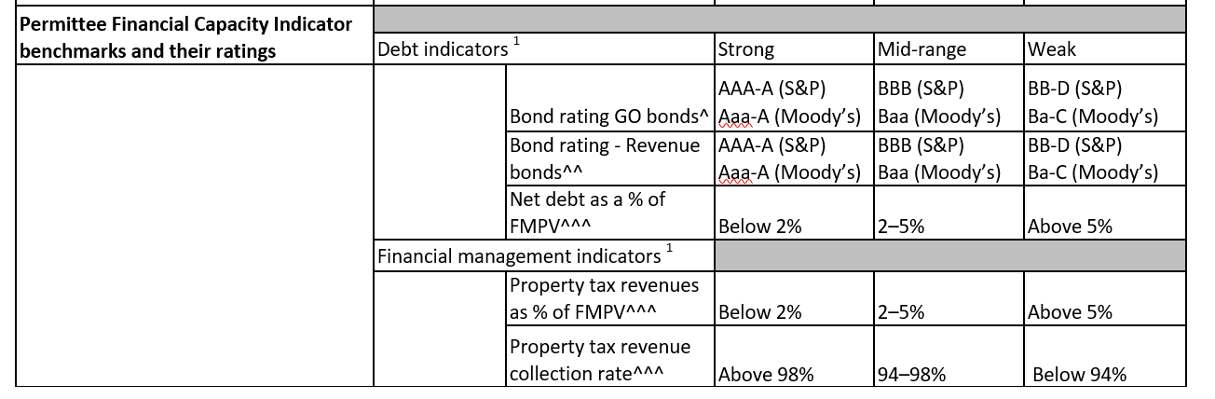
Additional financial capacity
This is a general measure to gauge where the municipality is in reference to the capacity to raise additional funds though bond avenues.

Slide 23
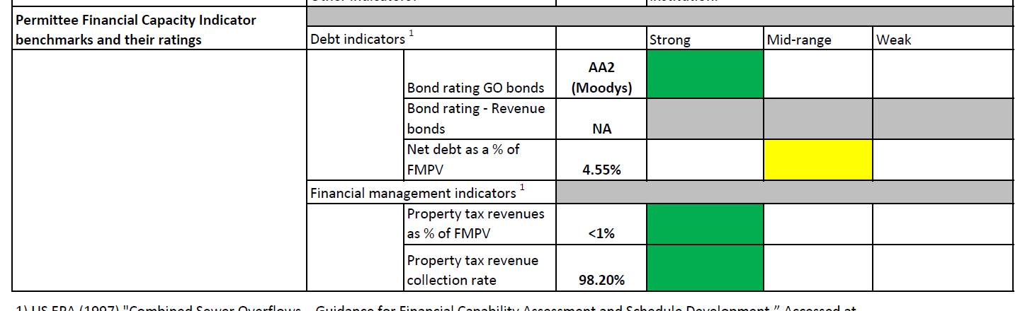
City example

